Slide 1
Functional aspects of gazetteers

Slide 2
Gazetteer protocol
Model
  entity: place
  attributes: identifier, name(s), footprint(s), type(s), code(s), status
  explicit relationships: part-of, capital-of, etc.
Query
  by identifier, by name, by footprint, by relationship, etc.
http://legacy.alexandria.ucsb.edu/gazetteer/protocol/

Slide 3
Spatial context
Many (most? all?) queries have it
  “Pine Mountain”
Not easy to specify in protocol
  “Santa Barbara, CA” not supported
  spatially contained in polygon
  spatially contained in place
  has part-of relationship to place
Get very different, unpredictable results

Slide 4
Challenges
Explicit relationship problems
  incomplete
Spatial relationship problems
  fuzzy areas (“Sierra Nevada mountain range”)
  dirty data (digitized from map labels)
  scale issues (cities are points, roads are lines)
  generalized geometry (California BBOX includes Nevada)
  topology errors
Functional problems
  I.e., answer depends on why you’re asking
  “Is the Chumash reservation in Santa Barbara County?”

Slide 5
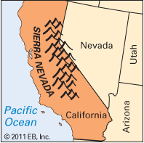
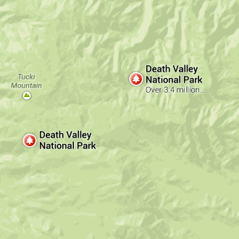
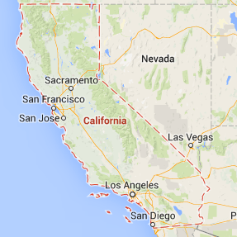
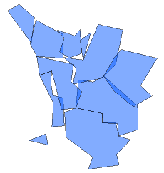

Slide 6
Challenges
Explicit relationship problems
  incomplete
Spatial relationship problems
  fuzzy areas (“Sierra Nevada mountain range”)
  scale issues
  generalized geometry (California BBOX includes Nevada)
  digitization differences
Functional problems
  I.e., answer depends on why you’re asking
  “Is the Chumash reservation in Santa Barbara County?”

Slide 7
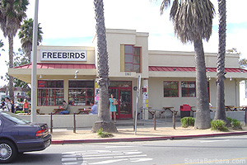
Is Freebirds a place?
santabarbara.com

Slide 8
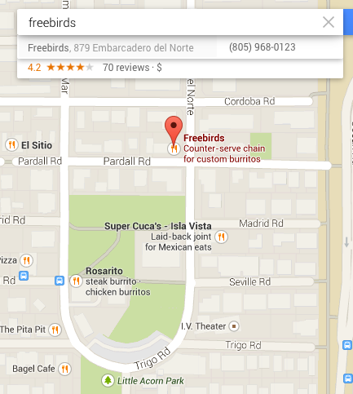
Is Freebirds a place?
Navigation: yes
Knowledge representation: no
Freebirds
business
has-name
subtype-of
eating
establishment
is-a
has-location
879 Embarcadero
del Norte
is-a
street
address

