Slide 1
Why?
Why data curation?
Why now?
Why the Library?
Why you?

Slide 2
Digital data is
  brittle
  precariously balanced
  fluid
  unruly

Slide 3
Data curation
  “the active and on-going management of data through its lifecycle of interest and usefulness to scholarship, science, and education; curation activities enable data discovery and retrieval, maintain quality, add value, and provide for re-use over time”
Cragin, Melissa H.; Heidorn, P. Bryan; Palmer, Carole L.; Smith, Linda C. (2007). An Educational Program on Data Curation. 2007 ALA STS Conference. http://hdl.handle.net/2142/3493

Slide 4
Technology adoption progression
  invented
  adopted
  widespread
  expected
  mandatory

Slide 5
Trend: new norms for science data
  discoverable
  contextualized: documentation, reviews, uses, provenance
  available: always, immediately, indefinitely
  usable by contemporary tools
  persistently identified and citable
  linked to and within scholarly literature

Slide 6
journal
article
Dryad

Slide 7
http://elifesciences.org/elife-news/Publishers-to-require-ORCID-identifiers-for-authors

Slide 8
Trend: data as publication
  citable
  credit-worthy

Slide 9
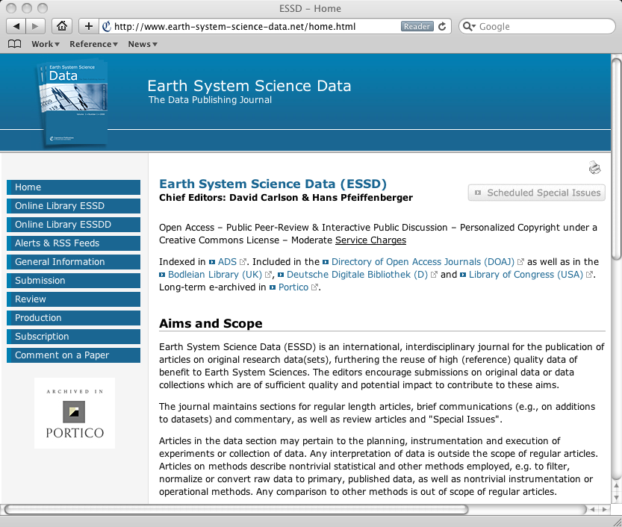

Slide 10
Trend: science increasingly data-driven, cross-disciplinary

Slide 11

MODIS
chlorophyll
level 0
SeaWiFS
GSM
phytoplankton
…
level 1a
algorithms
...
particulates
…
software
level 1b
calibration
...
level 2
reprocess,
revalidate
…

Slide 12
Dwight Reynolds
  1980s data: Sony Walkman cassette tapes
  “...as scholars we would all like access to complete documentation which includes, at minimum, the verbal text of the entire performance, along with notation of variants from different poets and different performances, musical transcriptions, audience interactions and interjections, a full ethnographic description of each performance, perhaps a motif-index, certainly a regular index, and it should probably also be made available on video and CD-ROM!”
Dwight Reynolds (2000), “Creating an Epic: From Apprenticeship to Publication.” In Textualization of Oral Epics, edited by Lauri Honko, 285-299. Berlin: Mouton de Gruyter.

Slide 15
Patricia Fumerton
  “...we rely heavily on EBBA scholarly judgments [...] EBBA’s goal is to make a database that can best capture [ballads] by incorporating the EBBA scholar in evaluating image variations, and ultimately (indeed, continually) prompting a retooling of the database so as to better associate impressions, in a supportive feedback between human and machine.”
Patricia Fumerton, Carl Stahmer, Kris McAbee, and Megan Browne Palmer, “Vexed Impressions: Toward a Digital Archive of Broadside Ballad Illustrations,” Digitizing Medieval and Early Modern Material Culture, ed. Brent Nelson and Melissa Terras (Tempe Arizona: Arizona Center for Medieval and Renaissance Texts and Studies, Arizona State University Press, Fall 2010)

Slide 16
http://joelfeigin.com/scores/Feigin_-_Two_Songs_From_12th_Night_Orch.pdf

Slide 17
Scholarship
  increasingly interacting with, organized around, driven by digital data
  researchers are both producers and consumers
  more/unmediated pathways to data reuse

Slide 18
New norms for data
  discoverable
  contextualized: documentation, reviews, uses, provenance
  available: always, immediately, indefinitely
  usable by contemporary tools
  persistently identified and citable
  linked to and within scholarly literature
This takes work!

Slide 19
Researchers?
  focused on research area
  not knowledgeable of curatorial aspects of tools
  not expert in data management
  time- and resource-constrained
  data management viewed as secondary
  motivations not aligned with curation needs

Slide 20
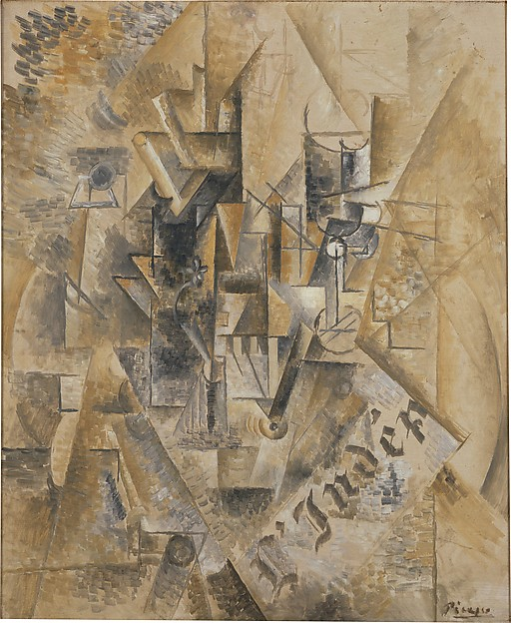
researcher/artist view

Slide 21
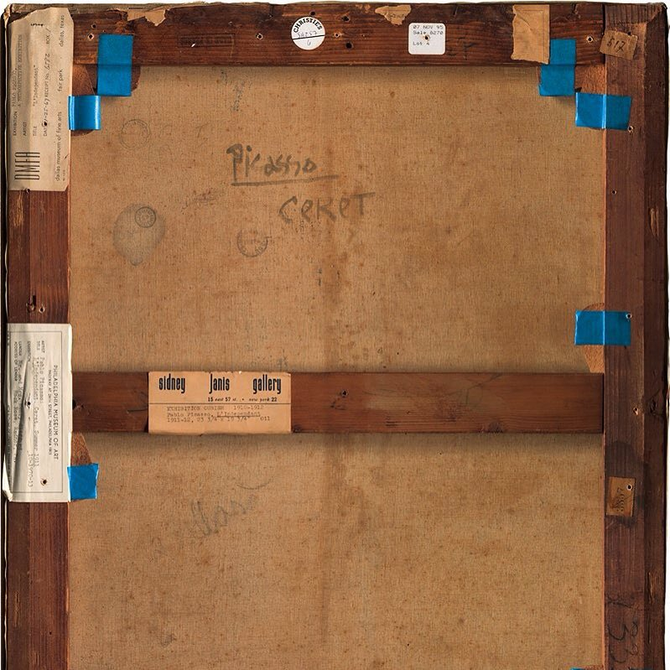
curator view

Slide 22
What about the Library?
  neutral
  curation expertise
  metadata, cataloging, search expertise
  missing: experience working with data earlier in the lifecycle

Slide 23
Library’s proposed role
  Researchers
    motivations unchanged
  Library
    awareness, identification of curation issues
    navigation of service space
    education
    assistance with projects
    relationships with researchers
  Curation services
    repositories (generic, discipline-specific)
    citation
    discovery/cataloging
    external, systemwide (CDL), campus

Slide 24
Tiered service model
  online resources
  subject librarians
  data curator(s)
  campus curation community
  Library advisory group

Slide 25
Training program
February 11
Overview of data management and the research data life cycle
March 17
Data management best practices and guidelines
April 14
Data Management Plans (DMP) and funding agency requirements
DMPTool
May 12
Repositories
Data storage options
June 16
Data sharing, permissions and licenses
Data citation
Identity management

