Slide 1
Data Curation
Key Contact(s) | Greg Janée, Tom Brittnacher
Team Members | Greg Janée, Tom Brittnacher
What We Do | Assist researchers with managing and curating their research data

Slide 2
Activities
Connect researchers with curation services, whether the latter be internally-provided or externally-provided
Provide consultation during the initial phases of projects
Hands-on assist in establishing effective day-to-day data management strategies
Identify solutions for long-term archiving of final products
*Data Collective pilot effort
Notes:
The Program does not directly curate data so much as provide assistance. The Data Collective project is an effort to bring a repository solution for faculty data to campus; currently in pilot phase. Four potential pilot subjects follow.

Slide 3
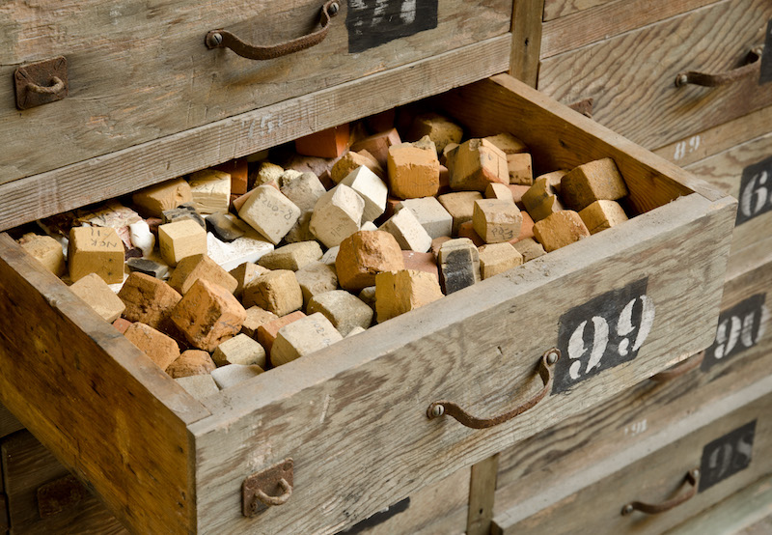
“I have generated many thousands of new radiometric age determinations over the past three decades...
Most of these analyses are in digital format...
Right now much of this data is in file folders as well as on various hard disks...
...but it would be incredibly useful to get this all into a searchable data repository.”
Notes:
An impossible situation and one which the Data Curation Program strives to avoid. There’s a legacy analog aspect to this particular problem, but even the digital data is in an unsupportable state.

Slide 4

“I have an extensive database currently maintained by Instructional Development...”
Notes:
A very Library-like collection (assuming there is content). Similar to other humanities collections (e.g., EBBA) in that it includes a relational database and associated web-based access system that greatly complicates curation. Like other projects, has some support but is looking for longer-term support.

Slide 5
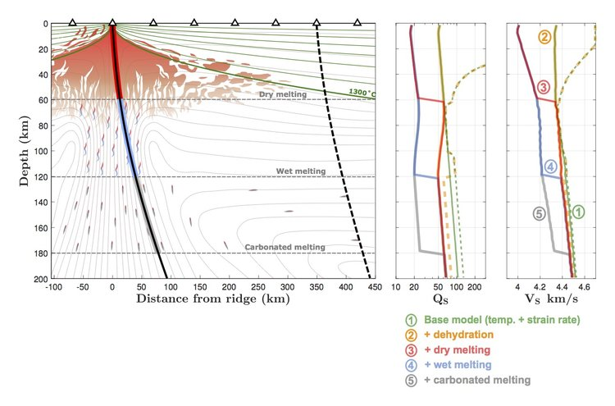
“I would like to archive .mat files (MATLAB data files) and plotting scripts (.m files) that accompany a paper I currently have in final stages of revision...”
Notes:
Archiving the data associated with a publication: a new paradigm, if not mandated. Data can’t always be handled as a supplement to the publication. And another paradigm, if not mandate: archiving associated software as well.

Slide 6
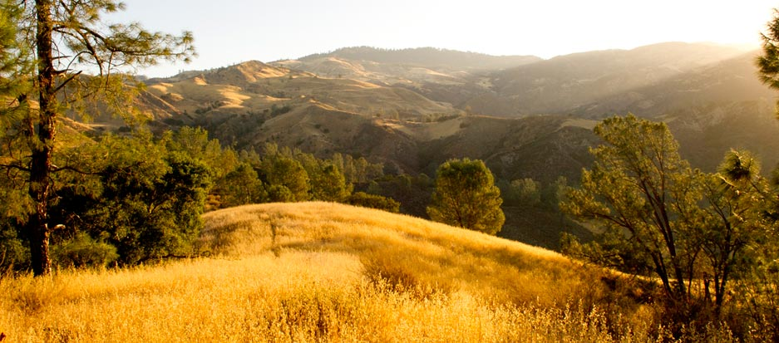
“Sedgwick Reserve accumulates heterogeneous data that are critical to meeting its mission, including:
• geospatial data on boundaries, experiments, ...
• tabular research data collected on the reserve
• environmental monitoring data (weather stations, wildlife cameras, ...)
• reserve use data (e.g., class visitation)
Currently there is no solution for archiving most reserve data.”
Notes:
Heterogeneous data, both in terms of format and genre. While some types of data are archivable elsewhere (e.g., LTER), there is obvious value in grouping all data in one place to facilitate correlated usage. Also, example of data owned by a group/organization, as opposed to an individual, which brings up additional concerns regarding management, access, roles, etc.

