Slide 1

EZID
Greg Janée, John Kunze, Joan Starr CDL

Slide 2
EZID
CDL’s identifier registration and management service
ARKs, DOIs, other identifier types
UI, API, client libraries and tools
Integrated with Crossref, DataCite
Features
minting (identifier generation)
mapping across metadata standards
Dublin Core, ERC, Crossref, DataCite, ...
ownership and access controls
visibility controls
access and advertising
search, bulk download, OAI-PMH, JSON-LD
link checking

Slide 3

Direct usage
Campus-level “group”
typically campus library is sponsor/administrator
self-help user admin tools forthcoming
Multiple user accounts under group
typically correspond to departments, units
accounts are presumed to assume responsibility for identifier management
Notes:
Photo from https://www.yelp.com/biz_photos/sacramento-ballet-sacramento?select=K6H_OJYWVkWvssjdHWm6hA

Slide 4
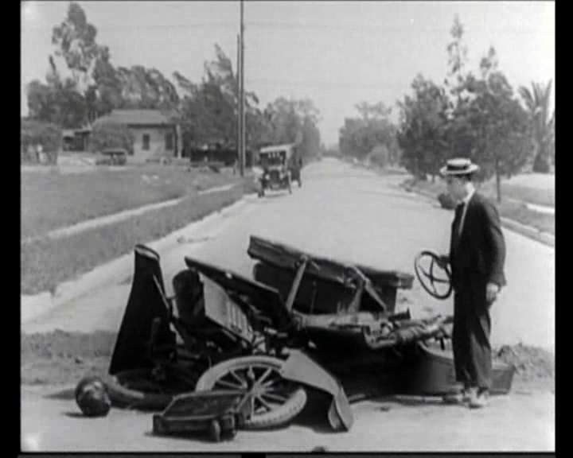
Avoiding problems
Things work well when:
user owns resource
user controls where resource lives
user created identifier
user is capable of, and committed to, maintaining resource and identifier
succession of resource and identifier are linked, co-occur
When above not true:
manual intervention required
Notes:
Photo: still from Buster Keaton, Three Ages, 1923.

Slide 5

Fixing boo-boos
Delete identifier
if not publicly released
Set to unavailable
not advertised, indexed
resolves to tombstone page
Deprecate “old” identifier
doi:10.1234/OLD
permanently set target = https://doi.org/10.5678/NEW
set export=no
ownership may revert to CDL
doi:10.5678/NEW
Notes:
Photo: Greg Janée, CC BY-NC

Slide 6
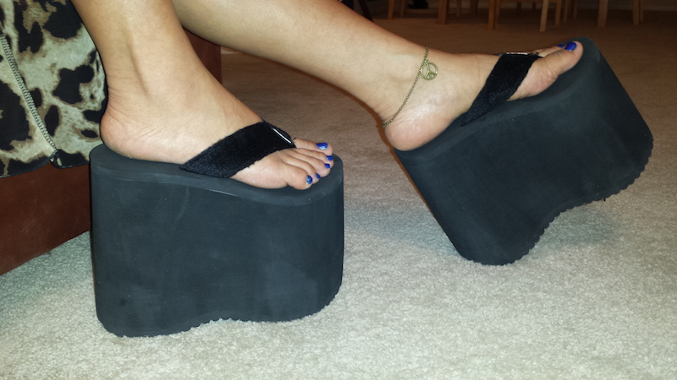
EZID as platform
EZID defines generic identifier model
prefix (e.g., “doi:”) identifies type of identifier
URI-compatible syntax rules
equivalency/normalization rules
associated (citation) metadata
metadata requirements
metadata mappings
interaction with external agencies
common attributes: target URL, owner, status, ...
Lots of identifier types fit this model
ARK, DOI, UUID, PURL, Handle, LSID, IGSN, RRID, ...
Consider using EZID to promote legacy and/or local identifiers to GUIDs
Notes:
Photo from https://en.wikipedia.org/wiki/File:Giant_7_Inch_Tall_Platform_Flip_Flop_Thongs.jpg

