Slide 1
Data Curation Program
And its role in enabling research
Greg Janée • gjanee@ucsb.edu

Slide 2
Topics
Genesis and overview of the program
  why, what, how
A fundamental mismatch
  between goals and the tools available
An emerging, broad mandate
  that involves campus IT
Three curation challenges
  that are IT-related

Slide 3
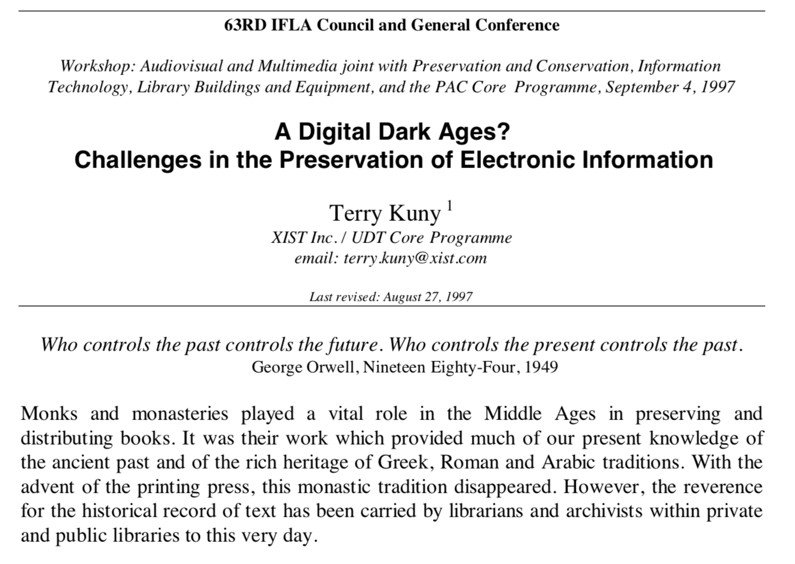
Background – preservation crisis
“...we are moving into an era where much of what we know today, much of what is coded and written electronically, will be lost forever.”

Slide 4
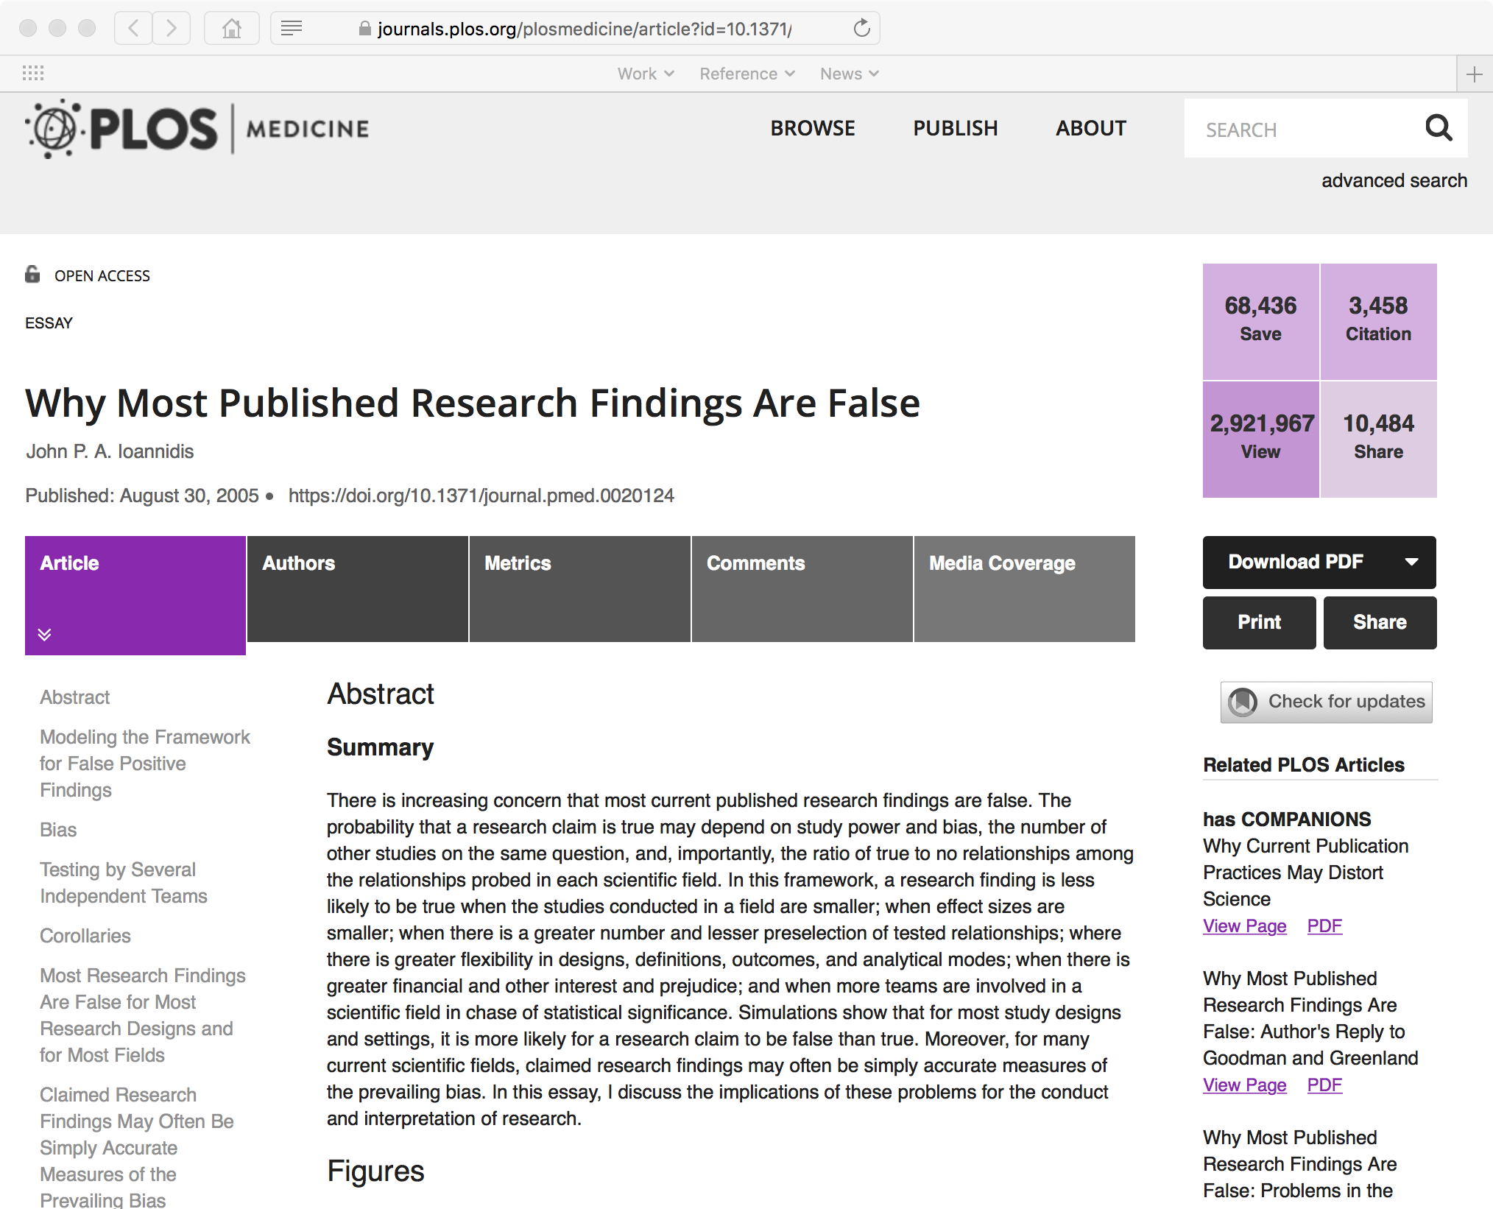
Background – reproducibility crisis

Slide 5
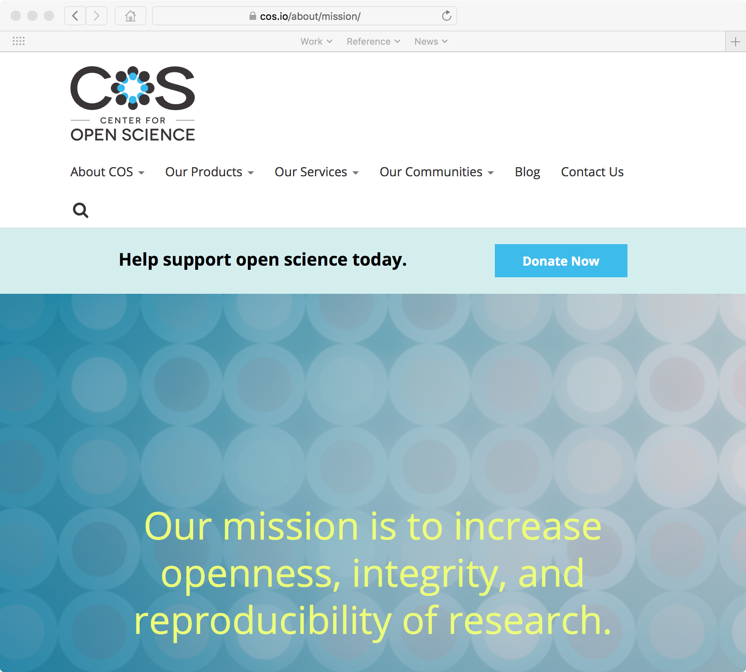
Background – COS, 2013

Slide 6
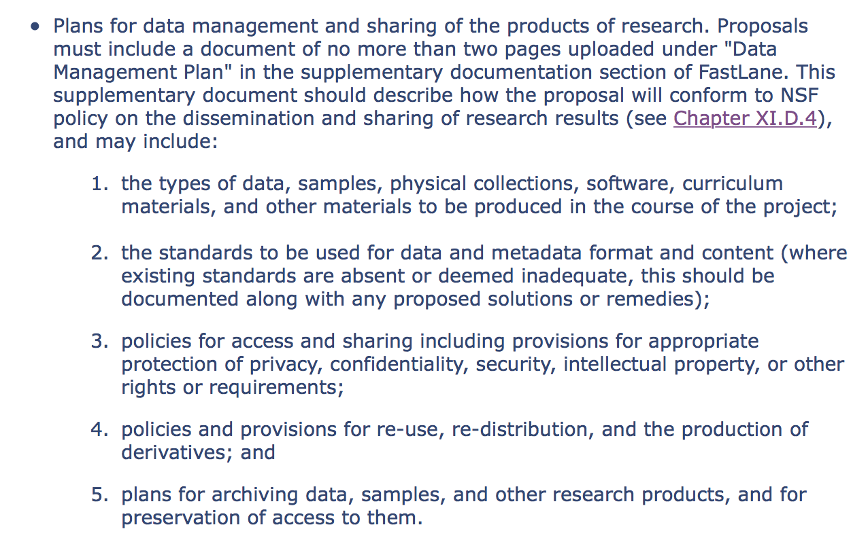
Background – NSF, 2011

Slide 7
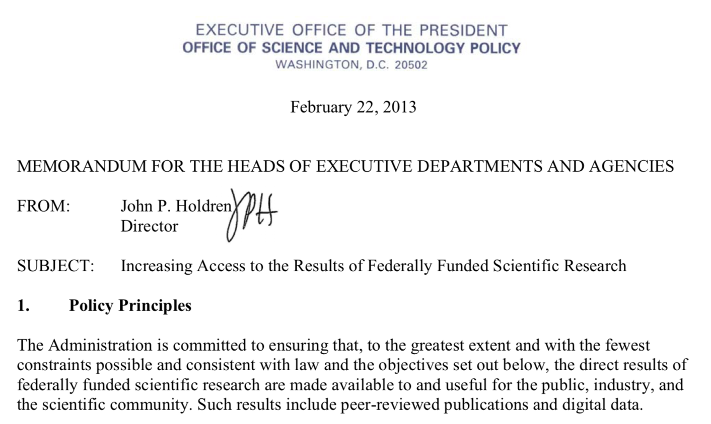
Background – OSTP, 2013

Slide 8
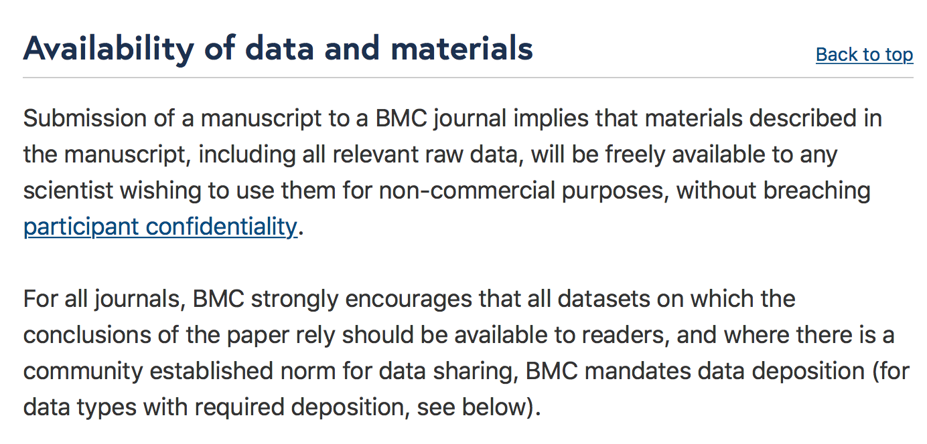
Background – increasing journal mandates

Slide 9
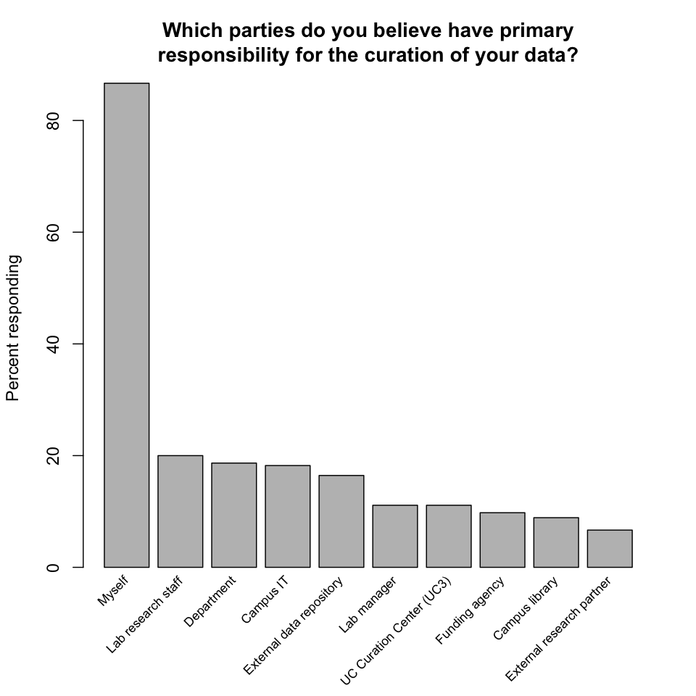
Background – 2013 UCSB survey

Slide 10
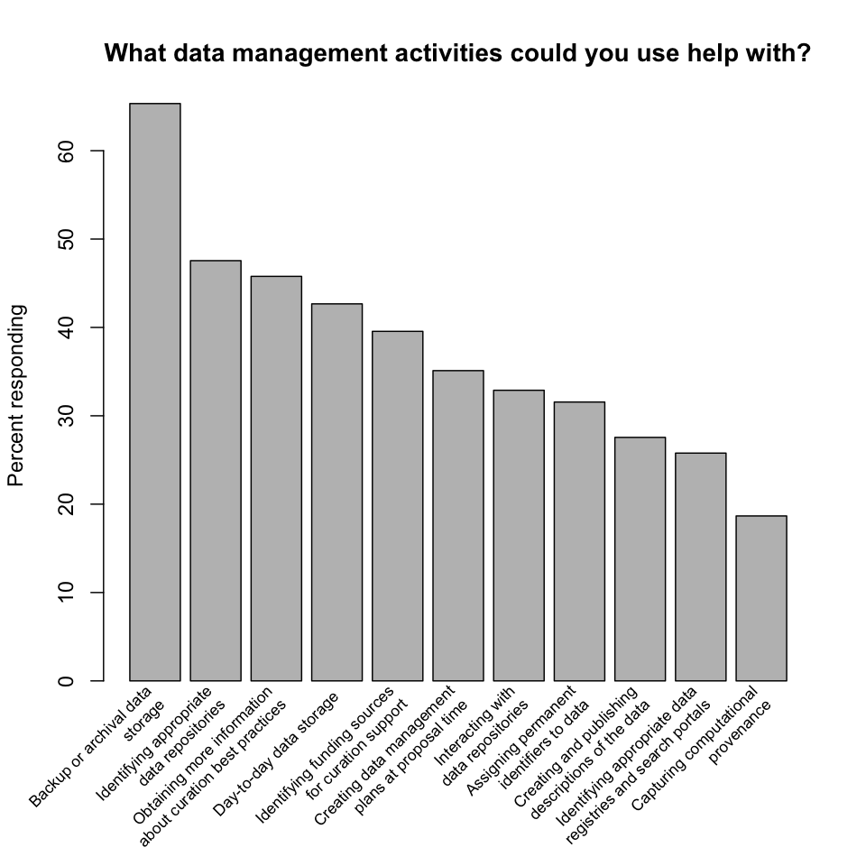
Background – 2013 UCSB survey

Slide 11
Data Curation Program
Mission: assist researchers in ensuring that research data is findable, accessible, interoperable, and reusable (FAIR), and sustainably preserved
Staffing
  Director
  Social sciences curator (just hired!)
  Earth & environmental sciences curator (in progress)
  Humanities curator (in progress)
  (Geospatial curator)

Slide 12
Activities
Consultation
  DMPs, data management, preservation strategies
Education
  Software Carpentry workshops
  school, classroom instruction
Preservation
  Dryad self-deposit repository/data publication platform

Slide 13
A fundamental mismatch
The curator’s mantra:
  to successfully curate data, must engage with researcher as early as possible
Using the one tool available:
  a repository in which one can deposit final products

Slide 14
What is the best tool/platform for
organizing software,
making it publicly available, and
supporting collaboration on it?

Slide 15
Software question
Answer: GitHub!
Notice how:
  not developed by library or curation or preservation community
  user sees benefits immediately
  no onerous end-of-project steps

Slide 16
What is the best tool/platform for
organizing software data,
making it publicly available, and
supporting collaboration on it?

Slide 17
Promising technologies
Computational notebooks
  Jupyter, RStudio
Execution environments
  Docker, WholeTale, binder, Code Ocean
Repositories that support working with data
  OSF, Dataverse
Integrations of the above

Slide 18
Data curation is computational
Focus on education, how data is created
  not on: archiving data
Consultations tend to be fluid
  close relationship to Collaboratory
Ergo: “Research data services”?

Slide 19
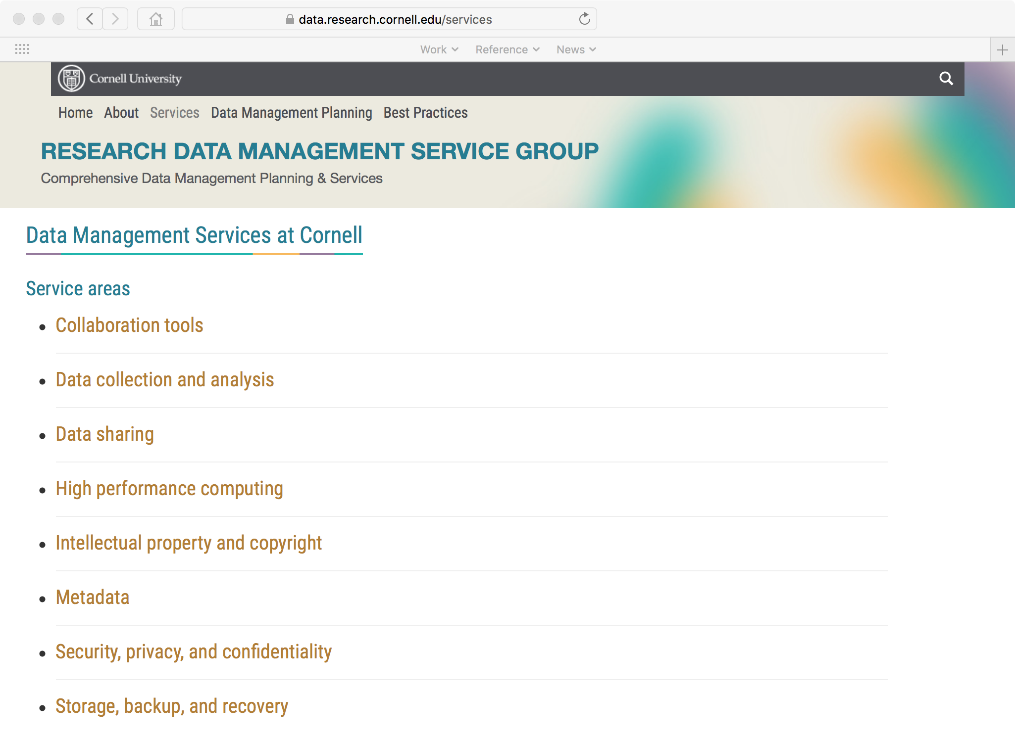

Slide 20
An emerging, broad mandate
3rd AAU/APLU workshop: accelerating access to research data
100 institutions
All engaged/engaging in campus-wide effort
Message: requires collaboration between
  library
  campus IT
  Office of Research
  Vice Chancellor for Research

Slide 21
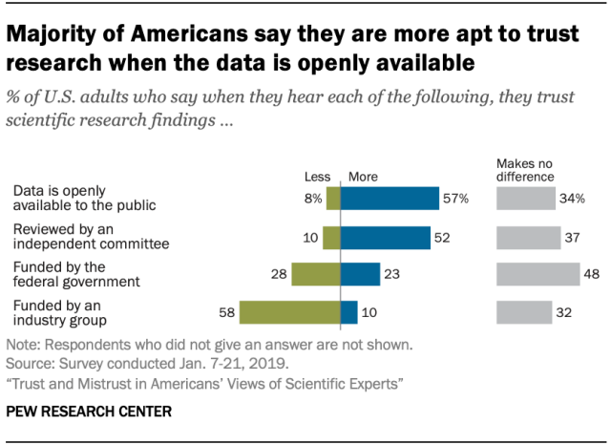
Incentivizing researchers

Slide 22
Utah State University example
After 3 years, library is monitoring 120 awards

Slide 23
Challenge #1: Preserving websites
Very common to produce website as lasting artifact
  particularly in the humanities

Slide 24
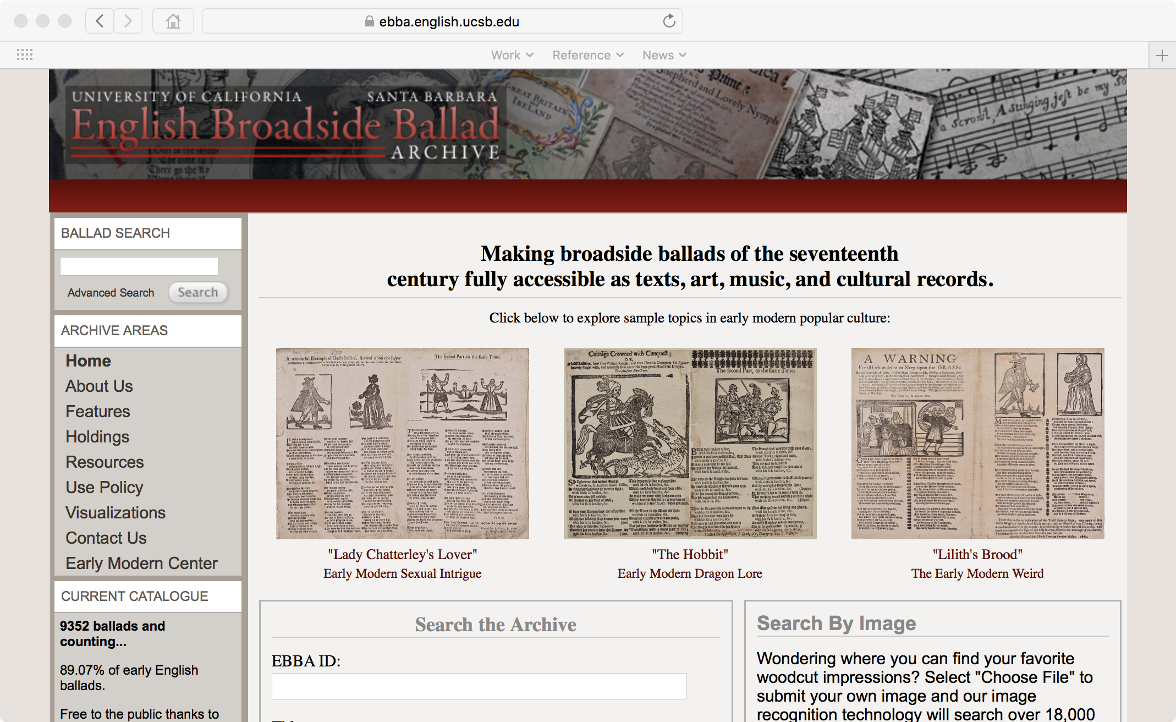

Slide 25
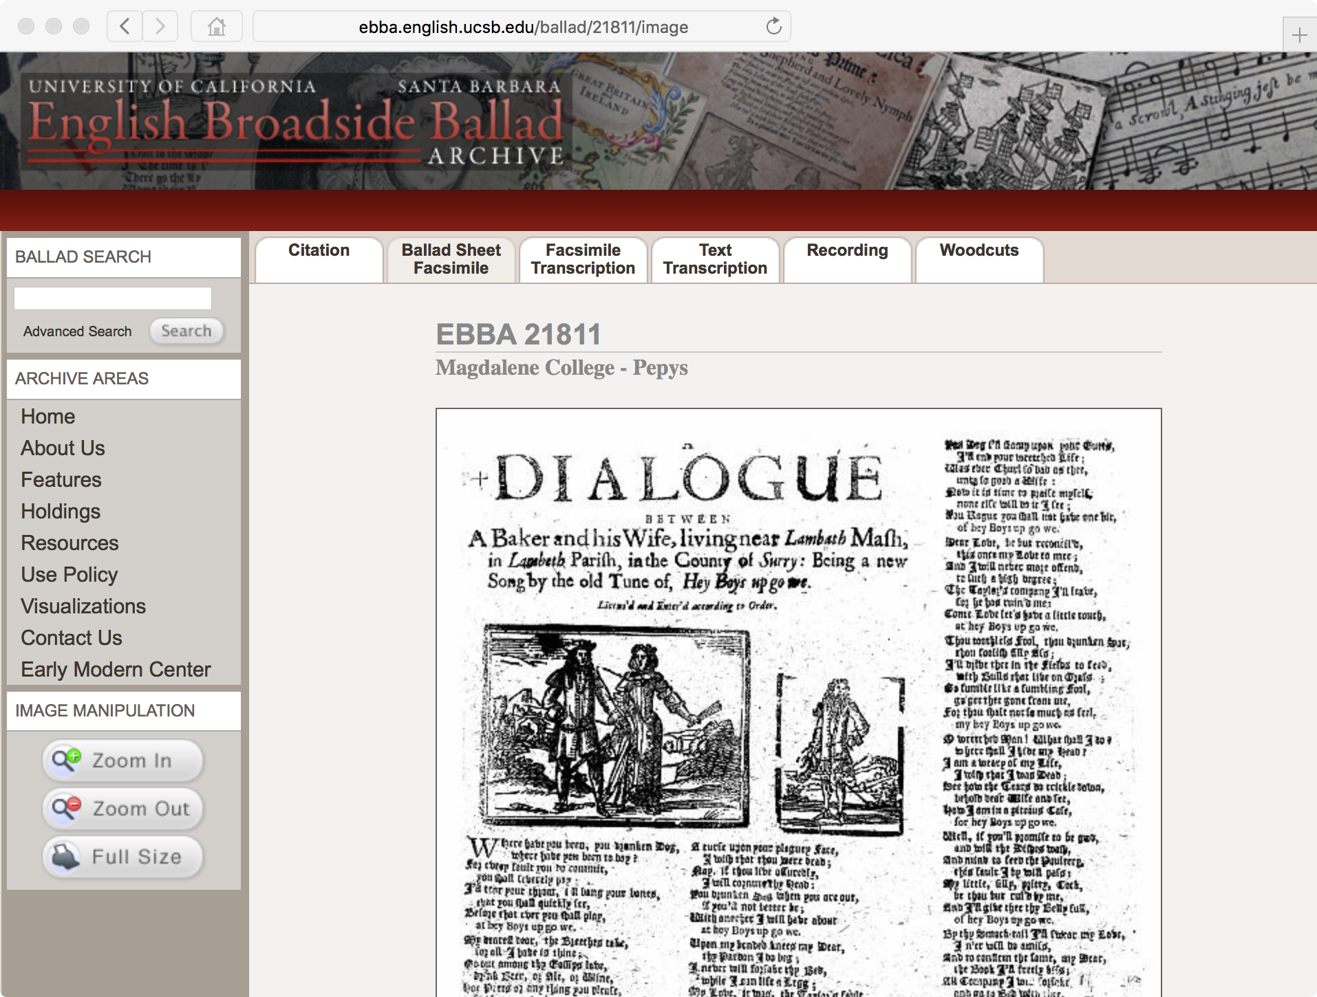

Slide 26
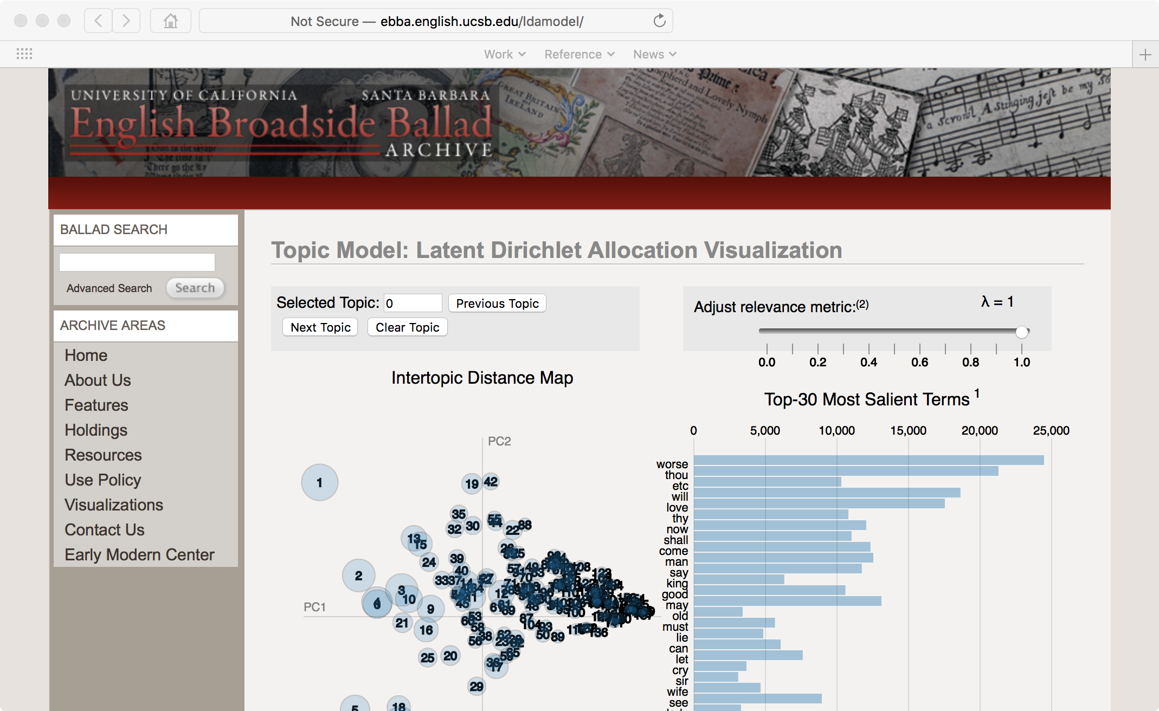

Slide 27
Preserving websites
Have Archive-It subscription
But doesn’t capture...
  database
  content not discoverable by crawling
  associated content, e.g., scan originals
  interactive, dynamic content

Slide 28
Preserving websites – solutions?
Probably impossible
But to at least increase lifetime:
  containerization
  centralized hosting, e.g., Pantheon

Slide 29
Challenge #2: Long-lived research programs
In the Earth sciences
Run for years, decades
  across grants
  across people
Evolving instrumentation, methods, data products
Continuously growing
Periodically recomputed
Large

Slide 30
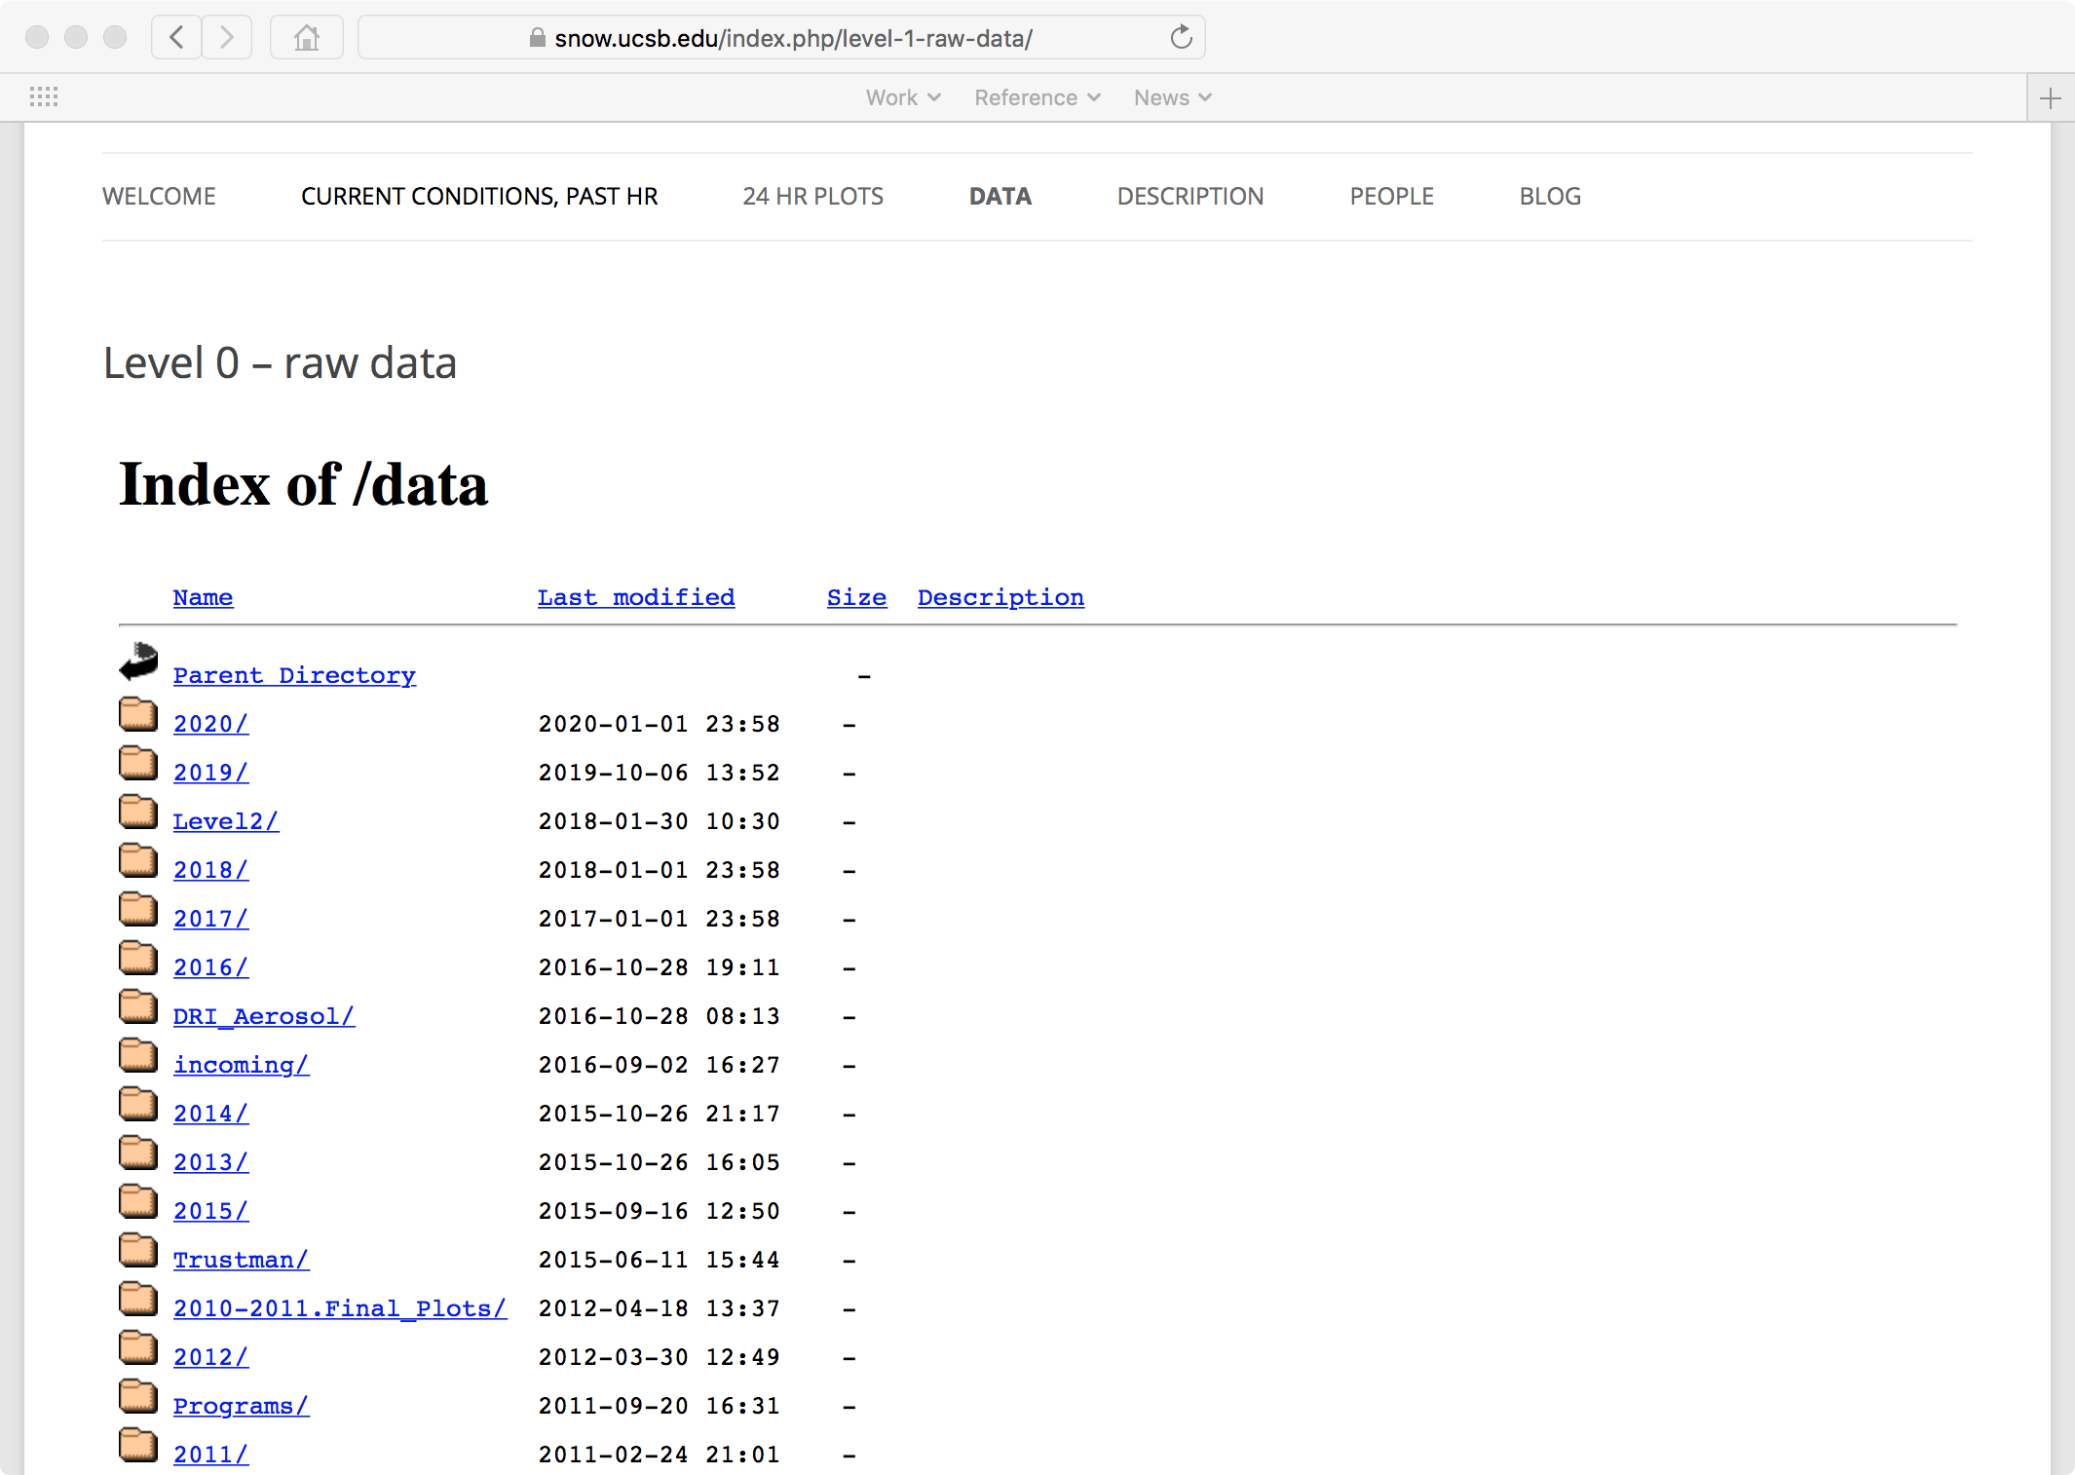
stages/levels -
workflow -
one-offs -
goes back to 1991
code -

Slide 31
Solutions?
Snapshots, yes, but...
Need curation solutions that cooperate, even coexist with large-scale compute environments
  storage, access, identification
  close collaboration between Library, CSC, datacenters

Slide 32
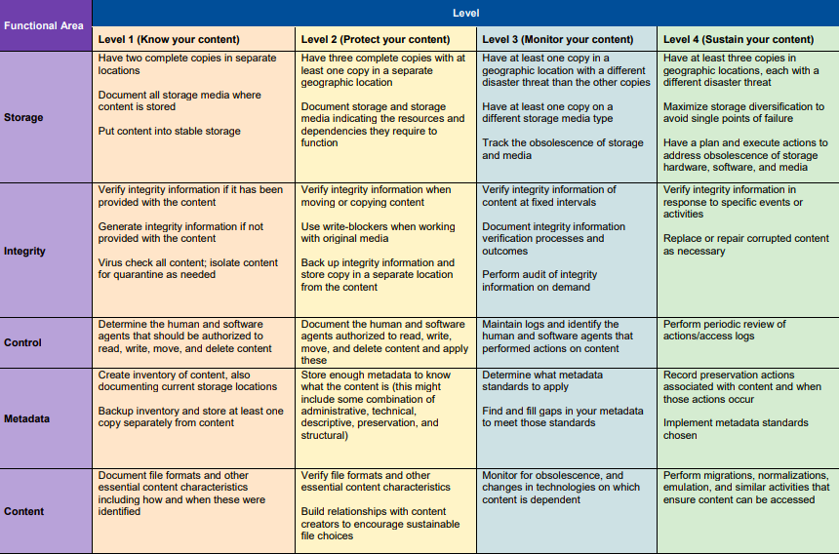
Challenge #3: Preservation storage
NDSA levels:

Slide 33
Current options
Merritt (CDL)
  3 copies: Wasabi, Minio, AWS Glacier
  $150/TB/yr
Chronopolis (UCSD)
  3 copies: UCSD, UMIACS, Texas DL
  $190/TB/yr
“Data Collective” (Library/ERI)
  3x250TB housed in Library, NHDC, CNSI
  prototype backup to Box
Notice:
multiple, varied solutions
cooperative
difficult to fund

