Slide 1
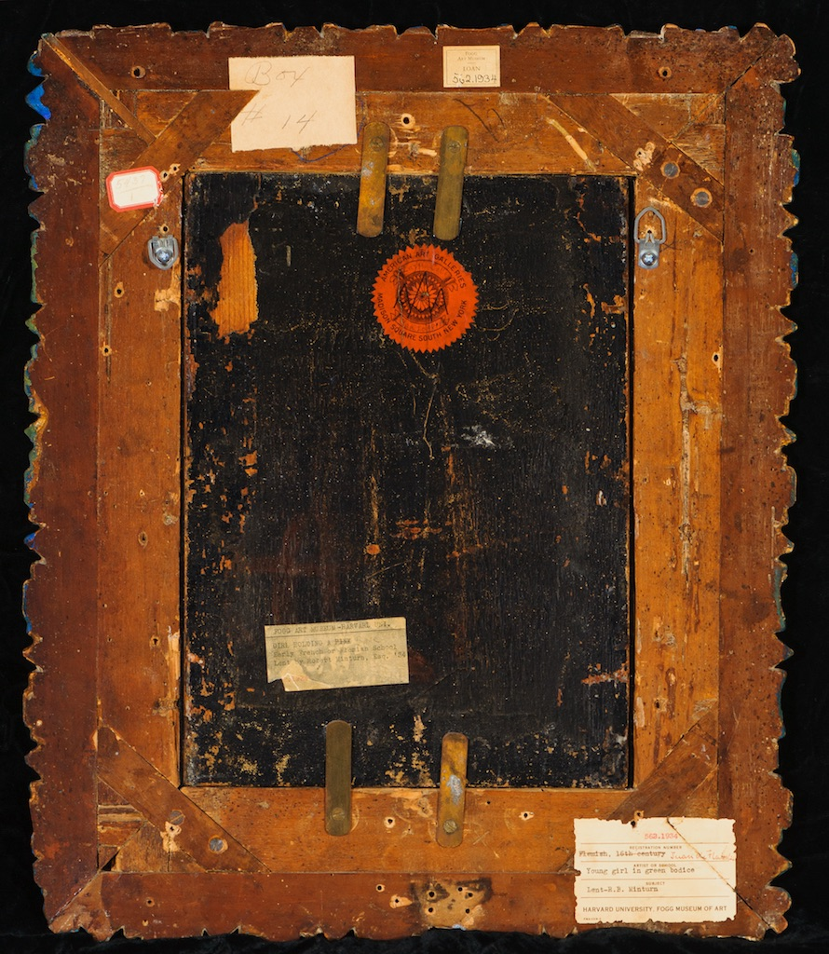

Digital Strategies Division
all-hands meeting

Slide 2
Our areas
Data services
Digital library development
Community building
Collaboration
Service support

Slide 3
Data services
Data access
licensed datasets, APIs, analysis tools
Consultation
finding, using, analyzing, visualizing, combining data
data management planning
data publication
data archiving
project embedding
Education
data literacy, data science
Carpentry workshops
data management
Data archiving
self-deposit repositories
support for large datasets
Goal: continue the renaissance

Slide 4
Digital library development
Needed:
preservation storage
asset management/workflow support
access
discovery
Overall strategy
leverage for-fee services, well-supported community efforts, partnerships
reserve development resources for customization

Slide 5
Preservation storage
Characteristics
robustly stored
robustly managed (CoreTrustSeal-approved)
stores self-describing, self-contained archival objects (not files)
protects against accidental, malicious loss
Strategy
budget line item
Merritt or Chronopolis for Library collections
expand Data Collective for research data
will create possibilities for direct access by researchers
Goal: preservation storage in place and in use by 2021

Slide 6
Asset management system
Principle: information must be managed, at an object level, by a system that enforces requirements and constraints
i.e., Excel doesn’t cut it
Current Surfliner development effort!
Goals:
supports breadth of Library collections (SRC, geospatial)
integrated with preservation storage
in use by 2021
directly used by catalogers
akin to Alma

Slide 7
Access, discovery
Goal: this is where we want to be working
Access
provides collections in computationally accessible forms
supports semantic web
integrates with popular analysis platforms
citable
persistent identifiers, versioning, recommended citations
Discovery
internal
a bit of a mess now; strategy needed
external: appropriate indexing by Google Data, etc.
These are the visible aspects of our infrastructure

Slide 8
Community building
Internal
Carpentry
data management/data experts ← near-term goal
incubator for campus research groups ← near-term goal
External
Carpentry
Data Curation Network
Surfliner
Samvera
Dataverse

Slide 9
Collaboration
We’re in a unique position to facilitate/coordinate collaborative efforts
Examples:
Digitization, collection development policies
Research Resources, SRC
Infrastructure
SRC
UCSD, Surfliner
Data literacy, data science
Bren School, Data Science Initiative, Teaching & Learning
Large-scale computing
CSC

Slide 10
Service support
A successful service requires...
outreach
training
support
administration (users, permissions, templates, local policy)
service manager
Ergo, we must supply/coordinate for
internally-developed services: DAMS, Spotlight, ...
hosted services: Alma, Dataverse, ...
and: JIRA, website, LibGuides, ...

Slide 11
Vision
A library...
with a robust preservation infrastructure in place
providing cutting edge access to its collections and to research data
actively supporting researchers throughout the data lifecycle
perceived as research partner by faculty
teaching data literacy skills to all
serving as the hub of campus research communities

