Slide 1

Finding a home
for SPOT

Slide 2
Background
SPOT/Image
  French consortium
  multispectral (5m) & panchromatic (2.5m) remote sensing imagery
UCSB reseller agreement
  we can keep a copy of whatever we sell
  but for UCSB use only: http://www.spot.ucsb.edu/licensing.php
Result
  80,000+ scenes at UCSB, ~9TB
  >$10 million value

Slide 3
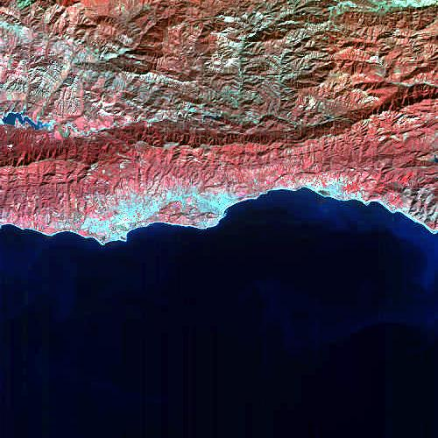

Slide 4
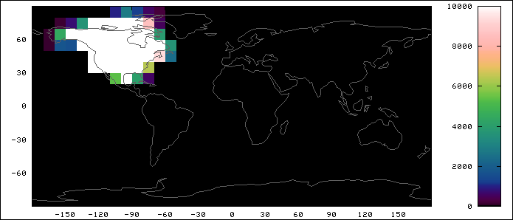
Coverage
Temporal coverage: mostly 2004-2007

Slide 5
Current state
Old systems (ADL, purchase system) long dead
  access = email Greg
Database dump
  Postgres/PostGIS
  all searchable fields: footprint, cloud cover, incidence angle, etc.
Data files
  “CAP” format (BIL image plus other files inside ZIP archive)
    have documentation
  various corruption, identification problems fixed
  browse images (500x500) & thumbnails (128x128) of all

Slide 6
At risk
Who knows about this?
  Mike Colee: files, program history
  Greg: catalog, data processing
  Kathy Scheidemen (retiring): contracts, licensing
Where else is this data?
  Still for sale
  At USGS/Eros: “This dataset of licensed commercial imagery is available to U.S. civil government agencies.”

Slide 7
Value proposition
Valuable, not easily re-acquirable
Useful indefinitely into the future (*)
Value-added, in relatively good shape
At risk
(*) Q: value relative to Landsat, other imagery we have access to?

