Slide 1
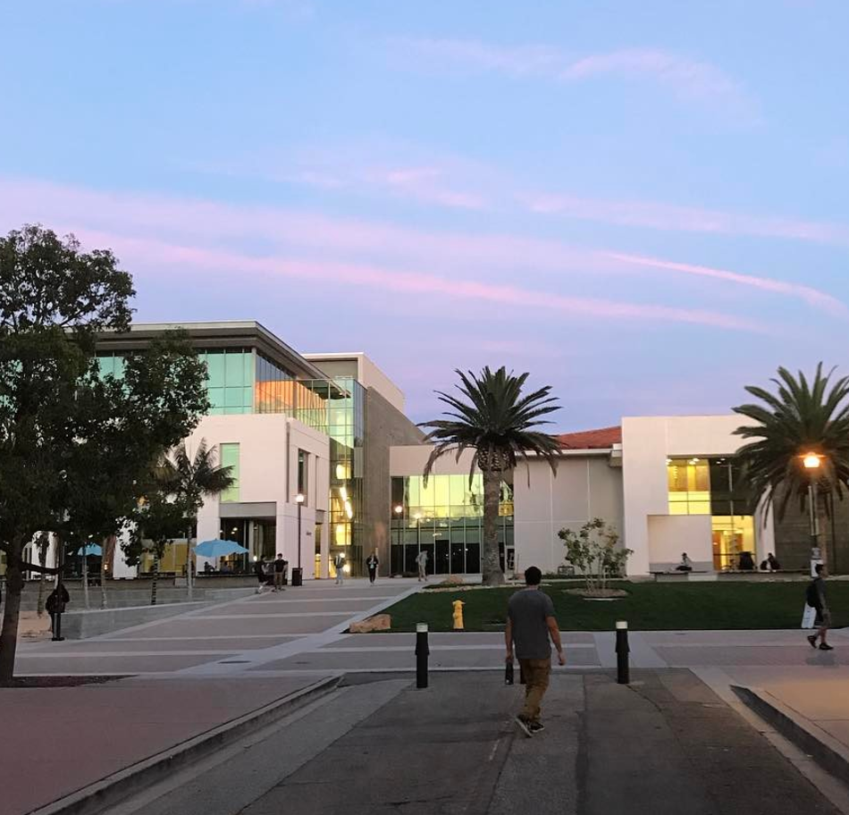
UCSB Library Data Services
Greg Janée
Jon Jablonski
Renata Curty
Ryan Horne

Slide 2
Data services
Instruction
Consultation
Computation
Repository
Physical facilities
Data (noun)

Slide 3
Instruction
Carpentry workshops
in 4th year
35 workshops, 400+ learners from 30+ departments
fully remote (and likely to remain so)
ramping up to 8 workshops per quarter
Need instructors!
Notes:
Carpentry: set of data skills curricula, and also a pedagogy that emphasizes experiential learning (students code along with instructors) and that allows students to walk away with running software implementations and projects on their laptops. List of topics on next slide.
Very popular, waiting list every time. Mostly graduate students, some faculty, increasing numbers of undergraduates (supporting CBSR and its SEEDS Fellows program).
Feedback is that students like learning remotely, so we’ll probably keep that (or at least hybrid) despite burden on Library.
Have been relying on volunteer postdocs, grad students to help us teach. Working on formalizing that.

Slide 4
Workshop topics
Bash (Unix command line)
Git and version control
Data science using Python (software carpentry and data carpentry)
Data science using R (software carpentry and data carpentry)
Databases and SQL
Geospatial data using R
Webscraping
OpenRefine
Authoring scientific publications using RMarkdown
Harvesting and analyzing Twitter data
Introduction to US Census data
Notes:
Topics have grown organically, based on what we hear people are interested in.
Workhorses are Python/Pandas/Jupyter and R/tidyverse/RStudio.
Most workshops are on tools; but also publication workshops and how to work with certain kinds of data.
We’re modifying existing curricula and creating new. Have used all three flavors of carpentry (software, data, library).

Slide 5
Upcoming workshop topics
Web publishing using GitHub Pages
Introduction to reproducible publications
Introduction to GIS with QGIS
Qualitative data analysis with NVivo
Sharing spatial analyses with ArcGIS StoryMaps
Introduction to Wikidata
Series of introductory workshops on digital humanities tools, data types, and methods

Slide 6
Other instruction
Data management workshops, drop-in instruction
Responsible Conduct of Research (RCR) training
Notes:
Carpentry isn’t only instruction we do.
RCR: required training on scientific rigor and reproducibility, data management, conflict of interest, ethics, etc. Library is supporting NIH-funded training grants in Bioengineering, MCDB.

Slide 7
Consultation
Data management
DMP preparation
data cleanup
data modeling, database design
data publication and archiving
Analysis
GIS tools, geospatial data
social media APIs, data
Finding and purchasing data
Piloting: long-term engagements
Notes:
Consultation over whole data lifecycle.
We won’t clean your data… but we will teach you how.
Have helped lab groups set up and document standard data handling procedures.
Working with OR to pilot ongoing relationships with projects.

Slide 8
Computation
Azure VMs
check out up to 50 hours
Four “labs”:
DataStats (R, Python, Eikon Datastream, EViews)
Geospatial (ArcGIS Pro)
NVivo
MaxQDA
Piloting: custom VMs for larger/longer jobs
Notes:
Two things came together: gift from Microsoft, and pandemic forced us to go virtual.
In high use: most of ~100 VM instances are in use. Will keep this service.
Still exploring costs and possible services; not trying to compete with CSC.

Slide 9
Repository and other services
Dryad
data repository/publication/citation platform
integrated with publishers, Zenodo/GitHub, DMPTool
locally curated
DMPTool, EZID, eScholarship
Working on: additional data management/repository platforms
Notes:
Looking at Harvard Dataverse.

Slide 10
Physical facilities
Community hosting
eco.data.science
Tidy Tuesday
Qualitative Data Analysis Study Group
Workstations
Brandwatch, MATLAB, SPSS, Stata
VR equipment

Slide 11
Data
Esri Data for Education Programs
Campus map data
Linguistics Data Consortium
ICPSR Data Archive
Thousands of datasets on CD-ROM...

Slide 12
Contacts
https://www.library.ucsb.edu/services/digital-scholarship
collaboratory@library.ucsb.edu rds@library.ucsb.edu

Slide 13
Name one hope for the future of data science at UCSB
Broadly available data literacy education
be able to look critically at data
understand how presentation influences interpretation
understand that how data was gathered/measured/counted affects its appropriate uses
Notes:
Some students learn these skills, but would like to see more broadly taught.
Important skills for all scholars, and society generally.
Taught in or by Library; or as 1-unit course; or as a drop-in curriculum module.

