Slide 1

Three birds, one stone: Advancing data literacy through RDM and Carpentry instruction integration
UC Santa Barbara
🐦🐦🐦

Slide 2
Outline for the afternoon
Introduction (0:35)
Background and motivation
Some concrete examples
Data literacy and RDM frameworks
Breakout 1 (0:45)
What data literacy/RDM topics should we be teaching?
Report-backs
BREAK (0:15)
Breakout 2 (0:45)
Where and how can these topics be taught?
Report-backs
General discussion, next steps (0:20)

Slide 3
Our background
Past experience
Many Carpentry workshops
Heavily reorganized, adapted existing curriculum
Developed new modules, lessons
RDM workshops
Graduate courses, new faculty
In the hopper
Campus data science initiatives
Focused on advanced algorithms, statistics
Looking for introductory, student support
Library undergraduate course
Formerly: How to use the Library
Being rethought as: How to be a scholar

Slide 4
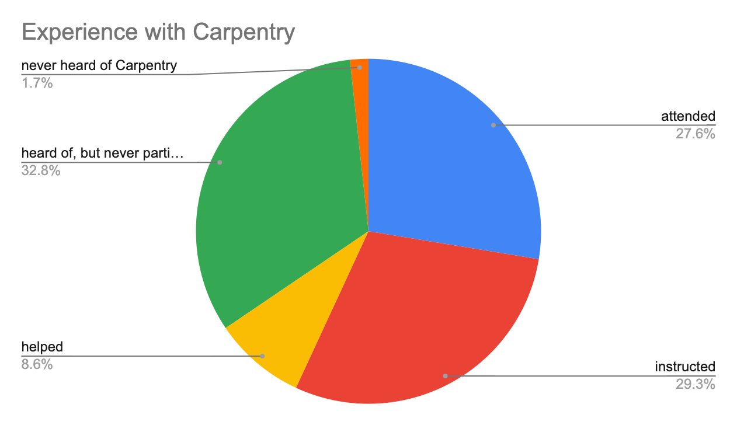
Your background

Slide 5
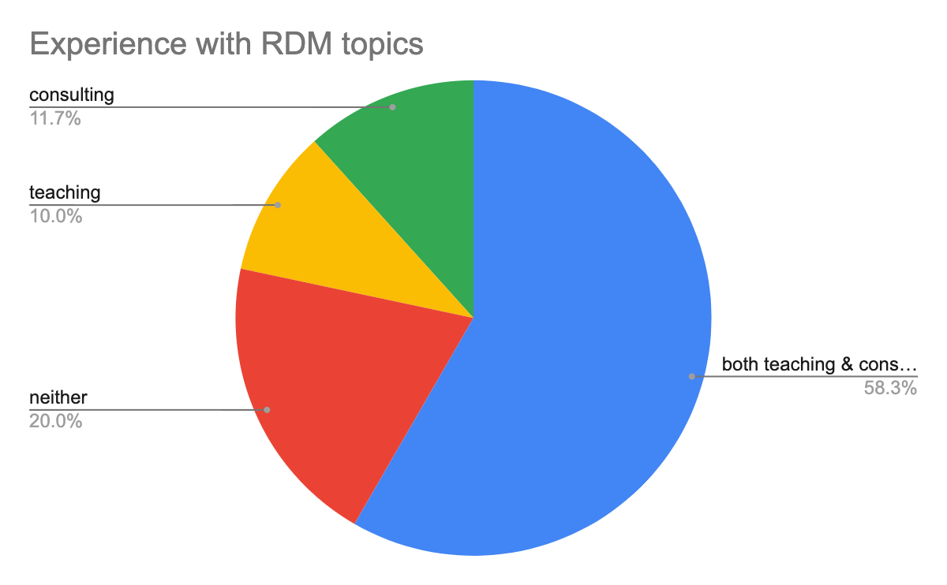
Your background

Slide 6

So what’s the problem?
We’re worried we’re not covering essential topics
Essential concepts, skills for future scientists
Essential for correctly reasoning, working with data
Essential for effective data management
Students request these topics, too
But topics are insufficiently addressed

Slide 7
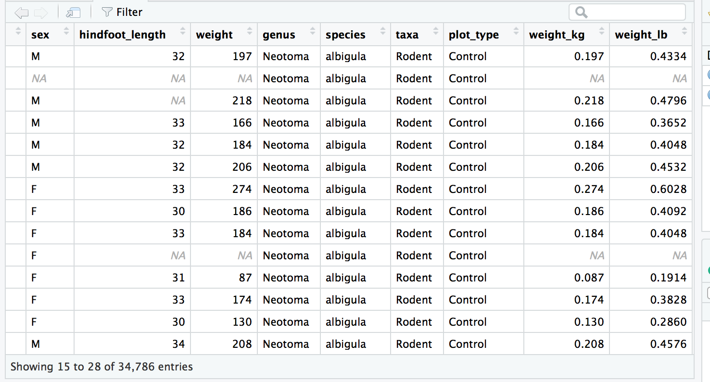
Topic 1: Accuracy and precision
± .0001 ?!
What students see as they work with data:
Notes:
Sample of in-lesson RStudio window. As students work with data, they naturally see the computer’s internal representations of numbers displayed, which can lead to false notions of accuracy (no, rodent weights are not known to one-ten-thousandth of a pound; that’s an artifact of the quantity being computed).

Slide 8
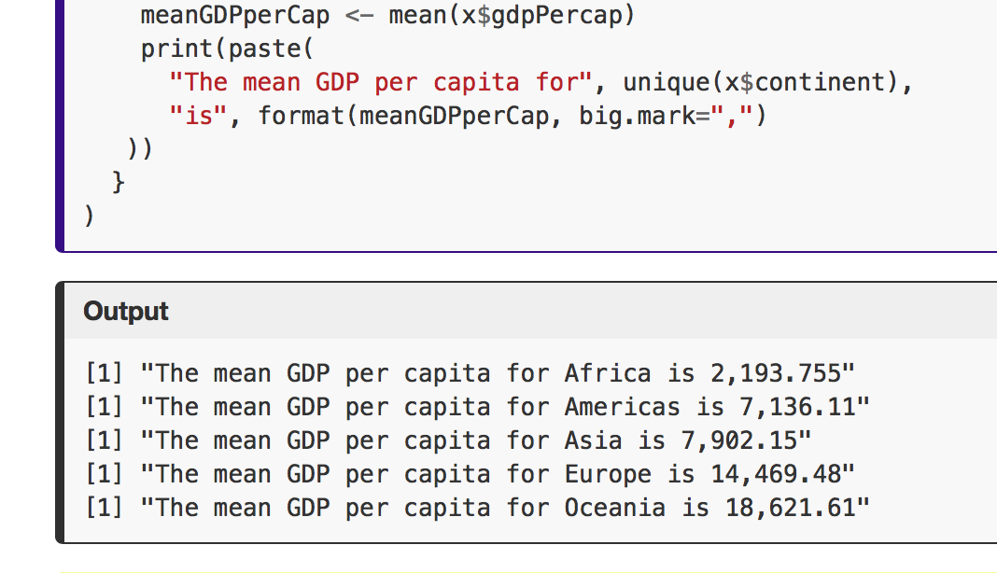
Topic 1: Accuracy and precision
Important concepts:
Accuracy
Error bounds
Significant digits
Confidence interval
Precision
Should not exceed accuracy
Often implied by number of digits printed
Reflects repeatability of measurement
?
Notes:
Important concepts include: all data has limited accuracy (expressed as error bounds, confidence intervals, significant digits). When numbers are displayed, it is misleading if the precision exceeds the accuracy. The example shown, from an R lesson, focuses on how to insert commas but misses the more important points.

Slide 9
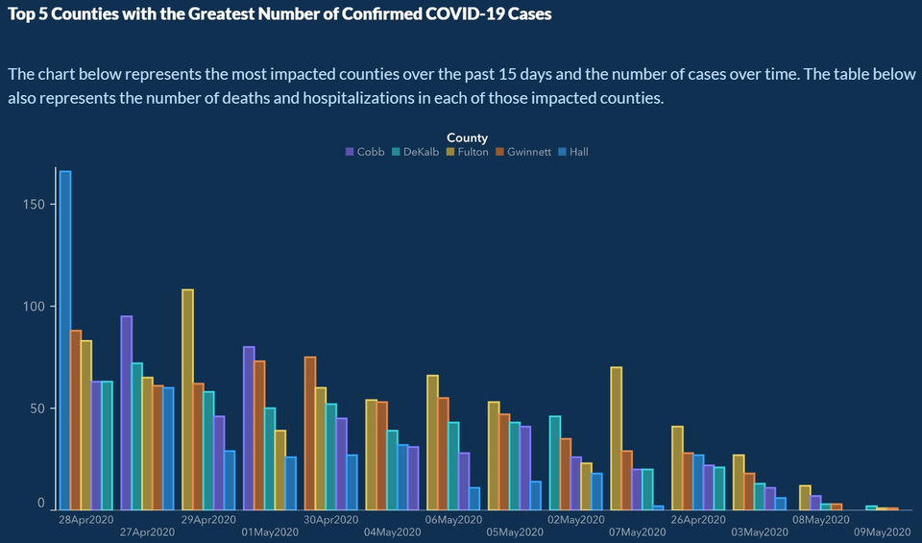
Topic 2: Avoiding unintentionally misleading graphs

Slide 10
https://towardsdatascience.com/stopping-covid-19-with-misleading-graphs-6812a61a57c9

Slide 11
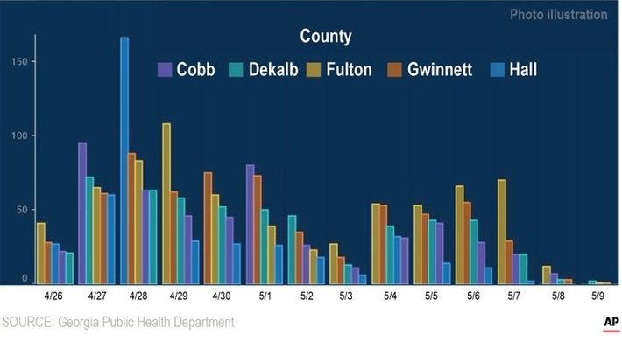
Corrected version:

Slide 12
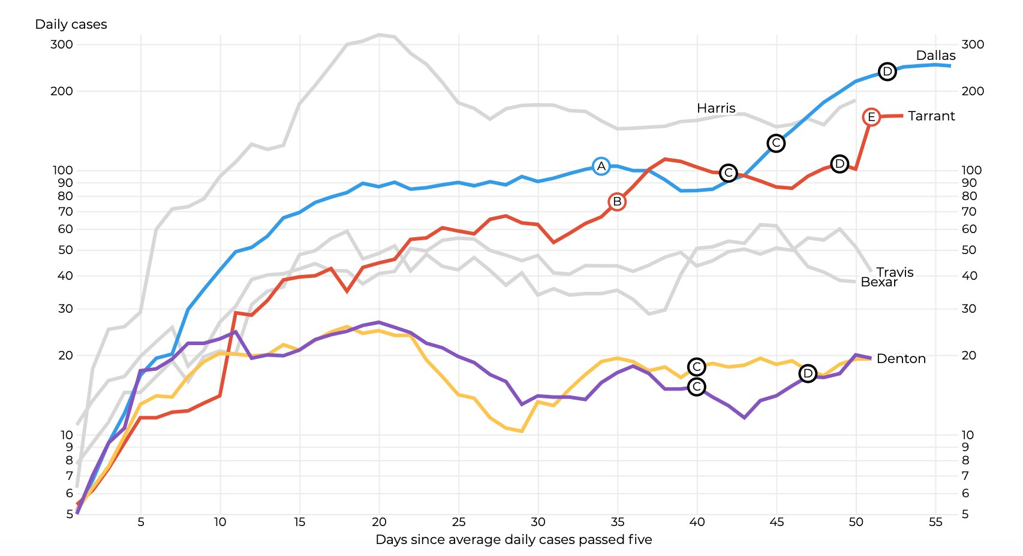
Even clearly labeled log scales can be deceptive
Dallas Morning News graphic republished by DMagazine. Tim Rogers, May 13, 2020

Slide 13
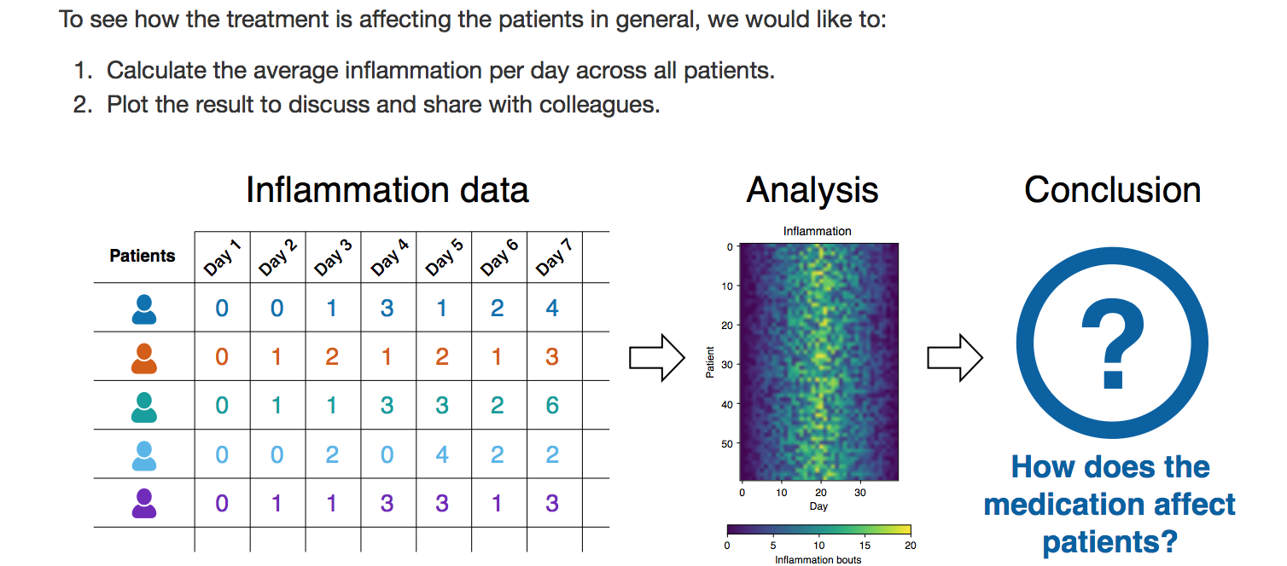
Topic 3: Personally identifiable information (PII)
Students learning Python work with some fictitious health data...
Notes:
From Python software carpentry. The data is invented and devoid of identifiers. In any real-world dataset, however, the data would surely involve PII, particularly if the data needs to joined with any other data.

Slide 14
Topic 3: Personally identifiable information (PII)
Important concepts:
Generally PII cannot be released, ethically or legally
Health data is additionally protected
Requires IRB approval and careful planning
De-identification likely required; may be easy (use opaque IDs) or hard (identity is still inferrable)
Original data, if it needs to be retained, will require safeguarding
Best practice: de-identify as soon as possible
Notes:
Use of PII requires careful consideration and planning up-front.

Slide 15
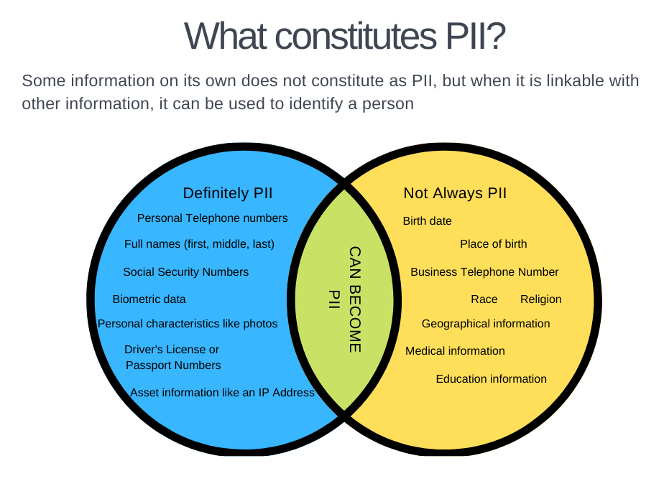
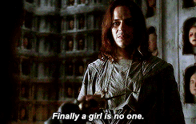
Topic 3: Personally identifiable information (PII)
Notes:
Use of PII requires careful consideration and planning up-front. Everyone included in a study or research that uses PII, must become “no one” in a sense, and it will take a significant portion of time to remove these references.

Slide 16
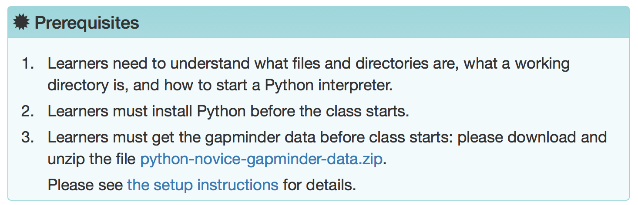
Topic 4: Data evaluation and citation
It’s common for students to work with pre-existing (and real) datasets, and valuable for the students to work with real data
Notes:
It’s valuable for students to work with real datasets instead of toy data, since real data gives students a better sense of what data looks like “ in the wild” (though not perfect because the data is pre-cleaned or has “planned” issues), Overall though the opportunities for examining the data are often much richer. But one issues in many lessons, such data is simply given - students are told to download it before the workshop and then we dive straight into python or R to manipulate it.
There isn’t time (or prompts) for students to examine the code book/ data dictionary, or just open the csv in excel and look around a bit before interacting with it in a new environment to them (such as R or Python)
We skip over evaluating the data for the use we’re looking at and just assume that we can do what we would like with it.
Talking to a prof - expressed regrets at not being able to take time to learn “fancy” tools like R or Python - but often sees students making beautiful visualizations - with completely flawed assumptions/ use of the data.

Slide 17
Topic 4: Data evaluation and citation
Important concepts:
Evaluation
Who created it? Why?
How was the data gathered/created?
What are its intended uses? Its limitations?
Citation
How to cite a dataset
DOIs
Dataset versions/dating
Identify subset used
Notes:
Who created it? For what purpose? What is the scope of the data & what were the original researchers assumptions/intentions?
How was it gathered? What implications does that have on the results?
Again, what are the limitations of the data being used? Does it fit the use you have in mind?
Citation:
Many times brushed over or there isn’t time to get to it at the end of a lesson
Not sure that carpentries lessons mentions DOIs at all, let alone talking about Dataset version or how one identifies a subset of data used.
Using data effectively, and validly for a scientific purpose, requires that we understand the genesis of the data, the motivations behind it, and its limitations. For our work to hold up to the scrutiny of peer review, and for general provenance, it is important that we cite the data.

Slide 18
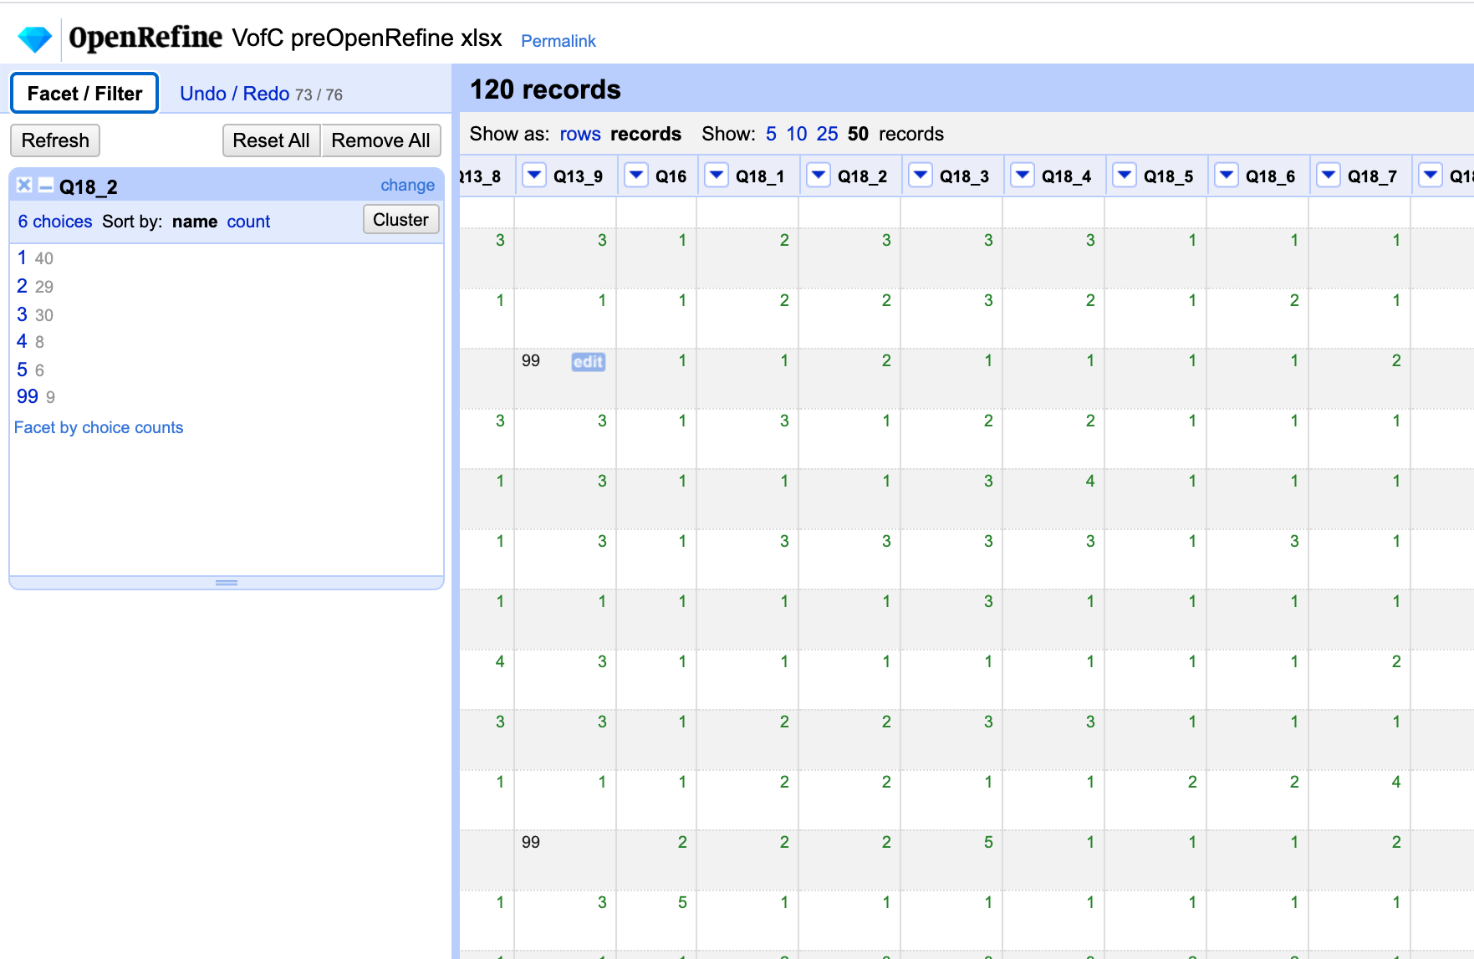
Topic 5: Handling missing data and Likert scales
While teaching data transformations and values replacement on Spreadsheets and OpenRefine, instructors can:
Provide tips on best practices for handling missing data
Cover the advantages and disadvantages of using odd versus even Likert scales in survey design

Slide 19
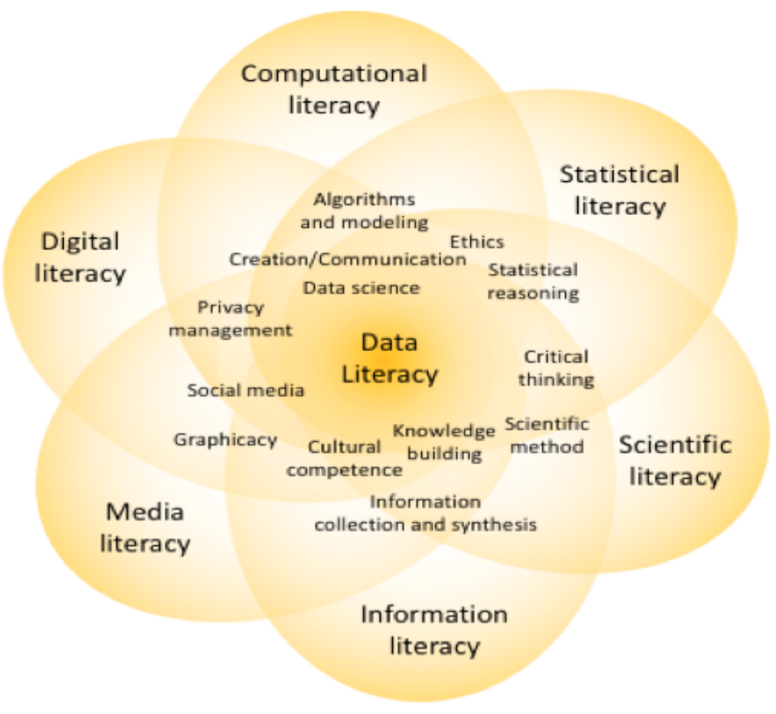
Data Literacy: An Interdisciplinary & Multi-Literacy Construct
Many Existing Conceptions:
A life skill for everyday problem-solving – enabling community engagement, citizen empowerment, activity tracking, and personal health management
A research skill for students and professionals – accessing existing data sets to produce and communicate new knowledge, making scientific experiments robust and reproducible
A building block and critical success factor for rolling out data science in business, government, and research
Bhargava, R., Deahl, E., Letouzé, E., Noonan, A., Sangokoya, D., & Shoup, N. (2015, October) Beyond data literacy: Reinventing community engagement and empowerment in the age of data [White Paper]. Cambridge, MA: Data-Pop Alliance. Retrieved from https://datapopalliance.org/item/beyond-data-literacy-reinventing-community-engagement-and-empowerment-in-the-age-of-data/
Corrall, Sheila (2019) Repositioning Data Literacy as a Mission-Critical Competence. In: ACRL 2019: Recasting the Narrative, April 10-13, 2019, Cleveland, OH. Retrieved from http://d-scholarship.pitt.edu/36975/

Slide 20

Data Literacy
Accounts for individuals’ capability to understand, explain, and document the utility and limitations of data by becoming critical producers and consumers of data, controlling their personal data trail, finding meaning in data, and taking action based on data.
The data-literate individual can identify, collect, evaluate, analyze, interpret, present, document, preserve, correctly attribute, and protect data.
Adapted from: Oceans of Data Institute (2016). Building global interest in data literacy: a dialogue. Waltham, MA: Educational Development Center. Retrieved from: http://oceansofdata.org/our-work/building-global-interest-data-literacy-dialogue-workshop-report

Slide 21
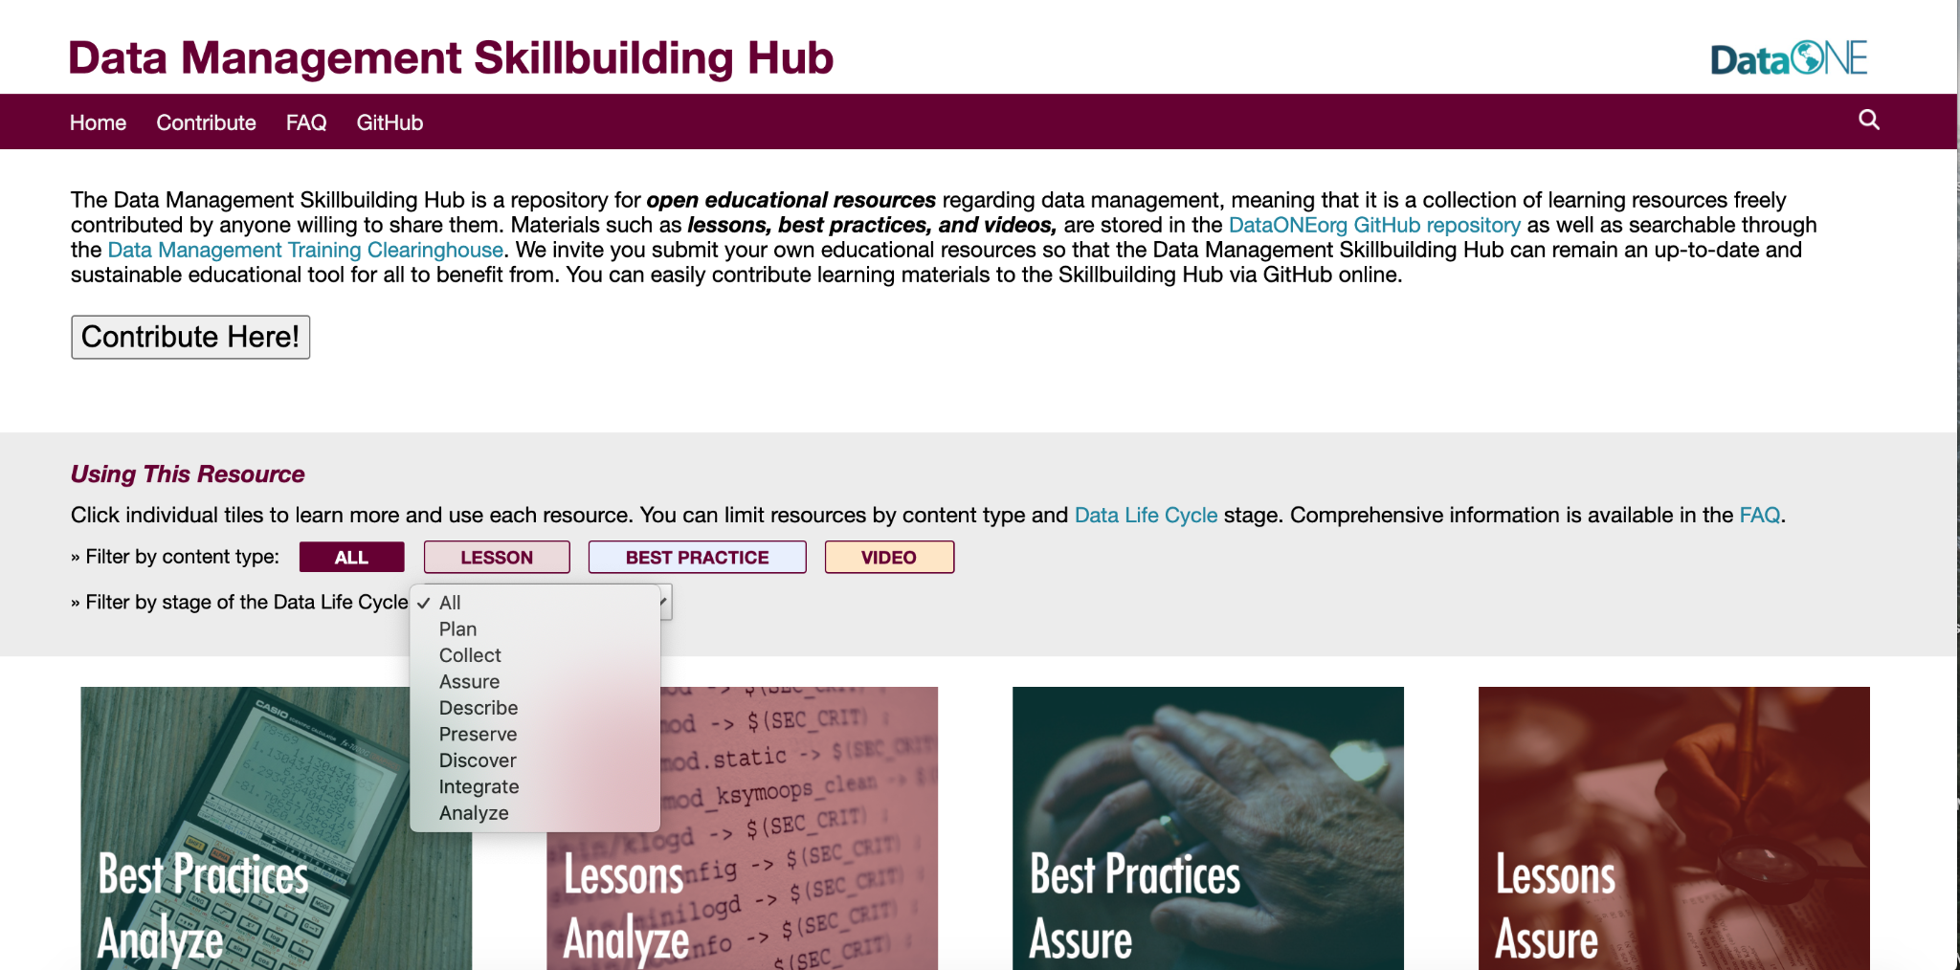
RDM
Research Data Management (RDM) concerns about processes undertaken to create and/or gather organized, documented, accessible, and reusable quality research data.
American Library Association. (April 17, 2018). Keeping Up With… Research Data Management. Retrieved from:http://www.ala.org/acrl/publications/keeping_up_with/rdm
https://dataoneorg.github.io/Education/

Slide 22
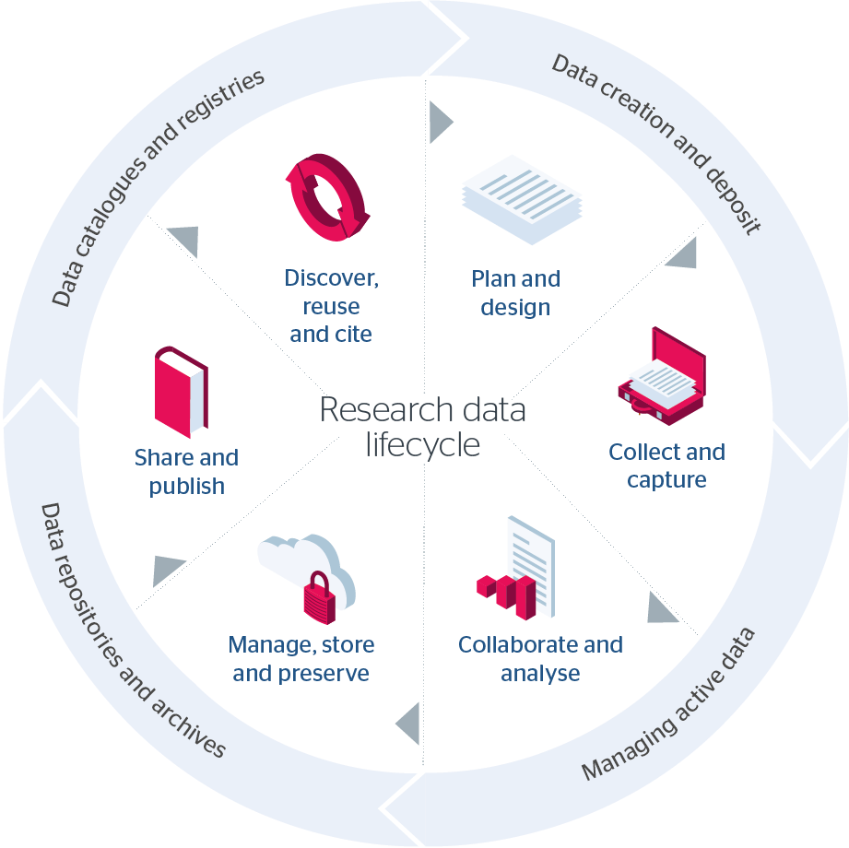
Research Data Literacy & RDM
Research Data Literacy can be concretely achieved through the development of competencies and skills connected to different stages of the research data lifecycle
Diagram:
Jisc ([2021]). Research Data Management Toolkit. Retrieved from: https://rdmtoolkit.jisc.ac.uk/research-data-lifecycle/

Slide 23
Topic Examples
IRB, DMPs, instrument design...
Data entry/input, handling missing data...
Data transformation, data cleaning, data visualization, version control...
File naming and organization, data documentation and metadata...
Licensing, de-identification, FAIR and CARE principles...
Data source identification, selection and attribution...
6
1
5
2
4
3

Slide 24
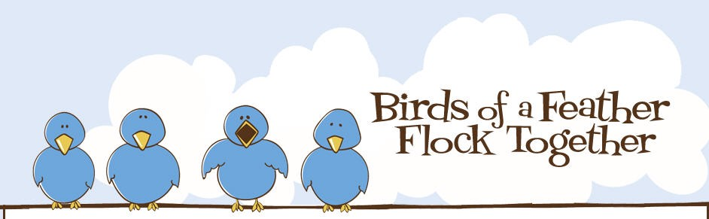
Breakouts
We have arranged breakout rooms to concentrate people who expressed familiarity with these Carpentries:
Room 1: Python
Software: Plotting and Programming in Python
Room 2: R
Data: Data Analysis and Visualization with R for Social Scientists
Room 3: Bash / Unix
Software: The UNIX Shell
Room 4: Open Refine
Library: Open Refine
Room 5: Version Control / Git
Version Control with Git
https://medium.datadriveninvestor.com/

Slide 25
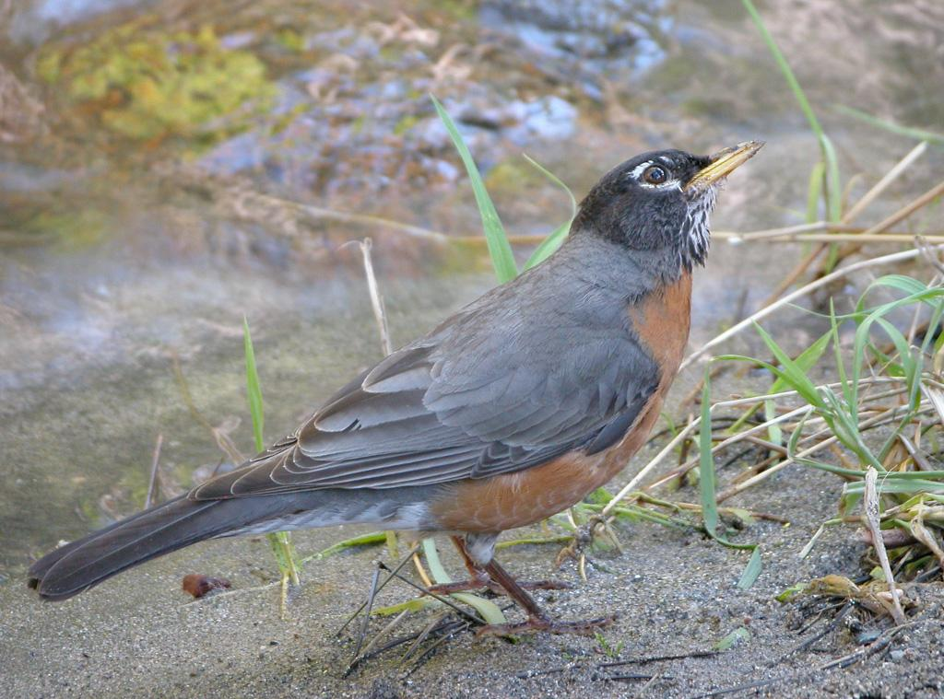
Breakout 1
What data literacy/RDM topics can and should we be teaching?
We = librarians, curators, facilitators

Slide 26

BREAK
Return at 1:55pm PST

Slide 27
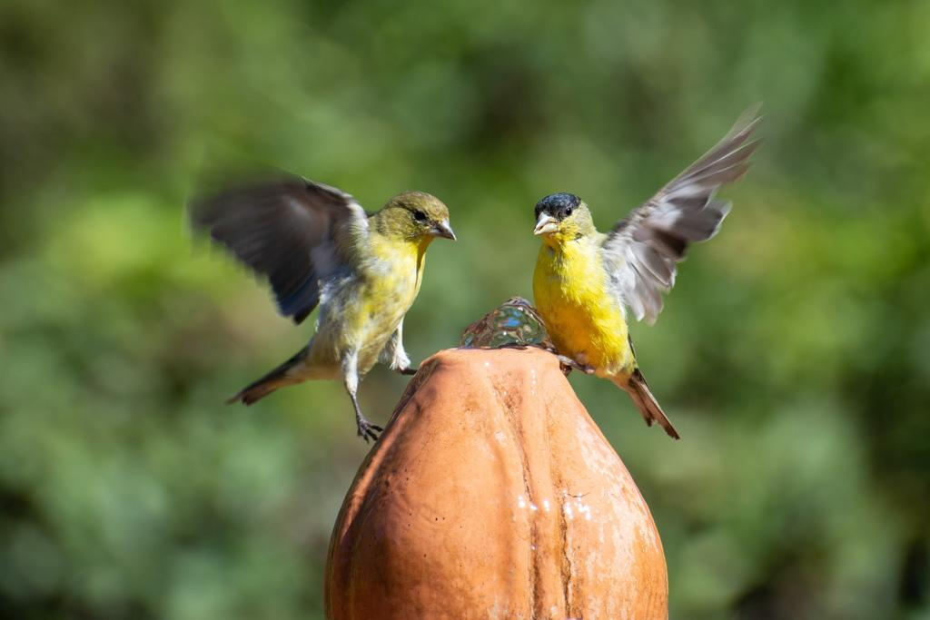
Challenges
Specifically with Carpentry lessons:
Too much material for the time allotted (always)
Heavy emphasis on hands-on activity
Cognitive load; saturation

Slide 28

Breakout 2
Where are how can these topics be taught?
Within Carpentries?
In other curricula?
How to add, augment, inject?

Slide 29
Thank you!
Renata Curty <rcurty@ucsb.edu> Jon Jablonski <jonjab@ucsb.edu> Greg Janée <gjanee@ucsb.edu> Kristi Liu <ksliu@ucsb.edu> Torin White <whitet@ucsb.edu>

