Slide 1
Launching a UCSB research data community
Greg Janée & Renata Curty

Slide 2
Motivation
Lack of awareness of Library offerings
“You have a data repository?”
Lack of coordination/collaboration
“You’re also teaching Carpentry workshops?”
Lack of shared knowledge
“What’s ‘FAIR’ data? What’s preservation storage?”

Slide 3
Community mechanics
Kickoff meeting
Host monthly meeting
Generate discussion topics, guest speakers
Offer time for member updates
Slack channel
Mailing list
Shared calendar

Slide 4
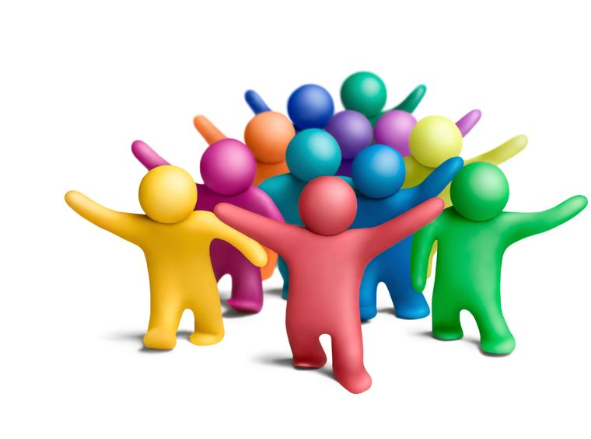
Community representation
Bren School of Environmental Science & Management
Center for Scientific Computing
Cheadle Center for Biodiversity & Ecological Restoration
Chemistry and Biochemistry IT
Computer Science
Data Science Initiative
Department of Statistics and Applied Probability
Earth Research Institute
Enterprise Technology Services
Interdisciplinary Research Collaboratory
Letters & Science IT
Library IT
Life Sciences Computing Group
Marine Sciences
Media Arts and Technology IT
National Center for Ecological Analysis and Synthesis
Office of Education Partnerships
Office of Research
Research Data Services

Slide 5

Meeting topics to date
Curation services and workflow (*)
Data repositories (current, planned) and use cases
Data science education
Data support staffing (positions, titles, job duties, funding)
Desired resources and services from a faculty perspective (*)
Electronic lab notebooks
Gaps in data-related services
Research computing and data capabilities
Scientific reproducibility and containerization (*)
(*) Indicates guest speaker

Slide 6
Where we’re at
Positive
Small cohort shows up regularly
Increased visibility for Library
Challenges
Limited participation overall
Limited contribution to discussion, new topics
No coordination/collaboration on instruction yet
Question for panel
How to broaden participation?

