Slide 1
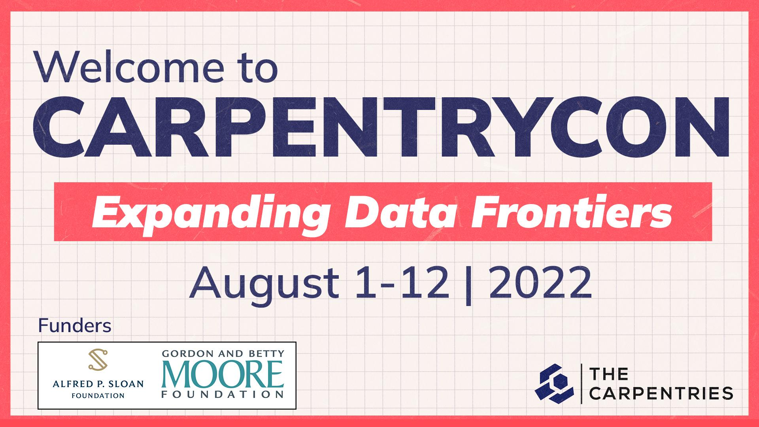

Slide 2
Incorporating
Data Literacy Topics
Into Carpentry Lessons
2022-08-03
Carpentry Con 2022
Notes:
Share etherpad link: https://pad.carpentries.org/cc2022-incorporating-data-literacy
Ask attendees to check-in so that we can follow-up with them.

Slide 3
UCSB Library Carpentry Program
In 4th year
35 workshops, 400+ learners from 30+ departments
Ramping up to 8 workshops per quarter
Notes:
We’re from the UCSB Library, and have been building up a Carpentry program over the last few years. Lots of demand, which keeps us wanting to do more! But what we find most gratifying is the range of departments the learners are coming from… almost every department on campus.

Slide 4
Our workshops
Canonical lessons
  R, Python, Git/Bash, OpenRefine, SQL, …
Helping beta testing new lessons
  Geospatial data using R
  Machine learning for tabular data in R
Developing new lessons
  Reproducible publications with RStudio
  Harvesting Twitter with Twarc
Notes:
We’ve taught a number of the canonical Carpentry lessons (drawn from software, data, and library carpentries), have helped beta-test some new lessons, and have tried our own hand and developing lessons. We’re not claiming to be Carpentry experts – the breadth of lessons is so great – but we’ve gotten pretty familiar with the Carpentry style and some of the commonly-taught lessons.

Slide 5
CARPENTRIES
Tools
Techniques
Skills
DATA LITERACY
Assessment
Interpretation
Applications
Uncertainty & limits
Communication, incl. visualization
Ethics
RESEARCH DATA MANAGEMENT
Open science & transparency
Reproducibility
Citation
Documentation
FAIR data
Notes:
As librarians in a research university, we’re interested in teaching tools and skills, certainly, but we’re also interested in teaching other, related topics that (we believe) are vital to modern scholarship and relevant to students and new researchers. These topics are touched in the Carpentry lessons now in various places, but we find ourselves wishing more substantial and standardized treatment was given to them.
And that’s the motivation for this workshop: a discussion about what, where, and how topics from data literacy and research data management might be incorporated into the Carpentries. We have a particular idea we want to share with you later, but first we want to do some brainstorming. And before that, we’d like to learn a little more about where you’re from and what your experience with the Carpentries is.

Slide 6
Menti polls
Notes:
Menti Presenter Link: https://www.mentimeter.com/app/presentation/37fde3ae13af54a9c7457a0072f03ba9/ac901165bb7c
What role(s) do you play in Carpentries?
What lesson(s) are you familiar with?

Slide 7
Workshop Agenda
Intro (Who are we and Motivation)
Menti polls (Getting to know you a bit)
Jam board - Data Literacy (All)
Our ideas (Data Moment!)
Jam board (Breakout Rooms)
Reporting
Wrap-up

Slide 8
Jam board (All)
Notes:
Link: https://jamboard.google.com/d/17COZdz76HyhLEf4dbRphTJofeG3EmXWhgxUpUjL5qC4/edit?usp=sharing
What does data literacy mean to you in terms of required skills?
Are you teaching such topics? If so, how?

Slide 9
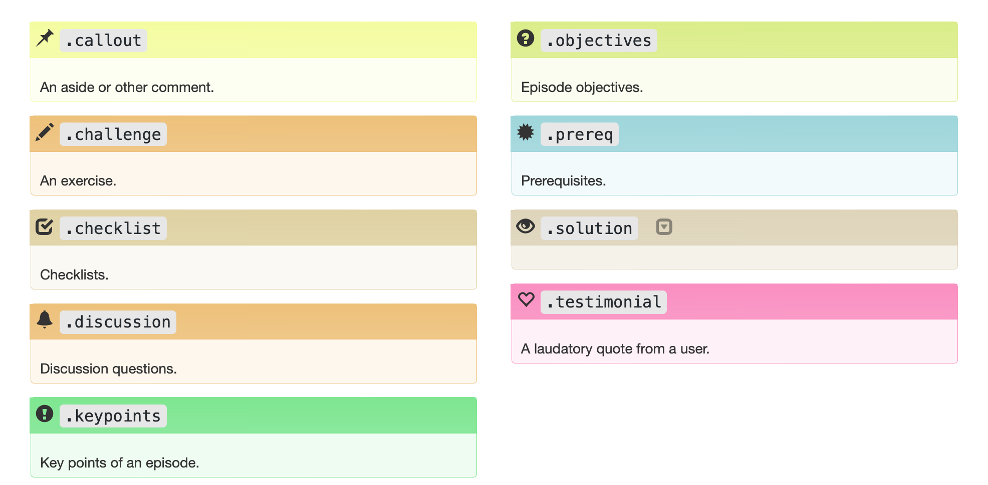
Idea: build on callout mechanism
Notes:
Here’s an idea we’ve been experimenting with: adding additional, stylized callouts. Here are the formatting callouts from the old Carpentry styling.

Slide 10
Idea: build on callout mechanism
Add:
“Data moment”
“Ethics moment”
Notes:
We might have two kinds of callouts: “data moments”, that address some data literacy or management topic, and “ethics moment”, that address ethical issues. Consistent formatting could provide a standardized way of presenting additional information. As is true when delivering any Carpentry lesson, there’s not necessarily time to delve into these topics. But the information is there, part of the lesson, available for followup or reference. Some concrete examples follow.

Slide 11
Some Examples

Slide 12
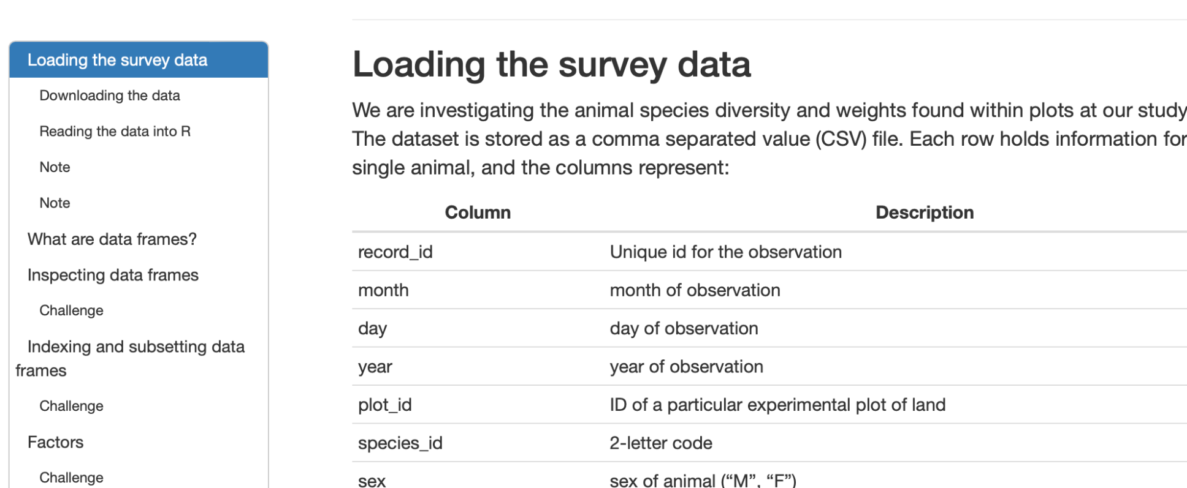
Data Moment 1: Documentation
Lesson: Data Analysis and Viz in R for Ecologists
Episode: Starting with Data
Notes:
This should look entirely familiar: students download a dataset as part of the workshop setup, then at some point in the lesson load it and start working with it. This is where the data is loaded in the R for Ecologists lesson. The lesson helpfully describes what the data is.

Slide 13
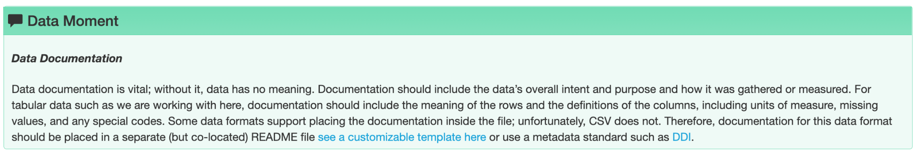
Data Moment 1: Documentation
Lesson: Data Analysis and Viz in R for Ecologists
Episode: Starting with Data
Notes:
But there’s so much more to say here. In real life, data is not just handed to you. It must be found, and then assessed and often transformed. Documentation is important for both assessment and reuse. And there are other, relevant topics such as licensing and citation.
We’re playing with the idea of a new category of callout box, which we dub a “data moment.” The callout box here touches just on documentation. We emphasize that we are not criticizing this lesson or any other Carpentry lesson. Rather, we’re proposing a standardized way of incorporating additional topics where they are most relevant.
Several other examples will follow.

Slide 14
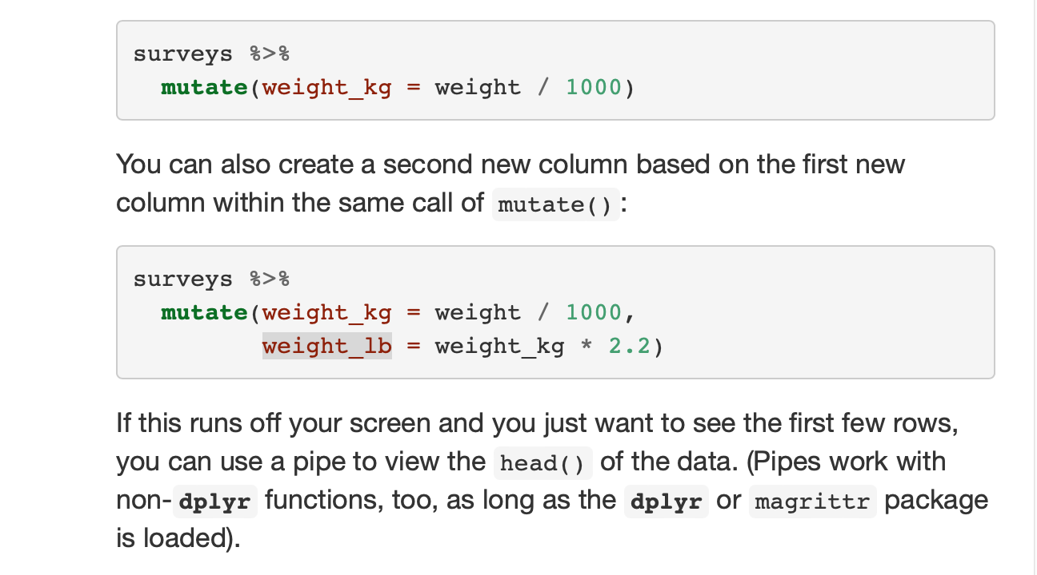
Data Moment 2: Accuracy and Precision
Lesson: Data Analysis and Viz in R for Ecologists
Episode: Starting with Data
Notes:
This would be a data moment after weight_lb is computed

Slide 15
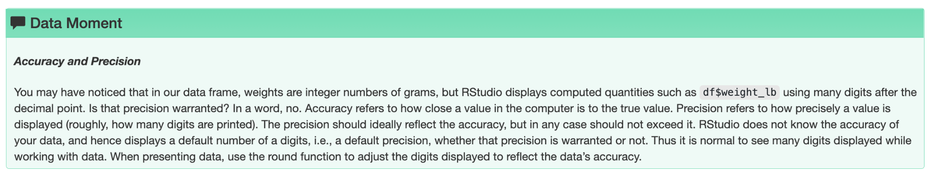
Data Moment 2: Accuracy and Precision
Lesson: Data Analysis and Viz in R for Ecologists
Episode: Starting with Data
Notes:
This would be a data moment after weight_lb is computed

Slide 16
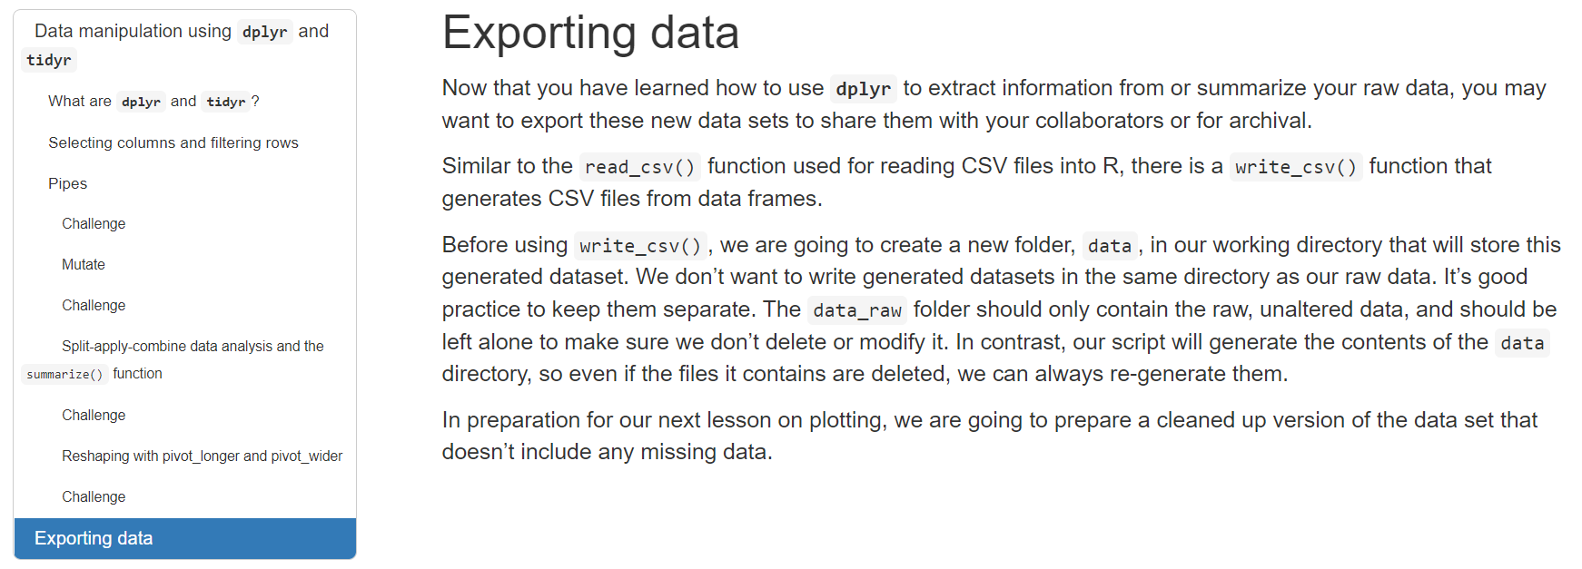
Data Moment 3: Citation
Lesson: Data Analysis and Viz in R
Episode: Manipulating, analyzing and exporting data with tidyverse

Slide 17
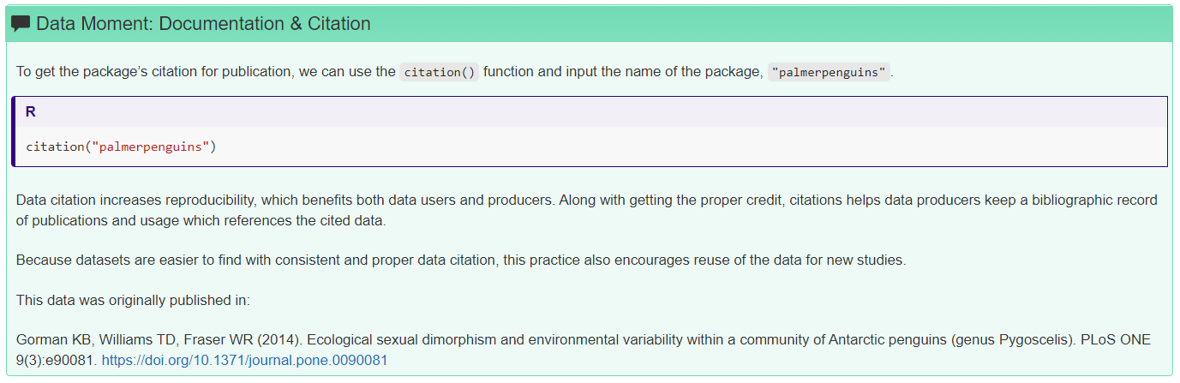
Data Moment 3: Citation
Lesson: Data Analysis and Viz in R
Episode: Manipulating, analyzing and exporting data with tidyverse

Slide 18
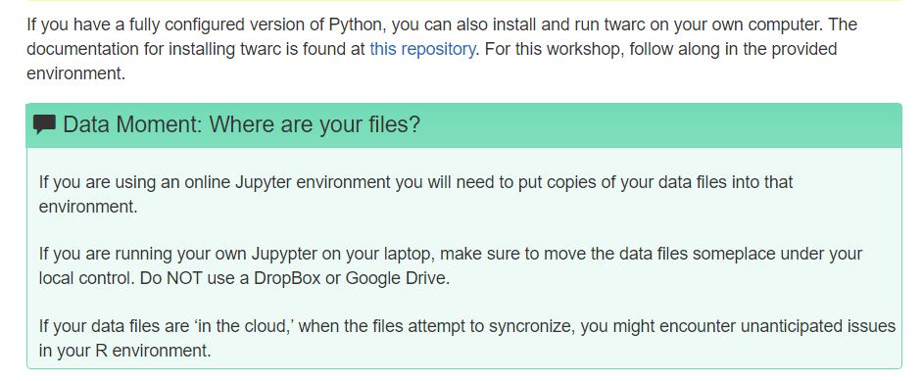
Data Moment 4: Where’s your Data?
Harvesting Twitter with twarc

Slide 19
A common problem
Learners often do not know where their files are located, and this continues to get MORE complicated
Microsoft’s OneDrive arrives with a user’s Desktop configured as a cloud drive by default. DropBox and other file sharing services often do the same.
Learners are ‘searchers’ not ‘sorters’

Slide 20
Future work on twarc Incubator lesson
Harvesting Twitter with twarc
Designed to reinforce concepts from
Intro to BASH and Python with Jupyter.
Episode 5 started as ‘Ethical Concerns and Twitter.’ After first offering, we will insert one concern into each episode and rename ep. 05 ‘Getting started with NLP’

Slide 21
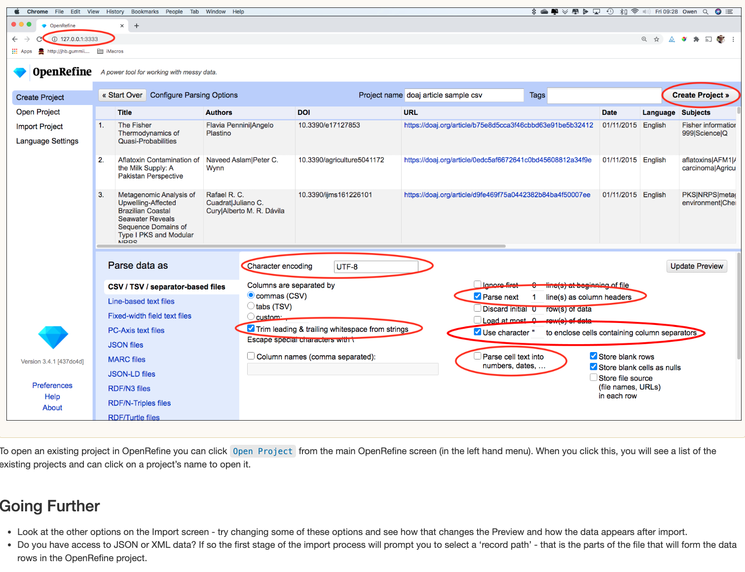
Data Moment 5: Quality Assessment
Lesson: OpenRefine (Library Carpentry)
Episode: Importing Data into OpenRefine
Notes:
Because carpentry workshops are designed around vetted and pre-selected datasets, not too rarely, we move from software installation straight to importing the dataset and working with data without much explanation about the dataset nor discussion about its composition and limitations. We envision an opportunity to educate learners about quality assessment and at least plant the seed on key principles/features that one should verify before making the decision to reuse a dataset. Essentially, this content could be added to many lessons, but we have crafted an example for the LC Open Refine curriculum.

Slide 22
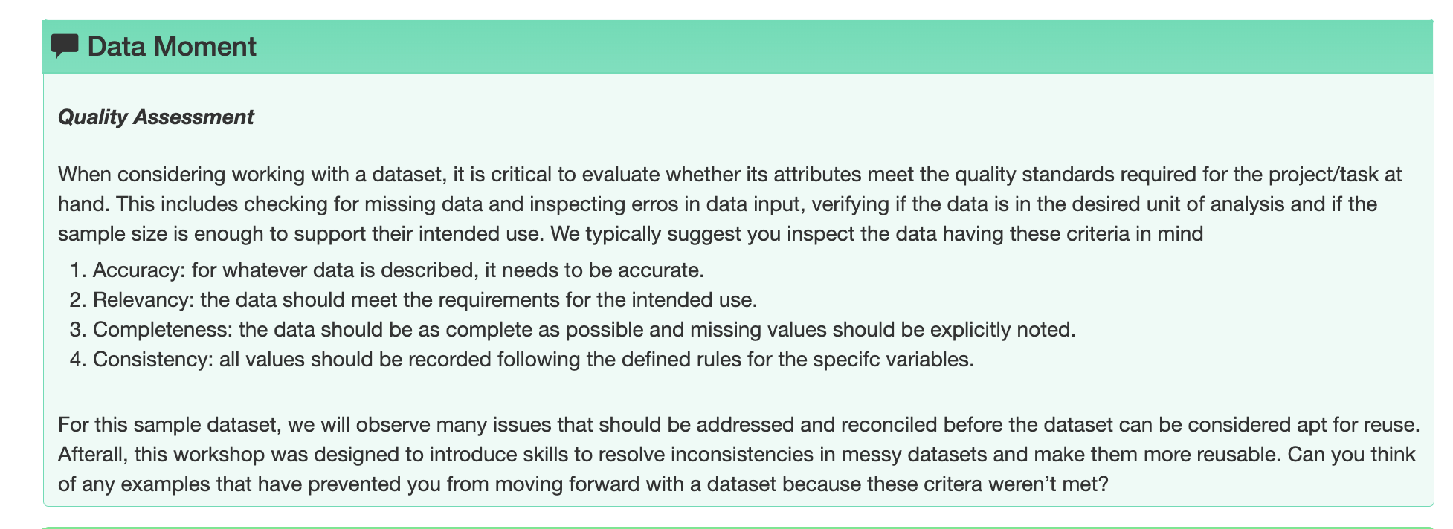
Data Moment 5: Quality Assessment
Lesson: OpenRefine (Library Carpentry)
Episode: Importing Data into OpenRefine

Slide 23
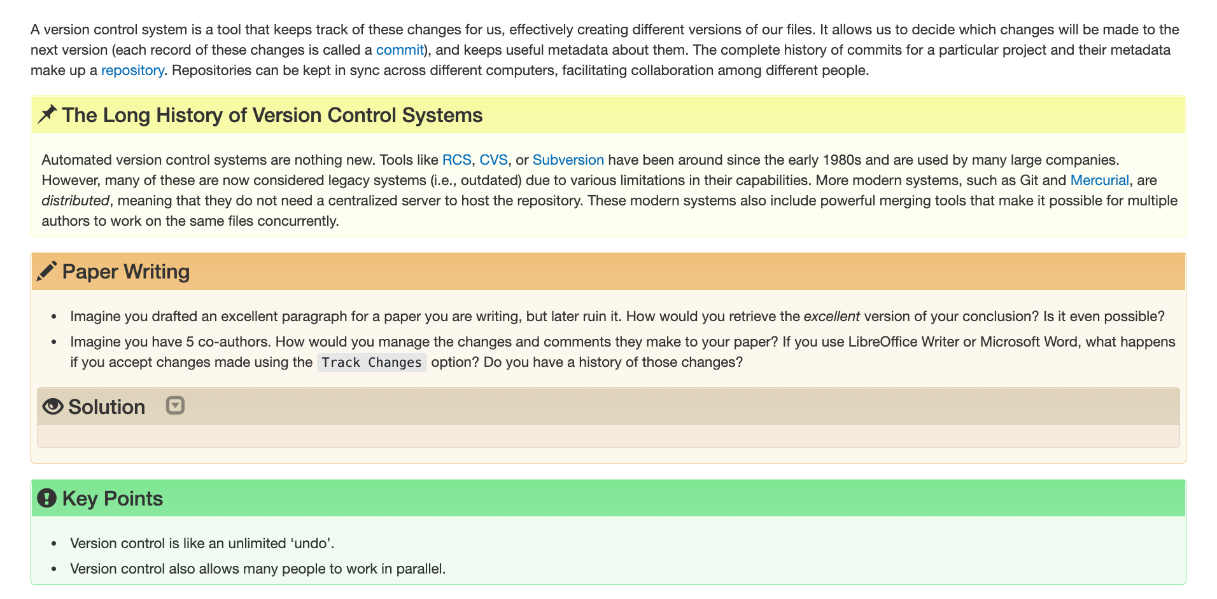
Data Moment 6: File Naming
Lesson: Version Control with Git
Episode: Automated Version Control
Notes:
Ep. 1 on Version control presents the importance of having files synced and tracking their history. It also presents scenarios when collaboration can be a challenge. We see an opportunity to also instill the value of adopting file naming conventions and refer learners to resources on best practices. Even though the workshop is designed around examples and preset names for the files, learners can benefit from this data moment when working on their own projects.

Slide 24
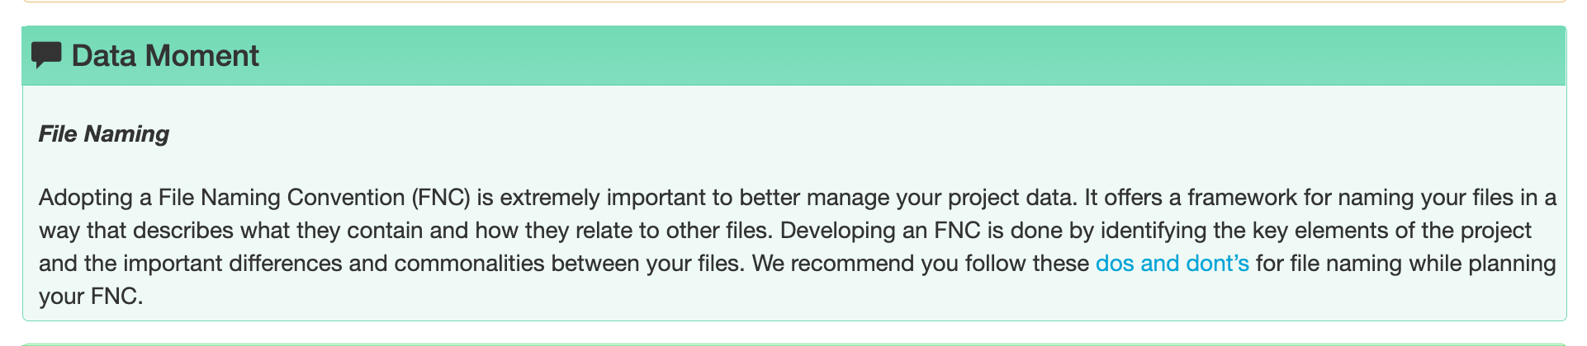
Data Moment 6: File Naming
Lesson: Version Control with Git
Episode: Automated Version Control

Slide 25
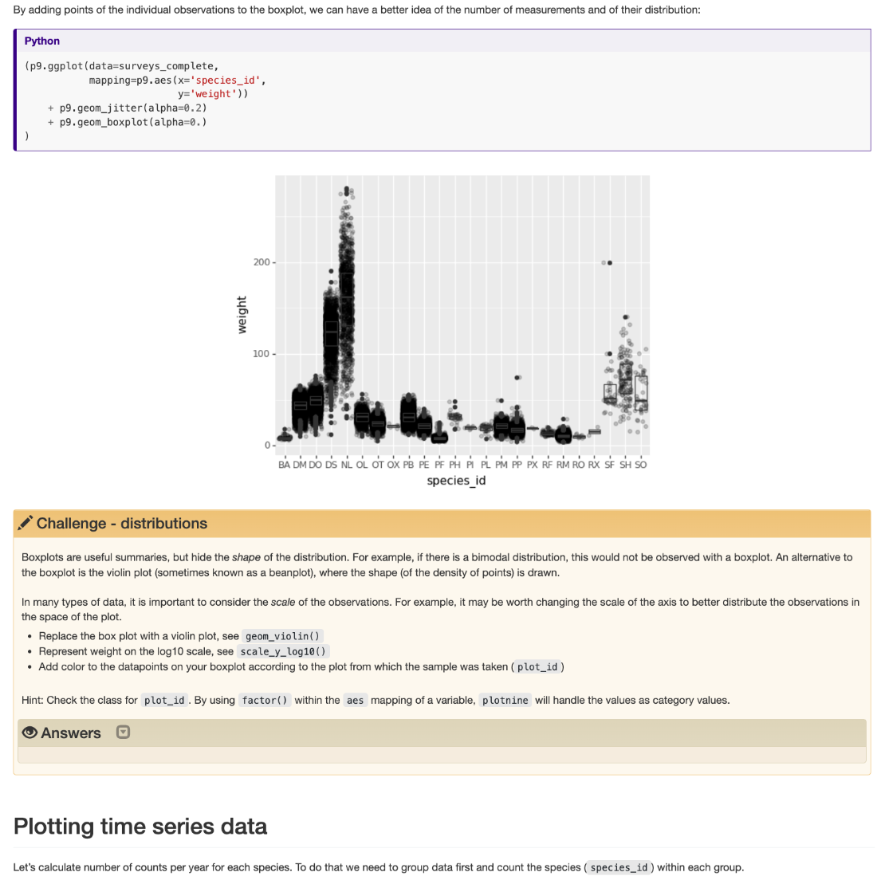
Data Moment 7: Communicate your data more effectively
Lesson: Data Analysis and Visualization in Python for Ecologists
Episode: Making Plots With Plotnine
Notes:
When introducing data visualization to learners, there is an opportunity to briefly expand the explanation beyond the mechanics of plotting by adding the importance of be mindful that some graphs will have limitations to visually represent the data and that consideration should be put into the best option available.

Slide 26
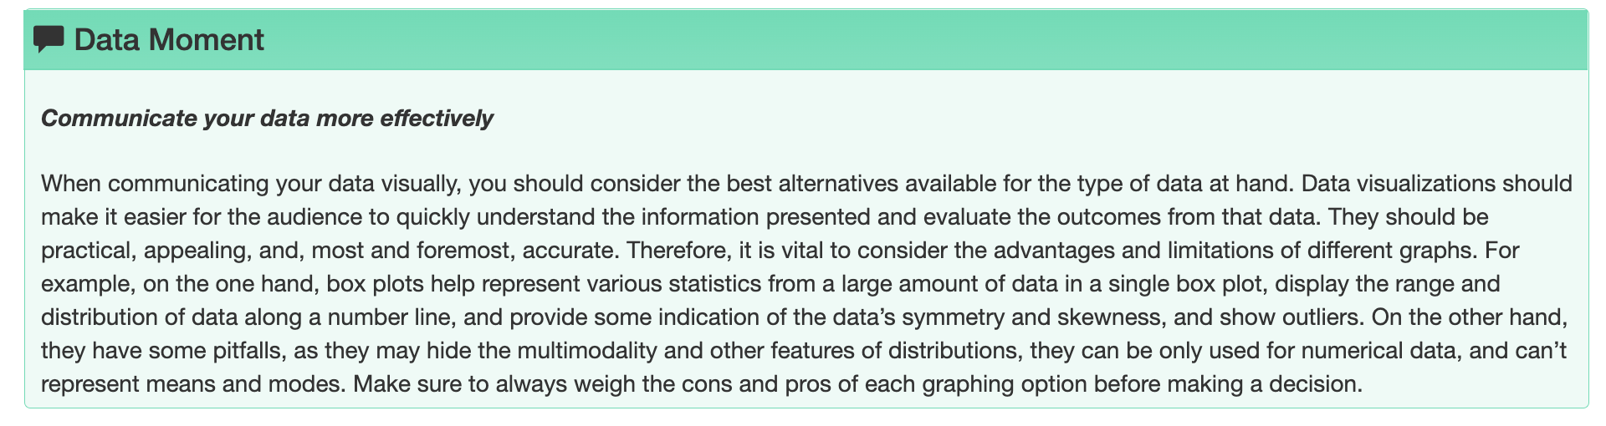
Data Moment 7: Communicate your data more effectively
Lesson: Data Analysis and Visualization in Python for Ecologists
Episode: Making Plots With Plotnine
Notes:
There is an opportunity to briefly expand the explanation on graphs beyond the mechanics of plotting by adding the importance of be mindful that some graphs will have limitations to visually represent the data and that consideration should be put into the best option available.

Slide 27
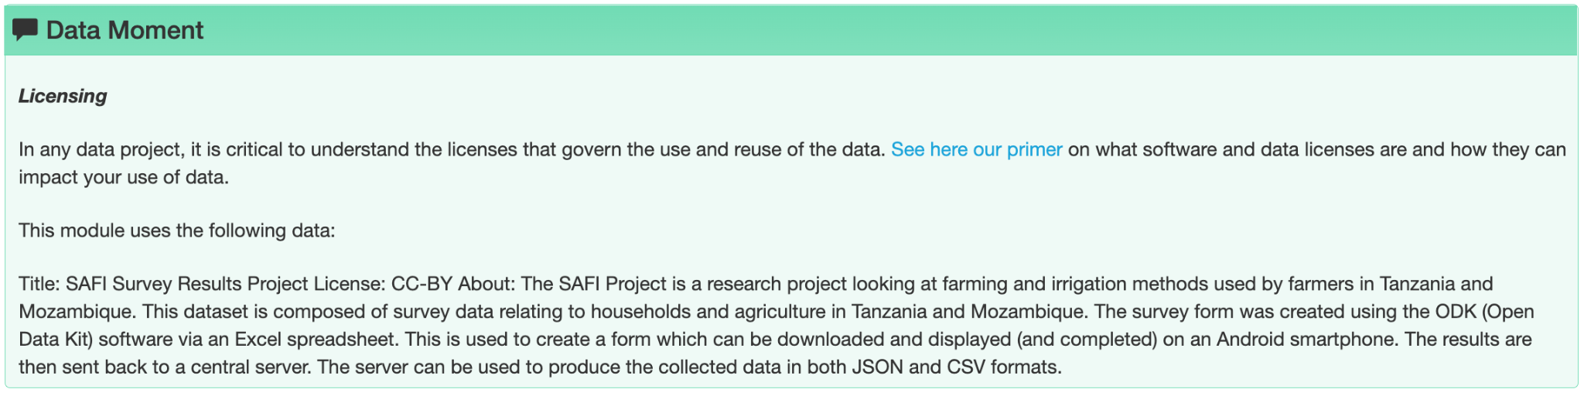
Data Moment 8: Licensing
Lesson: R for Social Scientists
Episode: Starting with Data

Slide 28
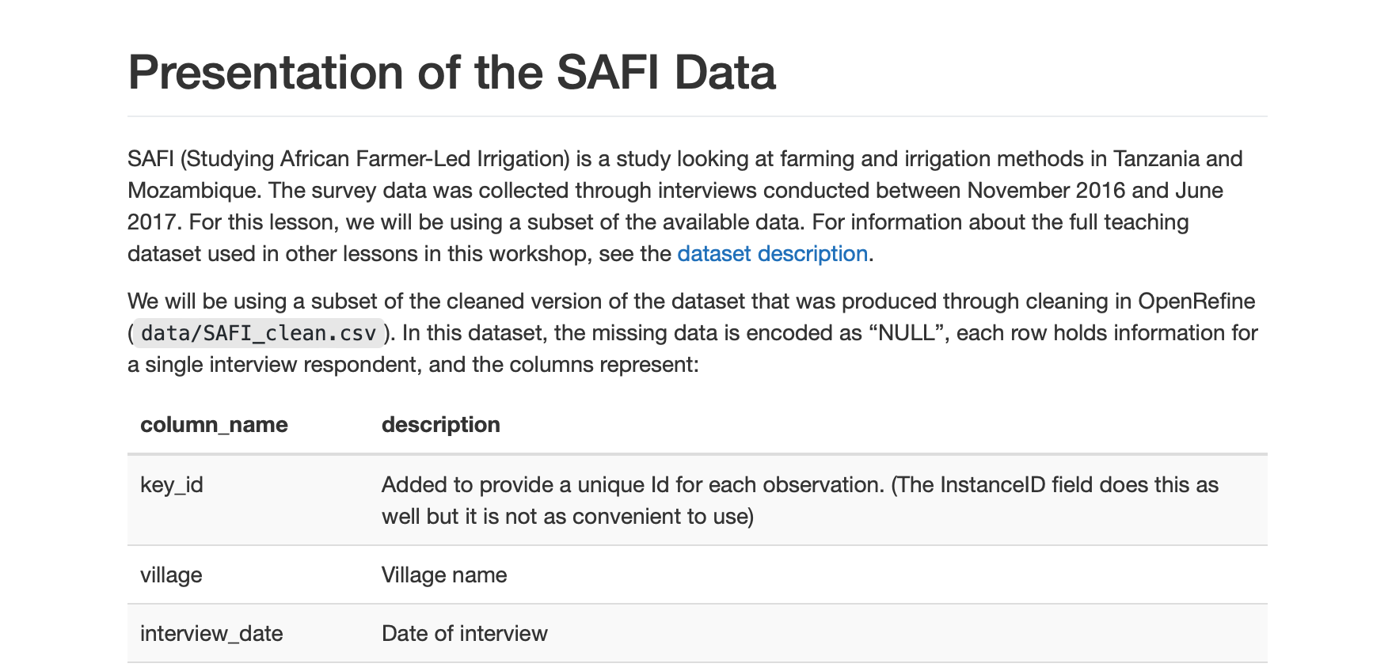
Data Moment 9: Ethics
Lesson: R for Social Scientists
Episode: Starting with Data
Notes:
Open this one to discussion

Slide 29
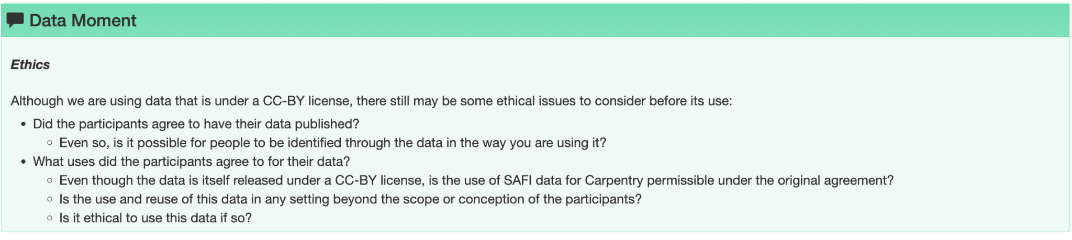
Data Moment 9: Ethics
Lesson: R for Social Scientists
Episode: Starting with Data
Notes:
Open this one to discussion

Slide 30
Jam board (Breakout Rooms)
Notes:
(Choose your Group # and Designate a Note Taker and Reporter)
Link: https://jamboard.google.com/d/1kxhsp6Bcw93CNGJPv6or2aLdGDpmOu0ArM9l1qa-Ypg/edit?usp=sharing
What topics would you add, where, and how?
What could be the next steps?

Slide 31
Thank you!
We hope to stay connected!
rds@library.ucsb.edu
dreamlab@library.ucsb.edu

