Slide 1
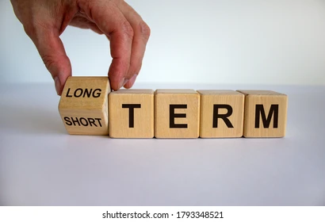
Curation of ongoing and long-running projects
Greg Janée & Renata Curty
UCSB Library - Research Data Services
University of California, Santa Barbara

Slide 2

Common research data lifecycle
Curation workflows are often built on a “default” research data lifecycle
Researcher…
starts project
creates/gathers data
submits the data
Data is published and researcher is done with the data
DMP consultation!
Curation!
Ethical. Reusable. Better.
datacurationnetwork.org
Notes:
Barring an initial DMP consultation, curator/curation involvement often only occurs at the end of a project, when the researcher is “done” with their data. This stereotypical workflow is reflected in the tools we use. Researcher works on data somewhere on their own (unrelated to repository), deposits data in repository, said data is curated, and then the researcher never looks at that data again (at least as it exists in the repository). The repository is for others to find/access the data, but is of little to no value to the original researcher.

Slide 3

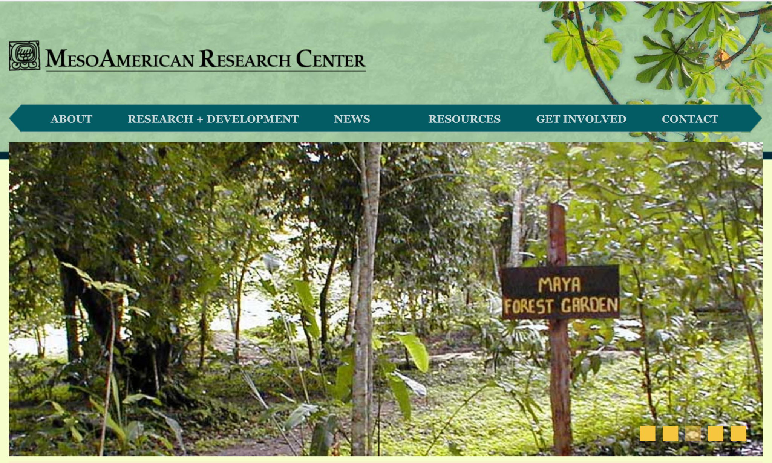

But not all workflows look like this…
Data collected over the course of a researcher’s career
Research labs and ongoing projects
Long-running field monitoring sites
Ethical. Reusable. Better.
datacurationnetwork.org
Notes:
But there are cases when researchers are never quite “done” with their data. We don’t have time to delve into these cases, but to give a taste of what we observe:
1: Researcher who, over the course of their career, gathers data (recordings, transcriptions, translations, close and distant reading data) about an oral Arabic epic poem.
2: Large research lab that studies a Mayan archaeological site, gathering and generating many types of data (spatial data, photographs, field notes, artifact metadata, analyses) over many years
3: Snow monitoring site, in operation for decades, with constantly evolving instruments and data streams

Slide 4
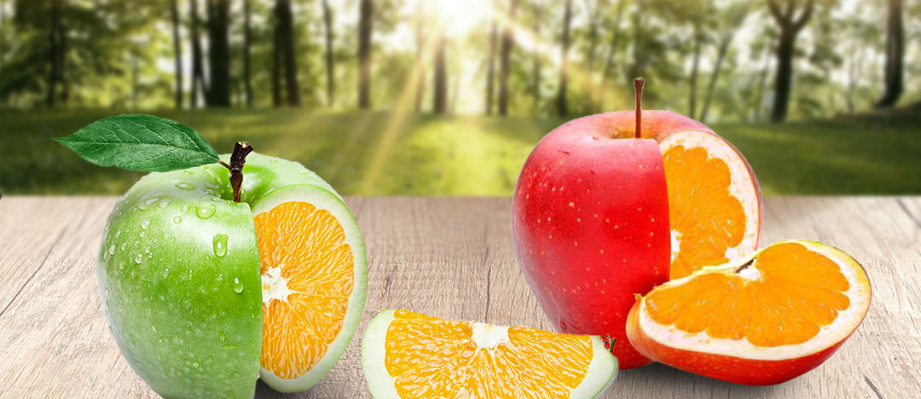
Common characteristics
There is no point at which data is “done”
Data is incrementally built up/shared/published (evolves, constant flux)
Data = collections of heterogeneous but related objects
Complex relationship between data and publications
Often highly collaborative with different people acting at various steps
Uses various tools often lacking in data repositories
Multiple types of licenses and restrictions may apply
Not necessarily grant funded
Long-lived, on the order of years/decades
Ethical. Reusable. Better.
datacurationnetwork.org
Notes:
The single most defining feature of these cases is that the data is never “done”. Rather…
Complex relationships: we’re *not* referring to the study model, as in, a research lab does study A, then study B, then study C, each with its own data. Rather, publications are based on the growing corpus of data.

Slide 5
Problem
Even today, they remain almost completely uncurated…
Lingering Questions
When and how should we offer curatorial support to such projects? With what infrastructure? How scalable?
Notes:
Greg: as I hand it off to Renata, the problem is that the data in these cases is not curated, and we curators play no real role. Which means, data is being used and is serving as the basis for publication and research for years/decades outside our idealized model.
As Greg mentioned, the workflows for such projects have some unique characteristics and we haven’t had yet the opportunity to offer curation support to them. This problem poses some questions to us: At what point(s) of the workflow should we offer curation support? What infrastructure should be offered? How can we scale our curation support?

Slide 6
Where are we at?
Evaluating solutions with the following features/requisites:
Self-deposit
Researchers to manage/partially curate their own data
Whole lifecycle
Computationally integrated
Space-making and collaborative
Pre-validation (manual and automated) and curation workflow
Incremental publication and versioning
Flexible licensing and access control
Ethical. Reusable. Better.
datacurationnetwork.org
Notes:
We are currently evaluating a few solutions considering the prerequisites listed here and which could better support the whole data lifecycle.
First we would like to favor a solution that, as our current repository, supports self-submissions.
Another important feature would be to offer integrations with tools that would allow research teams to manage and also perform some curation of their own data as they progress, based on recommendations we would provide. Ideally, this would be also a highly collaborative environment where research teams could adapt processes and use modular integrations to their own needs.
One more requisite would be a system capable of performing pre-checks and tied to a curation workflow (ideally aligned with the CURATED steps). Finally, we would like to identify a solution that supports incremental publication for growing datasets and versioning and which offers flexible licensing and access control at the file level.

Slide 7

Moving Forward
Interviews with PIs and research teams
Data management practices
Curatorial expectations
Tools and workflows
DCN Interest Group
Notes:
The prerequisites I just mentioned emerged from consultations, informal conversations, group meetings and from our own evaluation of the limitations of our current institutional repository (Dryad) to support workflows.
As a next step, we will be reaching out to PIs and their research teams from projects we have identified and conduct interviews to better understand their current data management practices, what expectations they have in terms of data curation, as well as the tools and workflows they currently use and would like to adopt. We hope to share the results with the network next year.
We take this opportunity to invite members you to discuss this topic with us, add that discussion as part of one of the existing interest groups agenda or even form a dedicated interest group to investigate how the DCN can better support curation for long-running and ongoing projects at large, as well as to collaborate in some joint deliverables as Wanda mentioned earlier today. Thanks!

