Slide 1
Transformative Developments
In the UCSB Library
Greg Janée

Slide 2
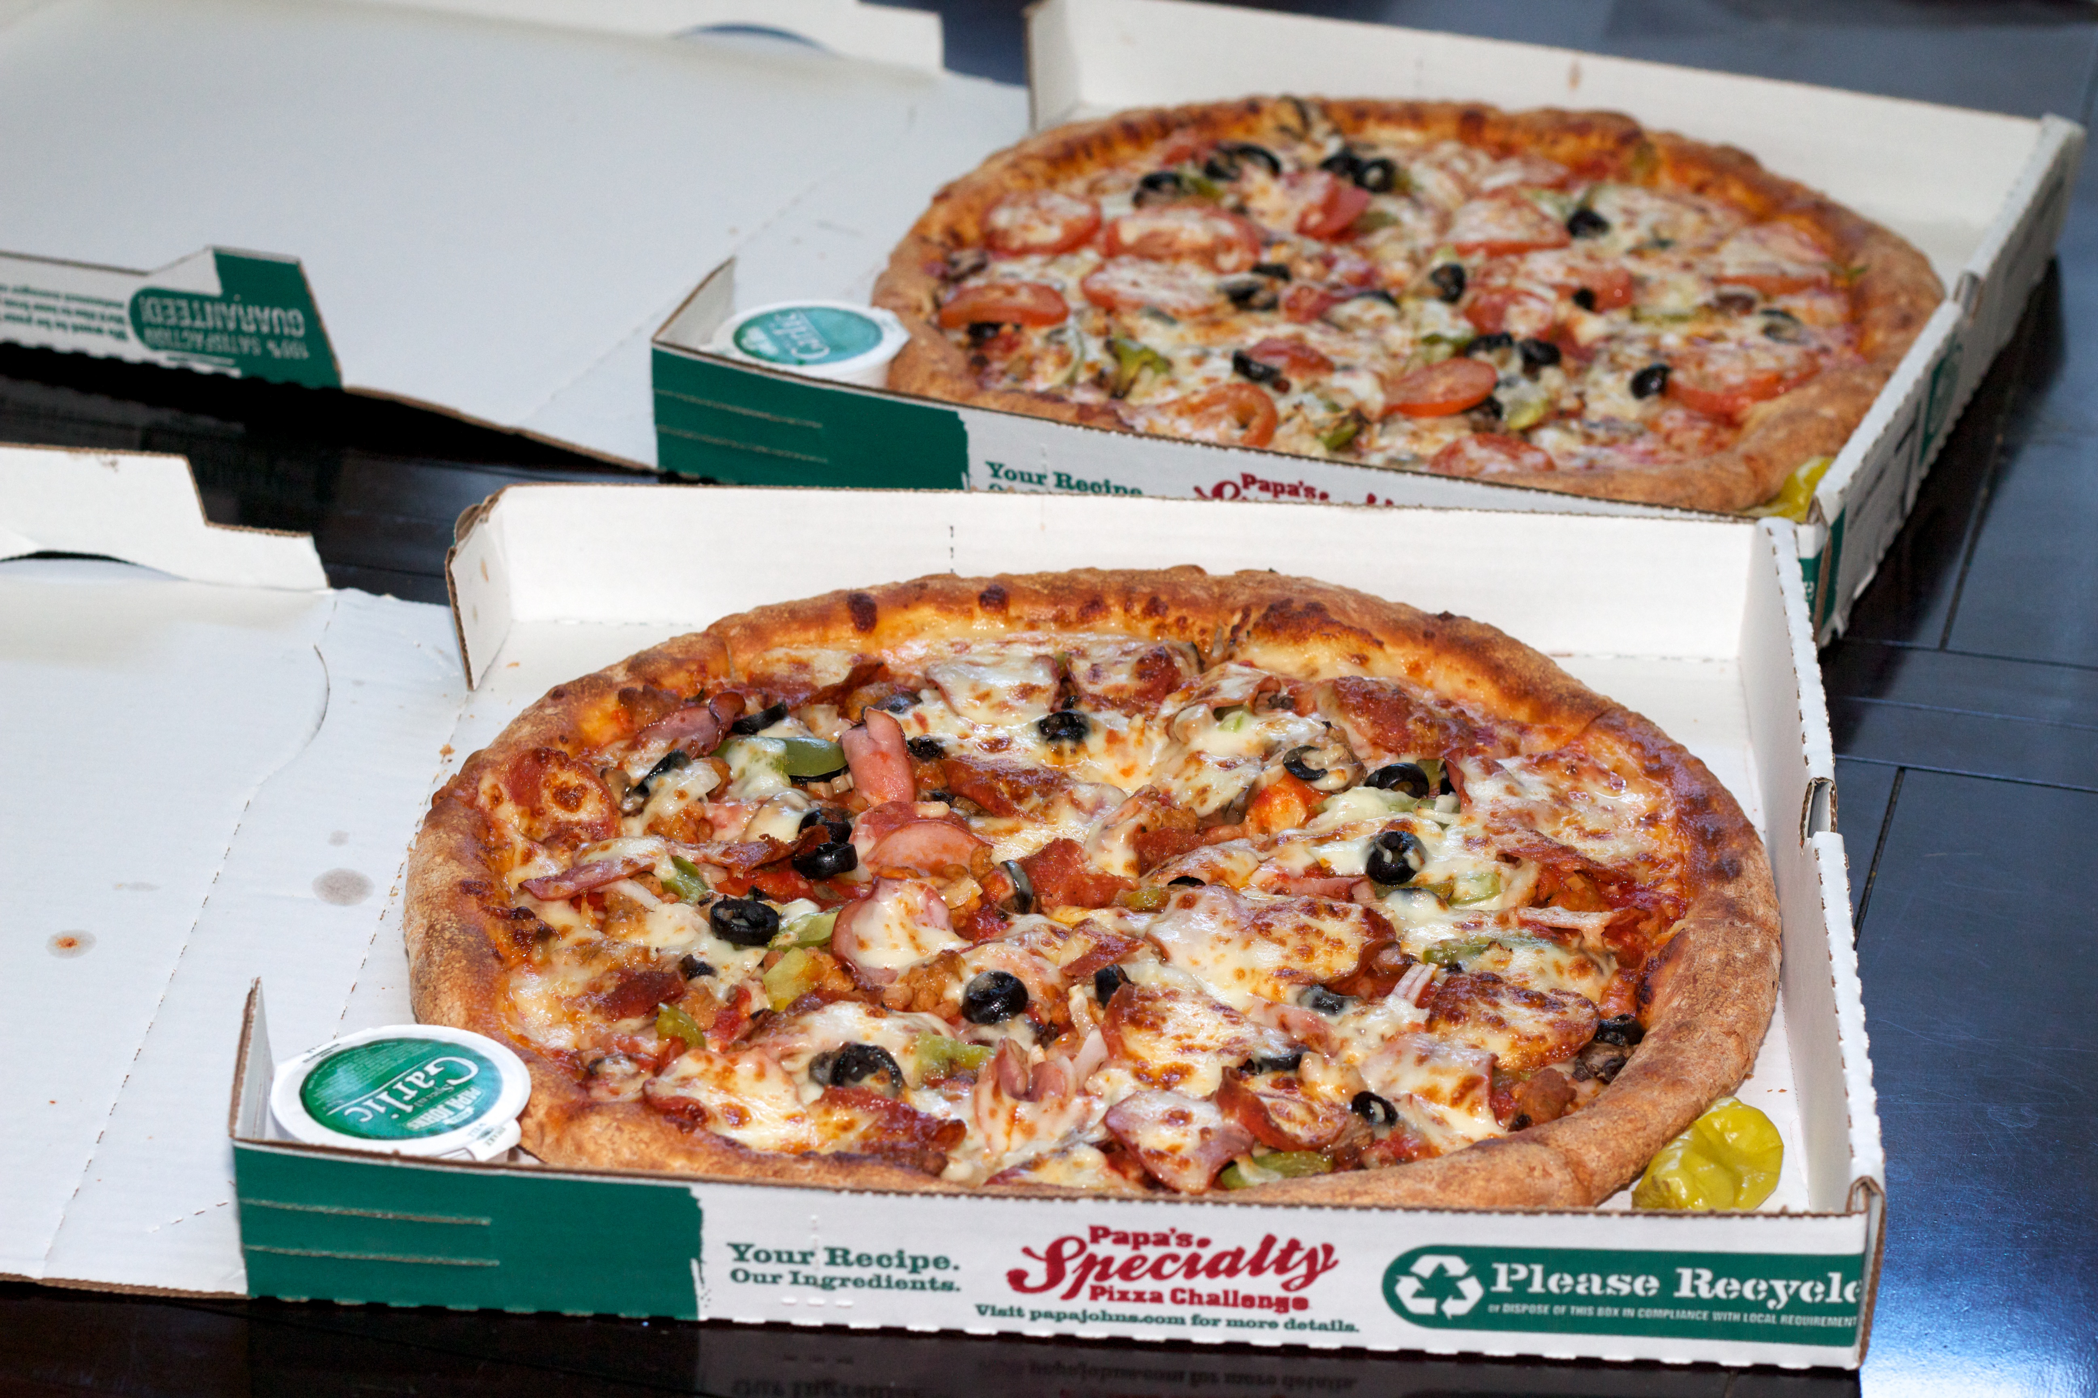

Slide 3
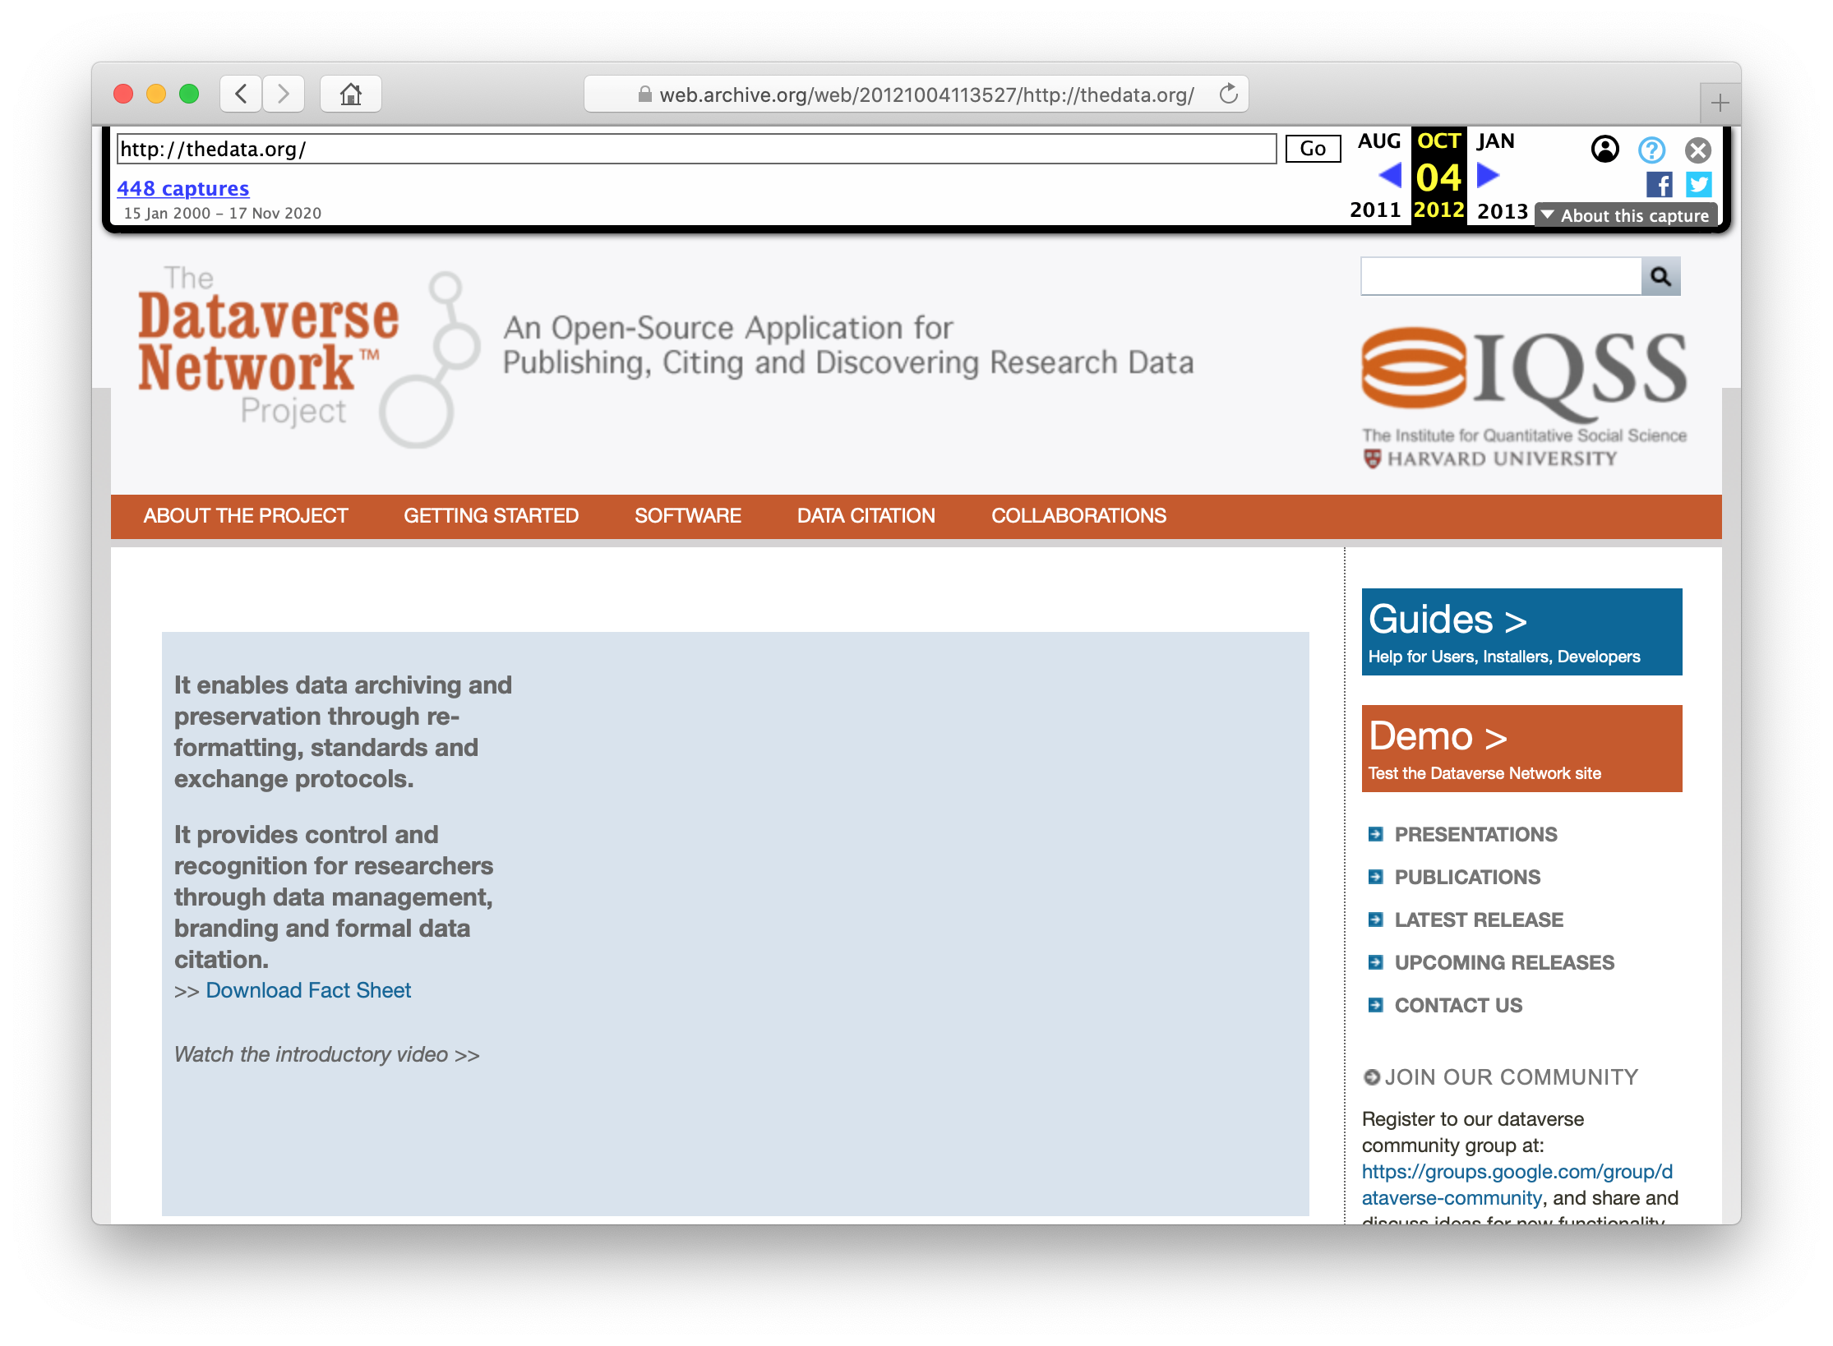

Slide 4
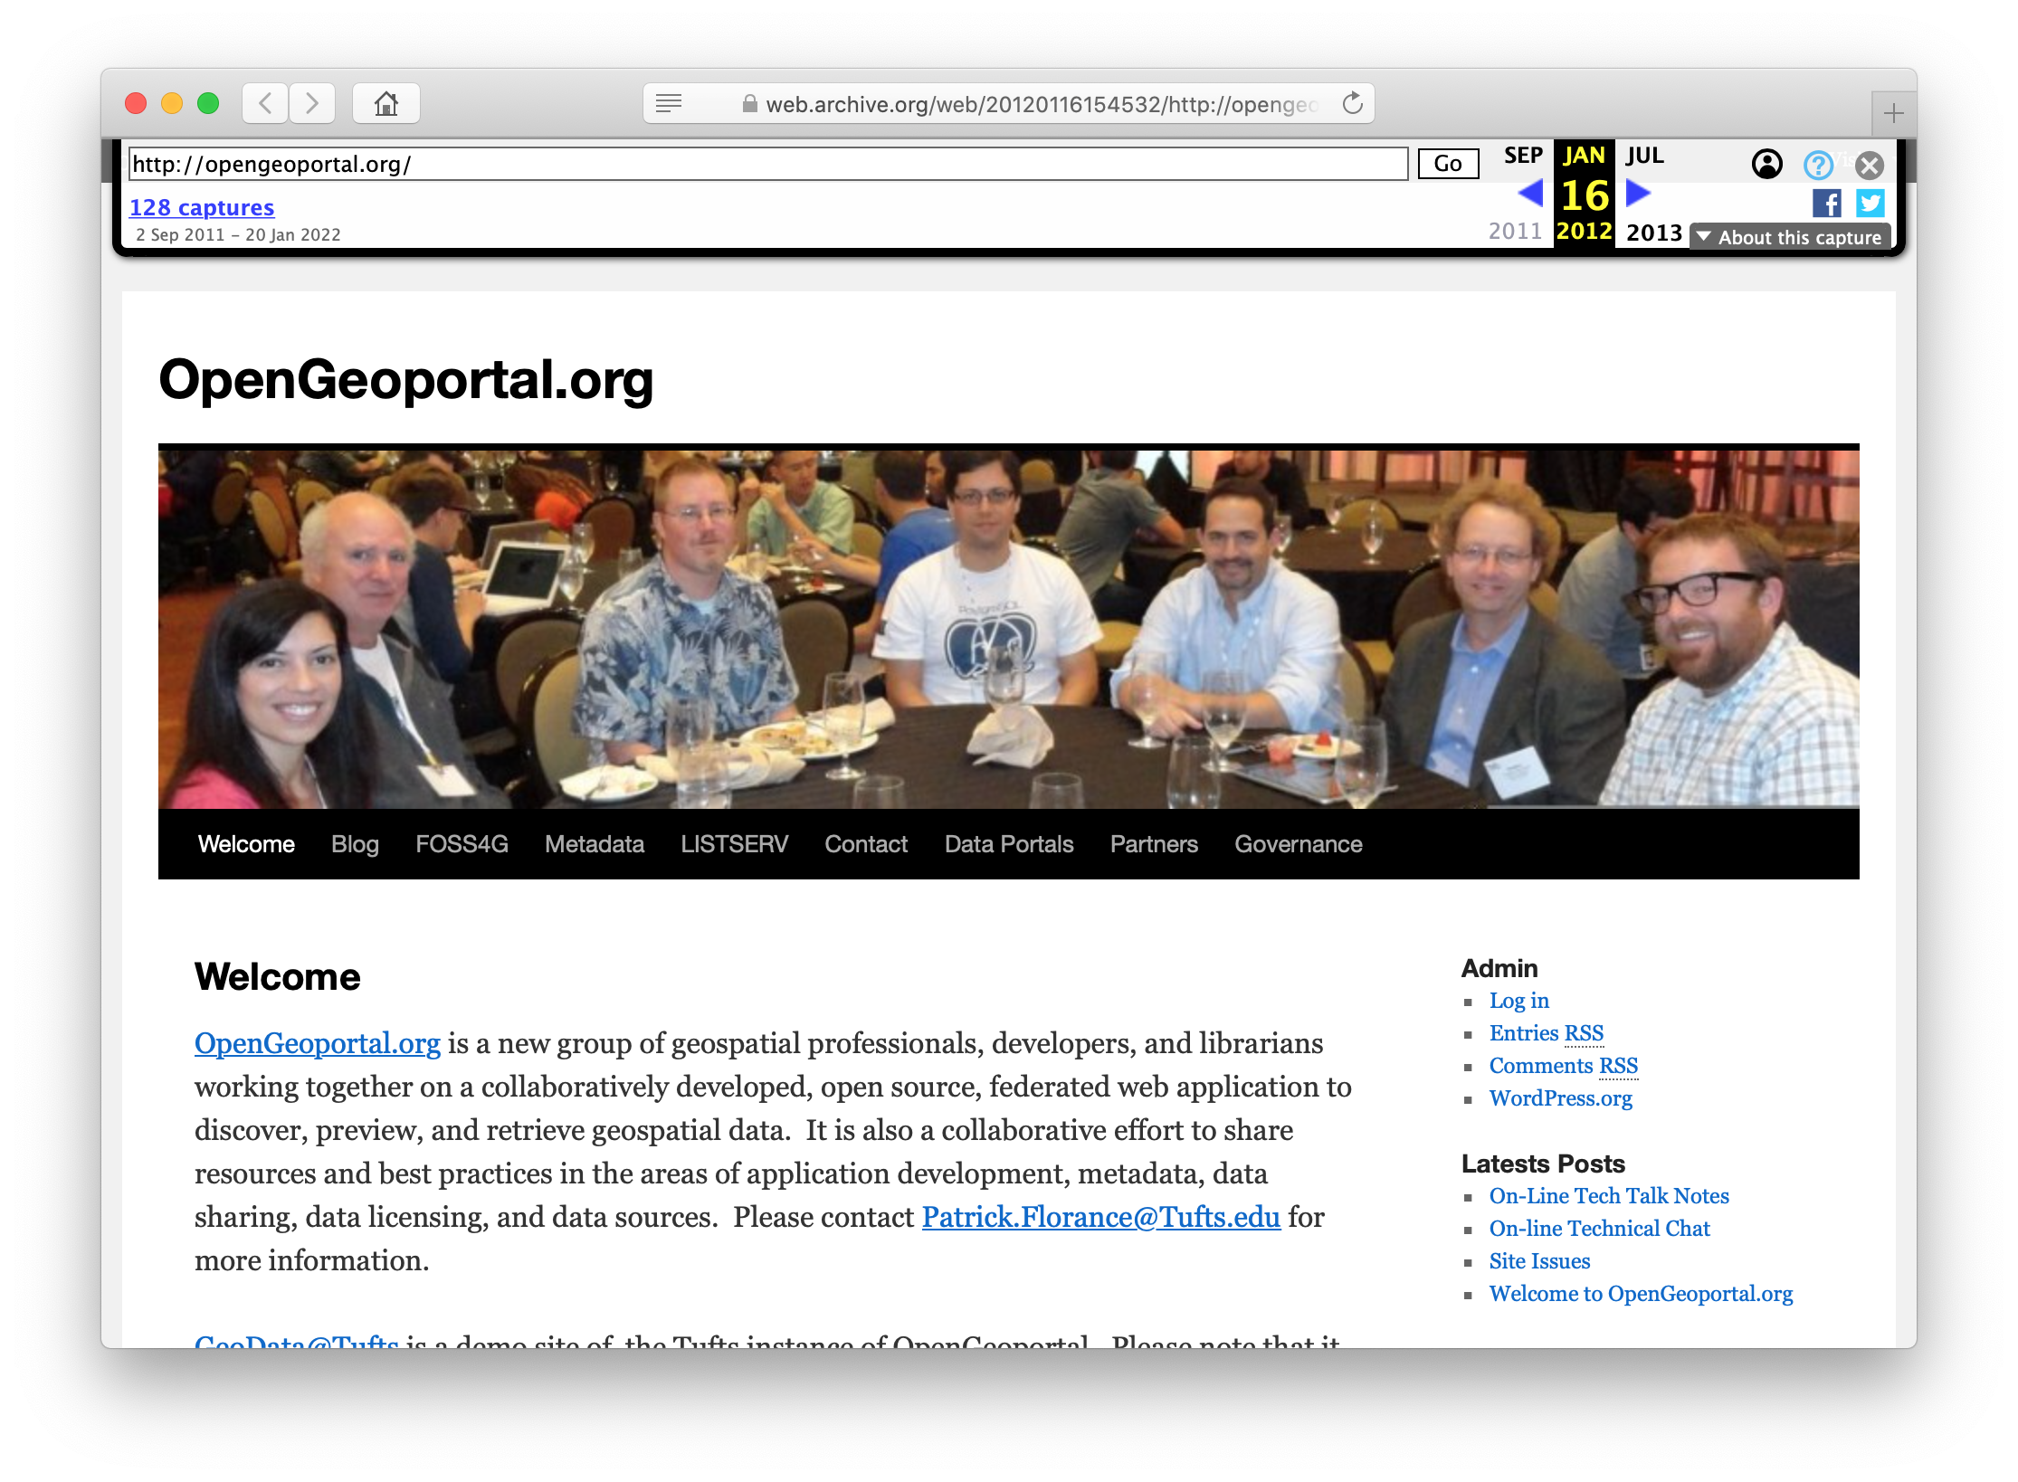

Slide 5
Three transformative developments
Digital preservation
Research data
Data science

Slide 6
1. Digital preservation

Slide 7
full-text search
ACCESS
Calisphere
DPLA
access
control
linked open data
DISCOVERY
Collections as Data
exhibits
Spotlight
APIs
RIM systems
PRESERVATION
embargo
Google indexing
compute environment
integration
DataCite
JSTOR Forum
repository
system
preservation
storage
content-specific interfaces
GIS, A/V, ...
content-specific
search
Alma
integration
migration
fixity checking
emulation
OAIS
deidentification
redaction
harvesting
OAI-PMH
preservation
metadata
contextualization
CITATION
licensing
metrics
Make Data Count
FAIR compliance
ORCID
integration
versioning

Slide 8
Digital preservation is a complex, multilayered exercise in social cooperation extended in time. Preserving digital content will require a series of handoffs, occurring repeatedly at many levels: between different types of media and storage subsystems, different object frameworks and organizational schemes, different repository systems, different institutions and policy regimes, and different application communities with diverse assumptions and interests. The design of such an “archive relay” for digital content must focus on achieving the kind of interoperability that maximizes the ease with which such handoffs can successfully be made...
Janée, Greg, James Frew, and Terry Moore. 2009. “Relay-supporting
Archives: Requirements and Progress.” International Journal of Digital Curation 4(1).
doi:10.2218/ijdc.v4i1.78

Slide 9
Digital preservation is a complex, multilayered exercise in social cooperation extended in time. Preserving digital content will require a series of handoffs, occurring repeatedly at many levels: between different types of media and storage subsystems, different object frameworks and organizational schemes, different repository systems, different institutions and policy regimes, and different application communities with diverse assumptions and interests. The design of such an “archive relay” for digital content must focus on achieving the kind of interoperability that maximizes the ease with which such handoffs can successfully be made...
Janée, Greg, James Frew, and Terry Moore. 2009. “Relay-supporting
Archives: Requirements and Progress.” International Journal of Digital Curation 4(1).
doi:10.2218/ijdc.v4i1.78

Slide 10
Digital preservation is a complex, multilayered exercise in social cooperation extended in time. Preserving digital content will require a series of handoffs, occurring repeatedly at many levels: between different types of media and storage subsystems, different object frameworks and organizational schemes, different repository systems, different institutions and policy regimes, and different application communities with diverse assumptions and interests. The design of such an “archive relay” for digital content must focus on achieving the kind of interoperability that maximizes the ease with which such handoffs can successfully be made...
Janée, Greg, James Frew, and Terry Moore. 2009. “Relay-supporting
Archives: Requirements and Progress.” International Journal of Digital Curation 4(1).
doi:10.2218/ijdc.v4i1.78

Slide 11
Digital preservation is a complex, multilayered exercise in social cooperation extended in time. Preserving digital content will require a series of handoffs, occurring repeatedly at many levels: between different types of media and storage subsystems, different object frameworks and organizational schemes, different repository systems, different institutions and policy regimes, and different application communities with diverse assumptions and interests. The design of such an “archive relay” for digital content must focus on achieving the kind of interoperability that maximizes the ease with which such handoffs can successfully be made...
Janée, Greg, James Frew, and Terry Moore. 2009. “Relay-supporting
Archives: Requirements and Progress.” International Journal of Digital Curation 4(1).
doi:10.2218/ijdc.v4i1.78

Slide 12
✘
ADL II
ADL III
ADL IV
ADEPT
NGDA
Comet
ADL I
✘
✘
✘
✘
✘
✘
ADRL
?

Slide 13


Slide 14
Cataloging
SRC curation
focus on
sustainability,
portability
systems
development
workflow
co-development
DSD
education,
training
infrastructure
operations
consulting
preservation
expertise
Digitization
Acquisitions

Slide 15
Risks
Unsustainable software
Insufficient resources, responsiveness
Lack of buy-in; tools/needs mismatch

Slide 16
2. Research data

Slide 17
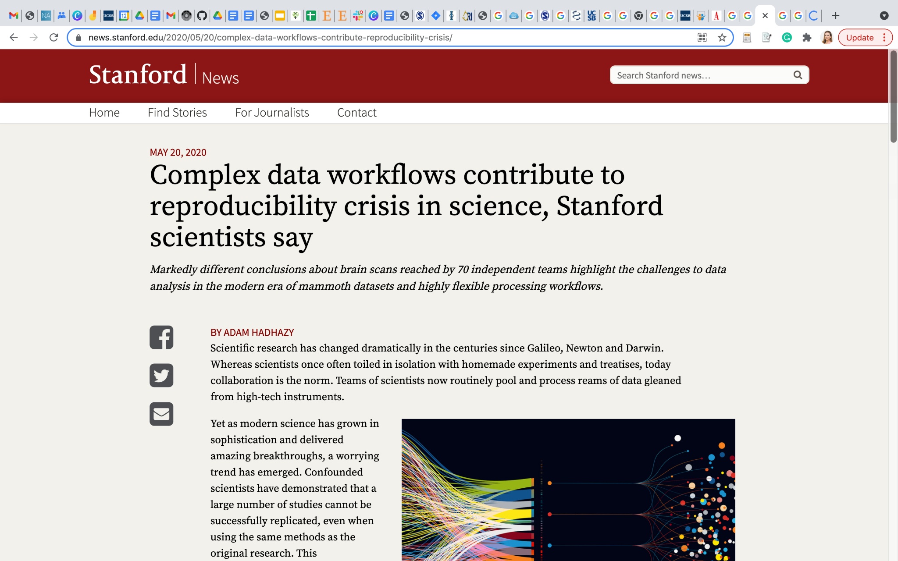
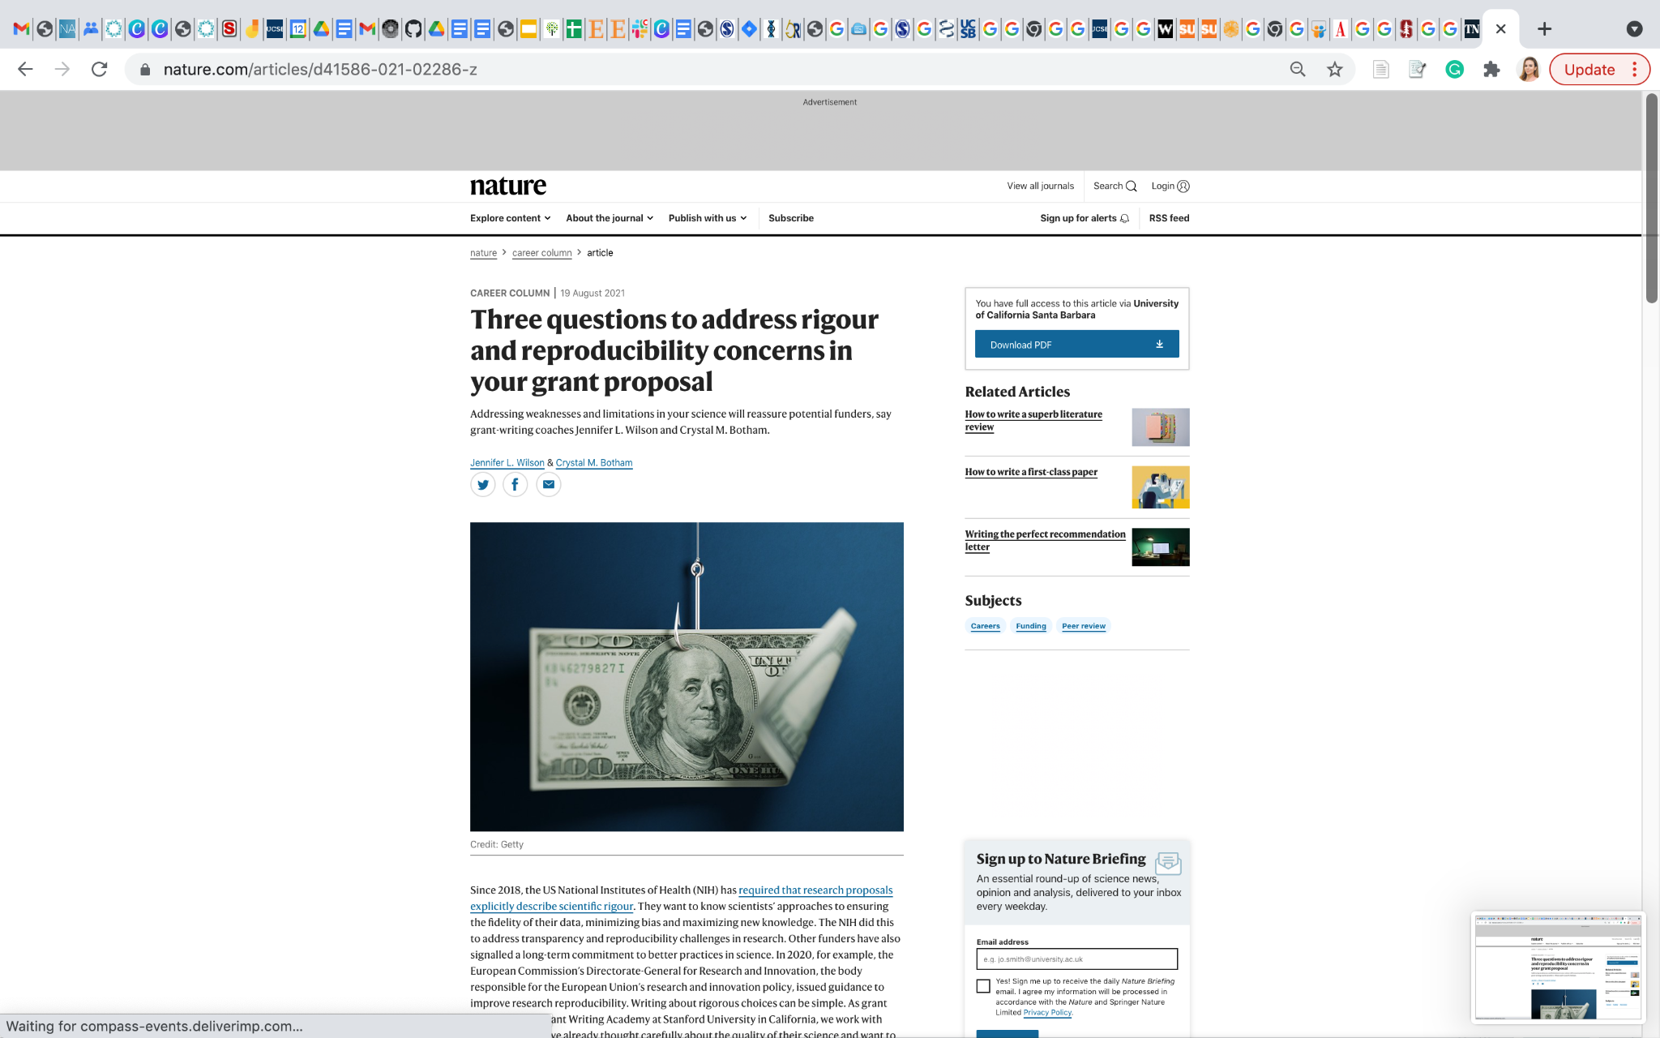
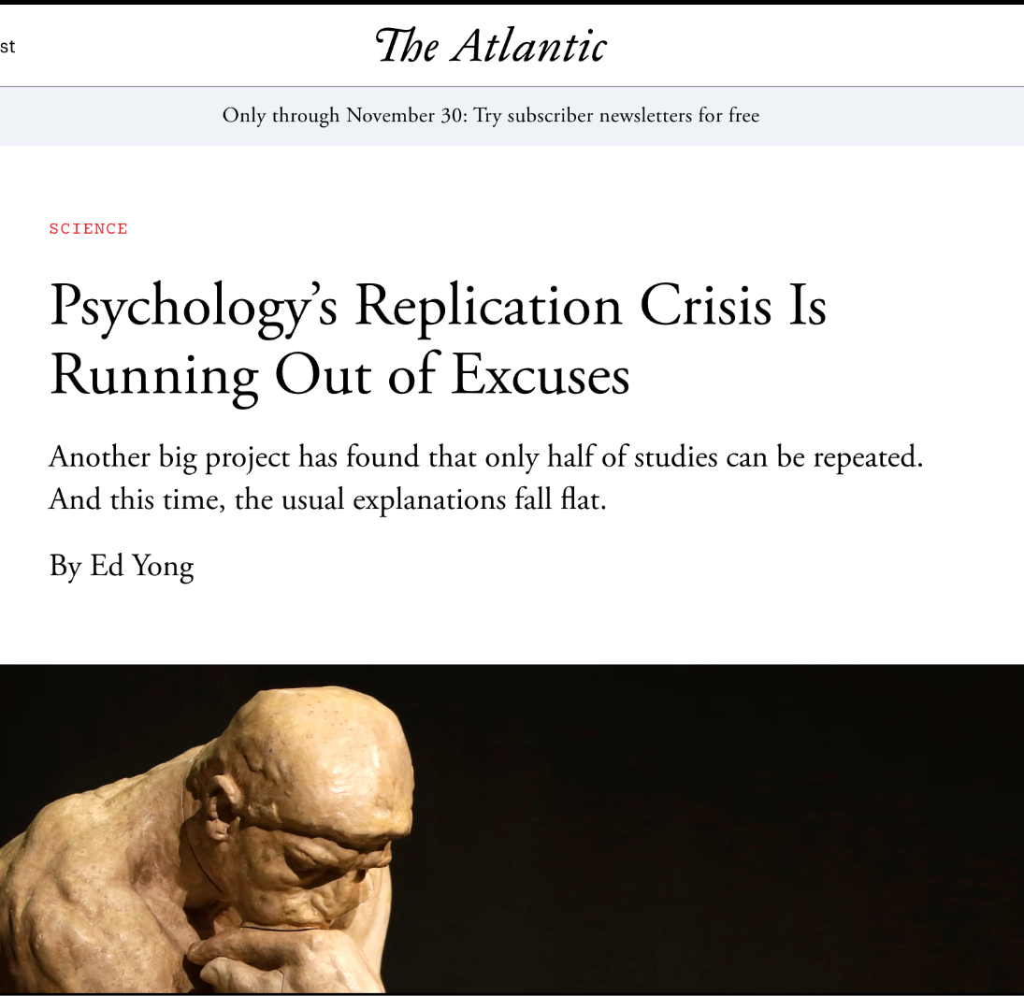
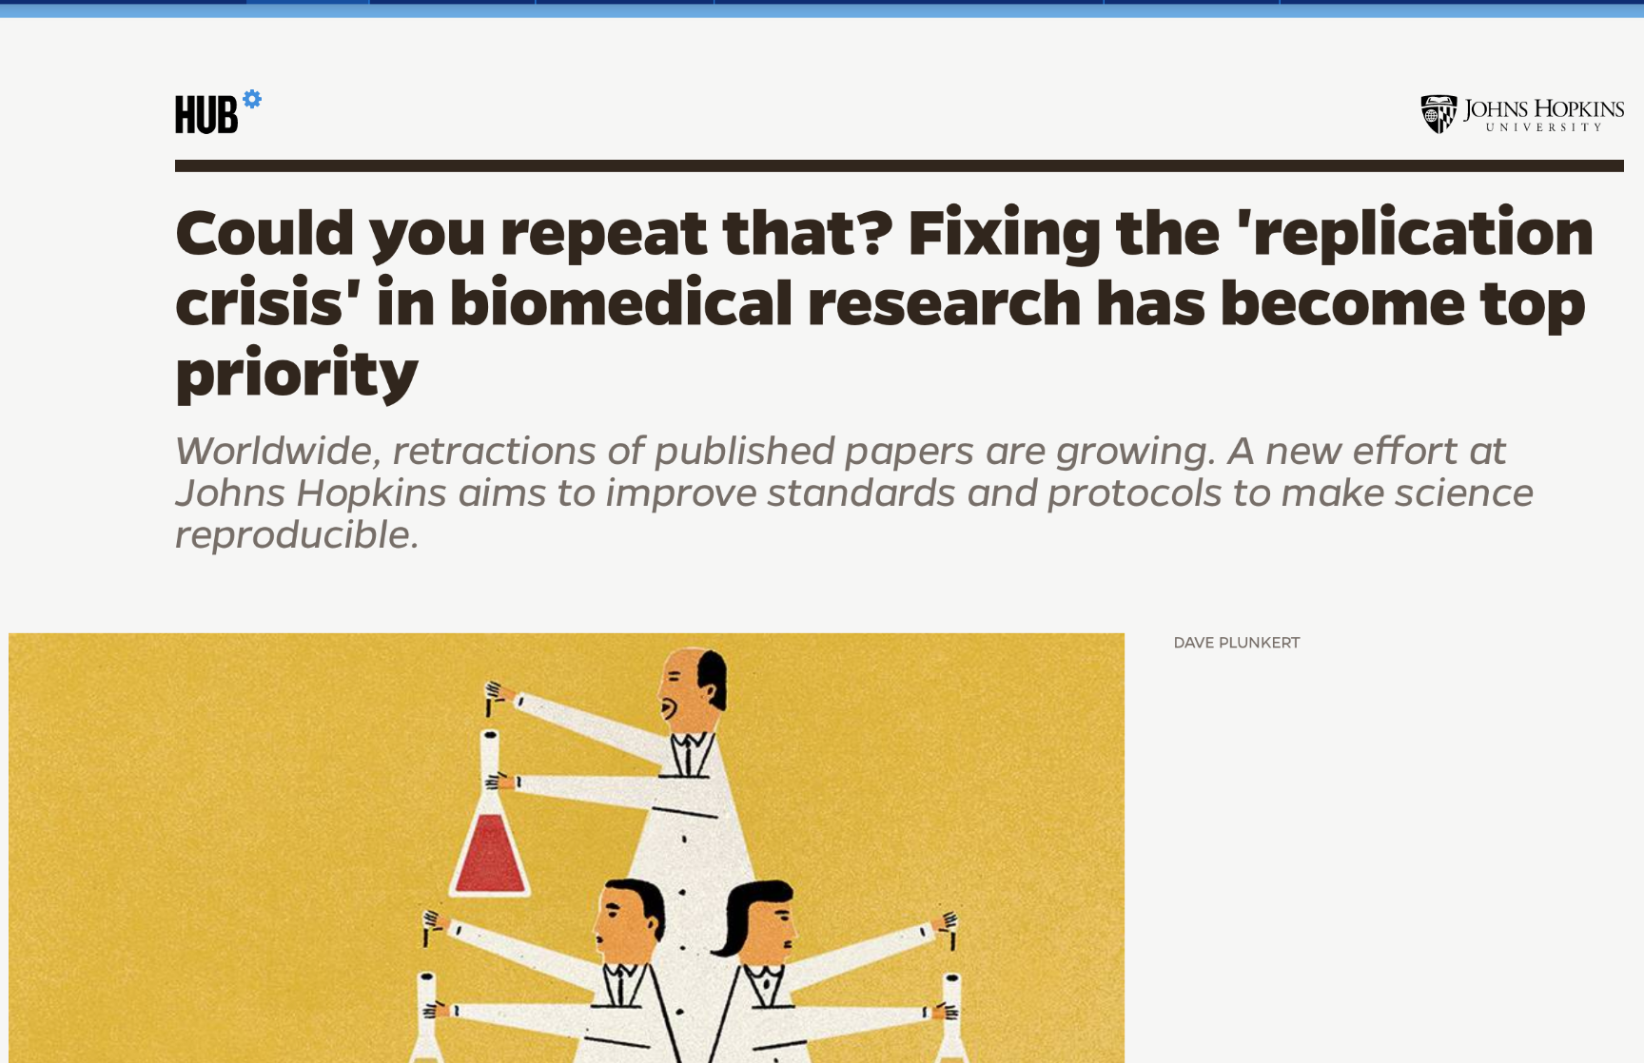
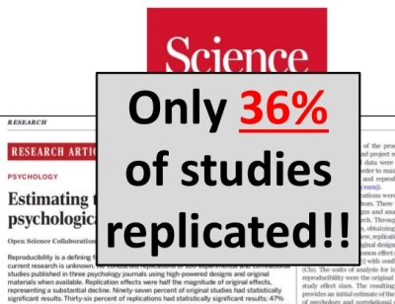
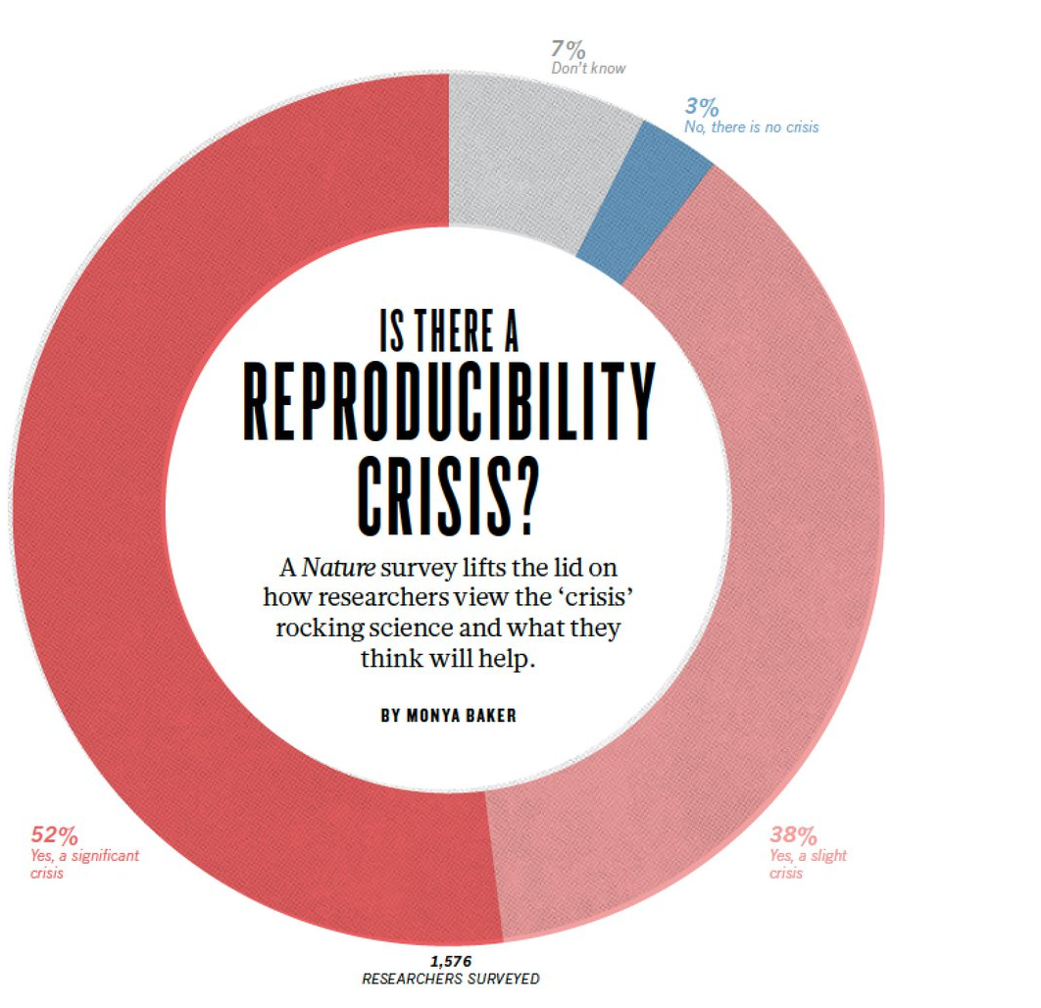
The Reproducibility Crisis

Slide 18
Motivations for transparency
Mitigate the reproducibility crisis
Accountability to funders
Scrutiny of research findings by non-specialists
Because we can

Slide 19
“Ensuring broad-based public access to research data is fundamental to advancing the research, education, and service missions of institutions of higher education. Public access to research data is, in fact, a natural continuation of academic institutions’ research mission and their function in creating and disseminating new knowledge for societal and economic benefit.”
Association of American Universities and Association of Public and Land-grant Universities. 2021. “Guide to Accelerate Public Access to Research Data.” Washington, DC. doi:10.31219/osf.io/tjybn

Slide 20
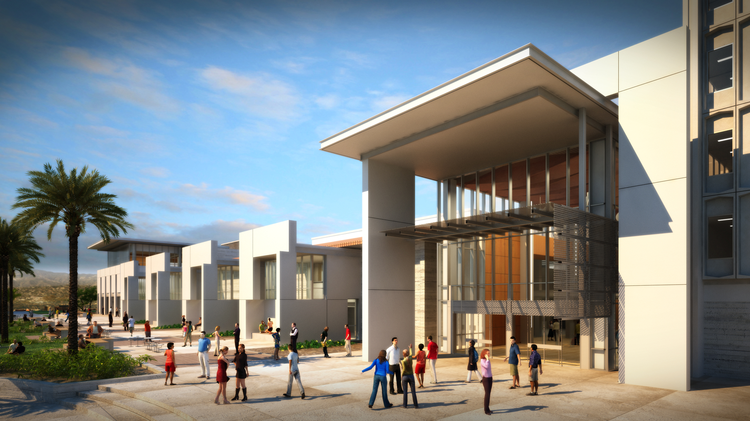
Who will make UCSB’s research data available?

Slide 21
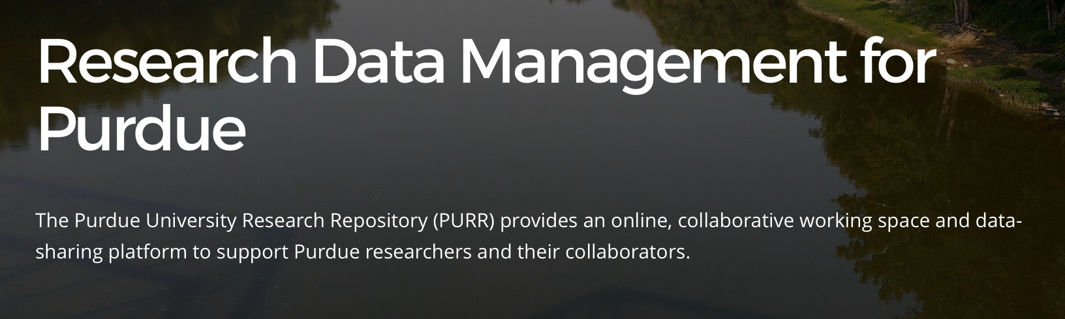

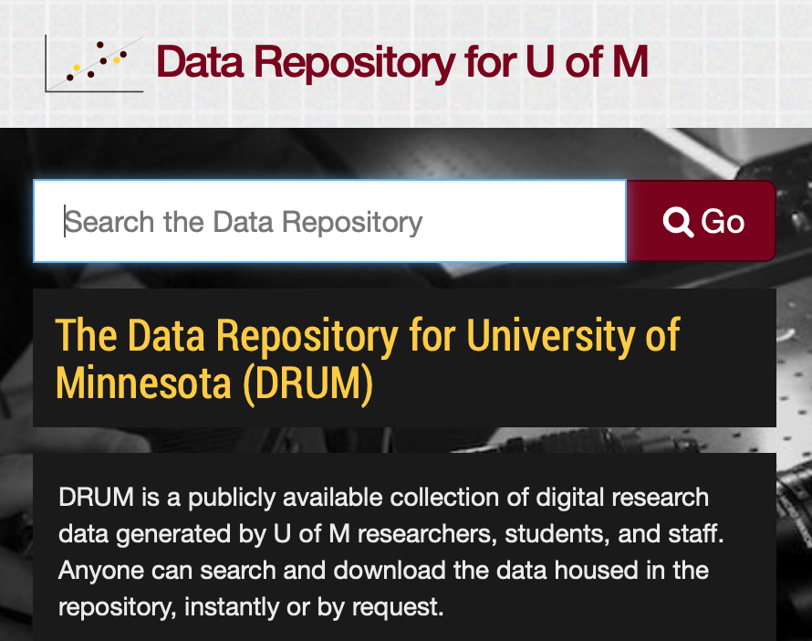
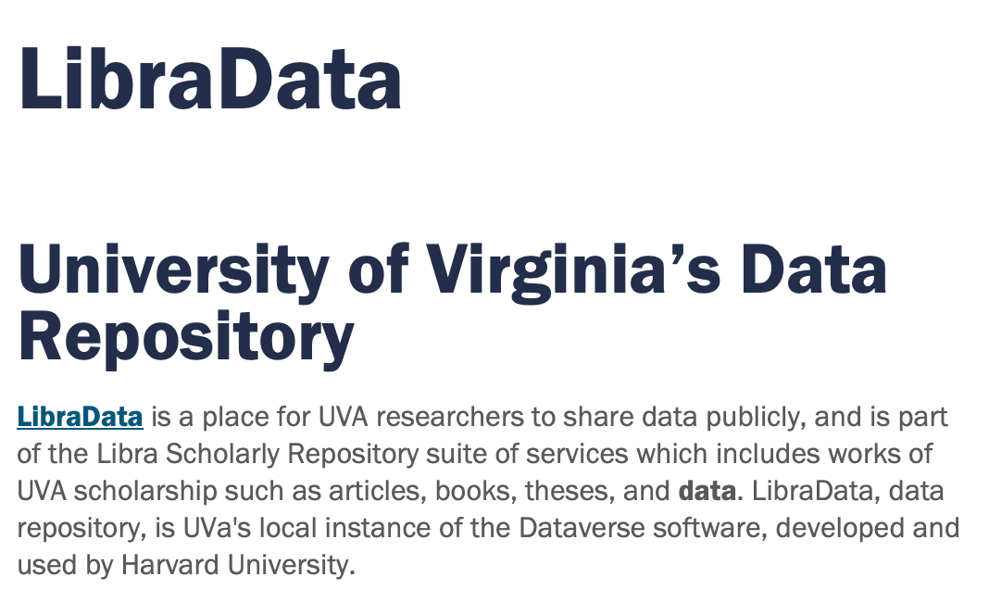

Slide 22
Risks
Unsustainable growth
Unsustainable commitment
Perceived low return on investment

Slide 23
3. Data science

Slide 24
UCB Berkeley Institute for Data Science
UCB Data Science Major
UCB Minor in Data Science
UCB Online Master’s in Data Science
UCI B.S. in Data Science
UCI Master of Data Science
UCI Data Science Certificate Program
UCLA Data Science Certificate Program
UCLA Data Theory Major
UCLA Statistics Social Data Science Minor
UCLA Data Science Center
UCR Data Science Undergraduate Major
UCR Master of Science with focus in Data Science
UCSB Data Science Initiative
UCSB Bren School Master of Environmental Data Science
UCSB B.S. degree and new academic unit in Data Science (proposed)
UCSC Data, Discovery, and Decisions (D3) research center
UCSF Library Data Science Initiative
UCSF Master of Science in Data Science

Slide 25
Data science instruction at UCSB
Degree programs
Data Science Initiative
Bren School
Departmental offerings
PSTAT DataLab
Quantitive Methods in the Social Sciences (QMSS)
General tool-oriented workshops
Center for Scientific Computing
Library

Slide 26
Each of the 12 Departments participating in the proposed major has had extensive interactions with the Library’s Interdisciplinary Research Collaboratory. The Collaboratory has offered open-enrollment workshops in collaboration with CITS and Communication, hired PSTAT and CS undergraduate students as peer consultants, and consulted on appropriate classroom and research software with faculty from the listed programs.
—Proposal for a Bachelor of Science (B.S.) Degree and New Academic Unit in Data Science

Slide 27
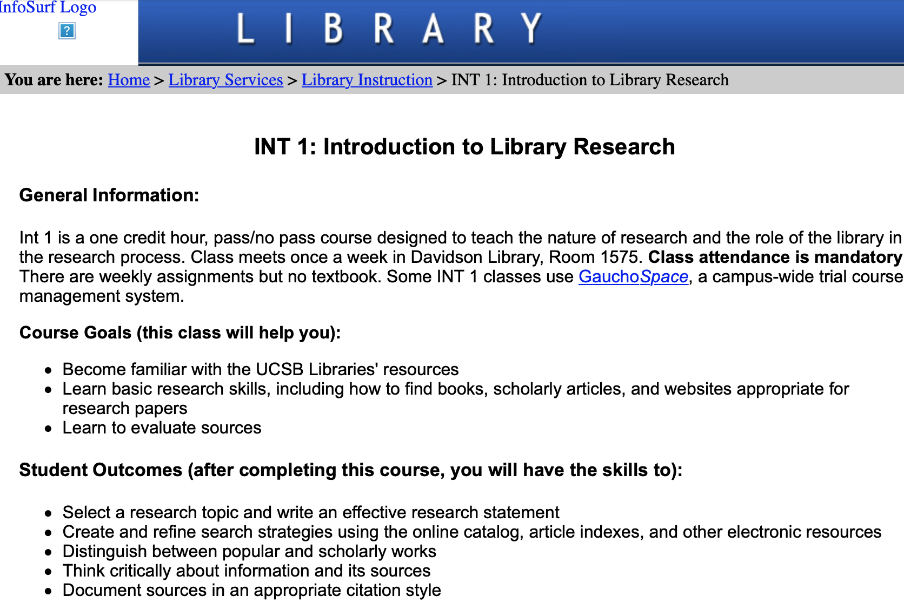
“How to be a scholar”

Slide 28
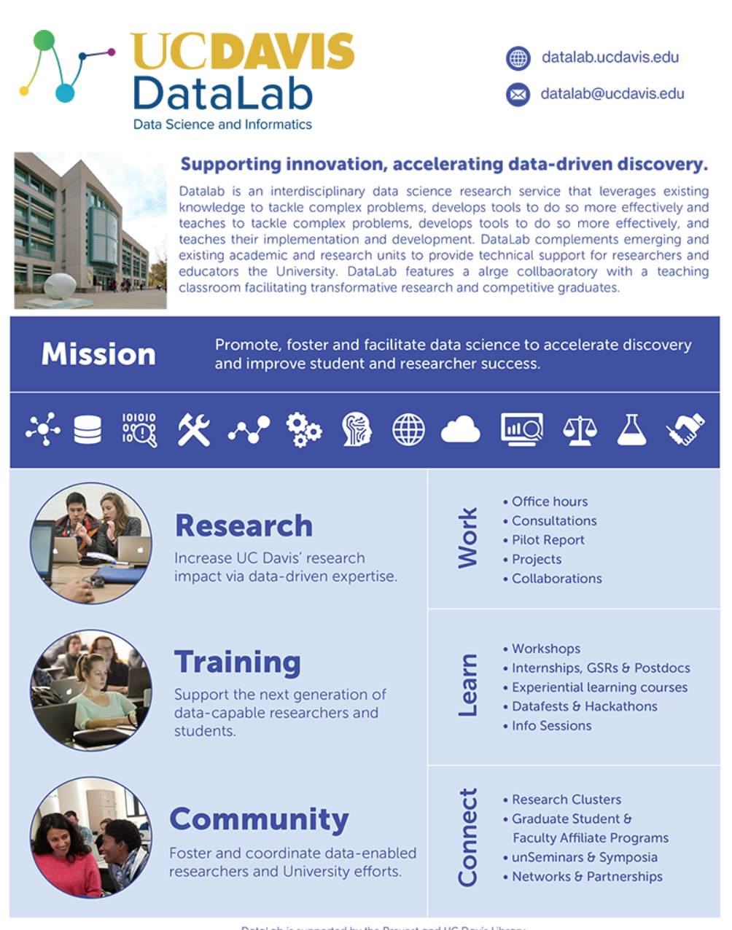
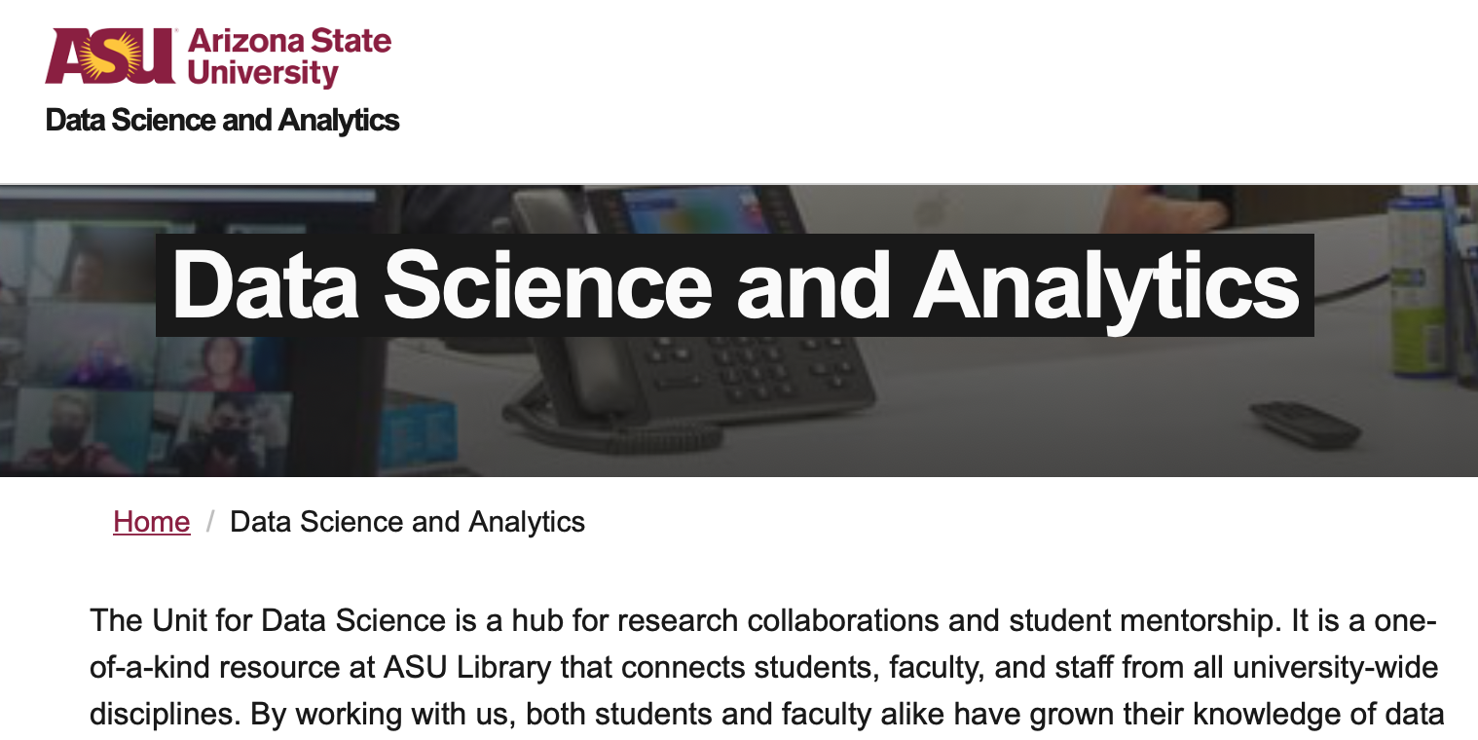
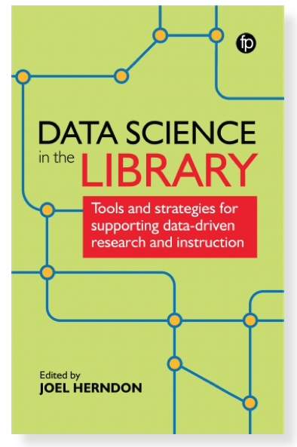
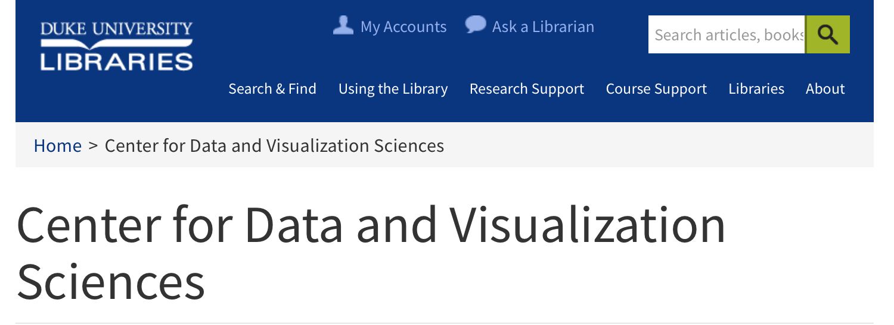

Slide 29
Challenges
Instructor depth
Instructors, period

