Slide 1

Library Services: Motivations
Advance open science
Enhance reproducibility, transparency, accessibility of UCSB research
Help satisfy funder requirements
Promote, enable credit in scholarly communication
Teach basic scholarship skills
Notes:
Greg

Slide 2
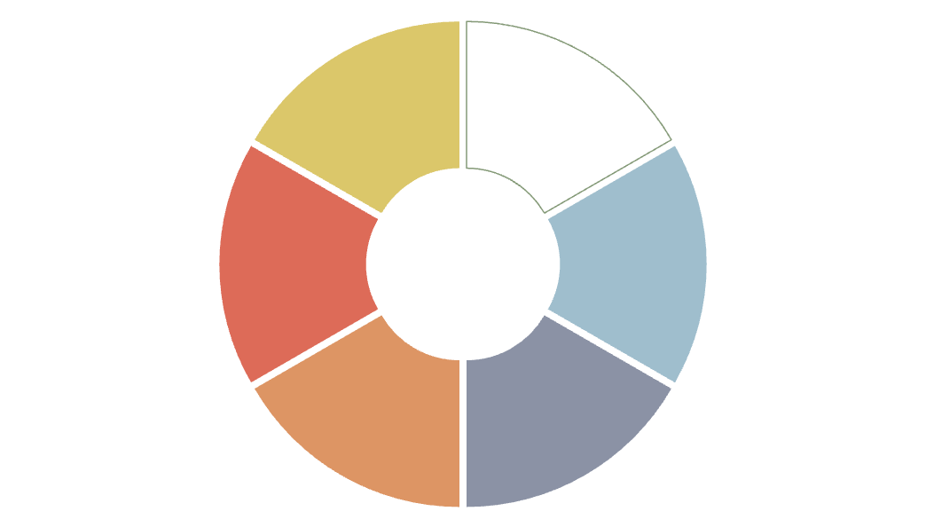
Library Services
 | Services | Consultation | Training
Envision
Plan | DMPTool | Addressing funder requirements | RCR: planning, data management, ethics
Generate/ Acquire | Dataset licensing | Data management approaches, best practices | Licensed dataset, API usage
Process/Analyze | VMs, licensed software | How to apply tools and techniques, how to work collaboratively | Basic tool and techniques (programming, notebooks, version control, deidentification)
Share/Use Reuse | Dryad, EZID, perma.cc | Where, how to share; licensing | Reproducible publications
Preserve/Discard | Dryad | Dataset curation | Student capstone guidance
Notes:
Greg

Slide 3
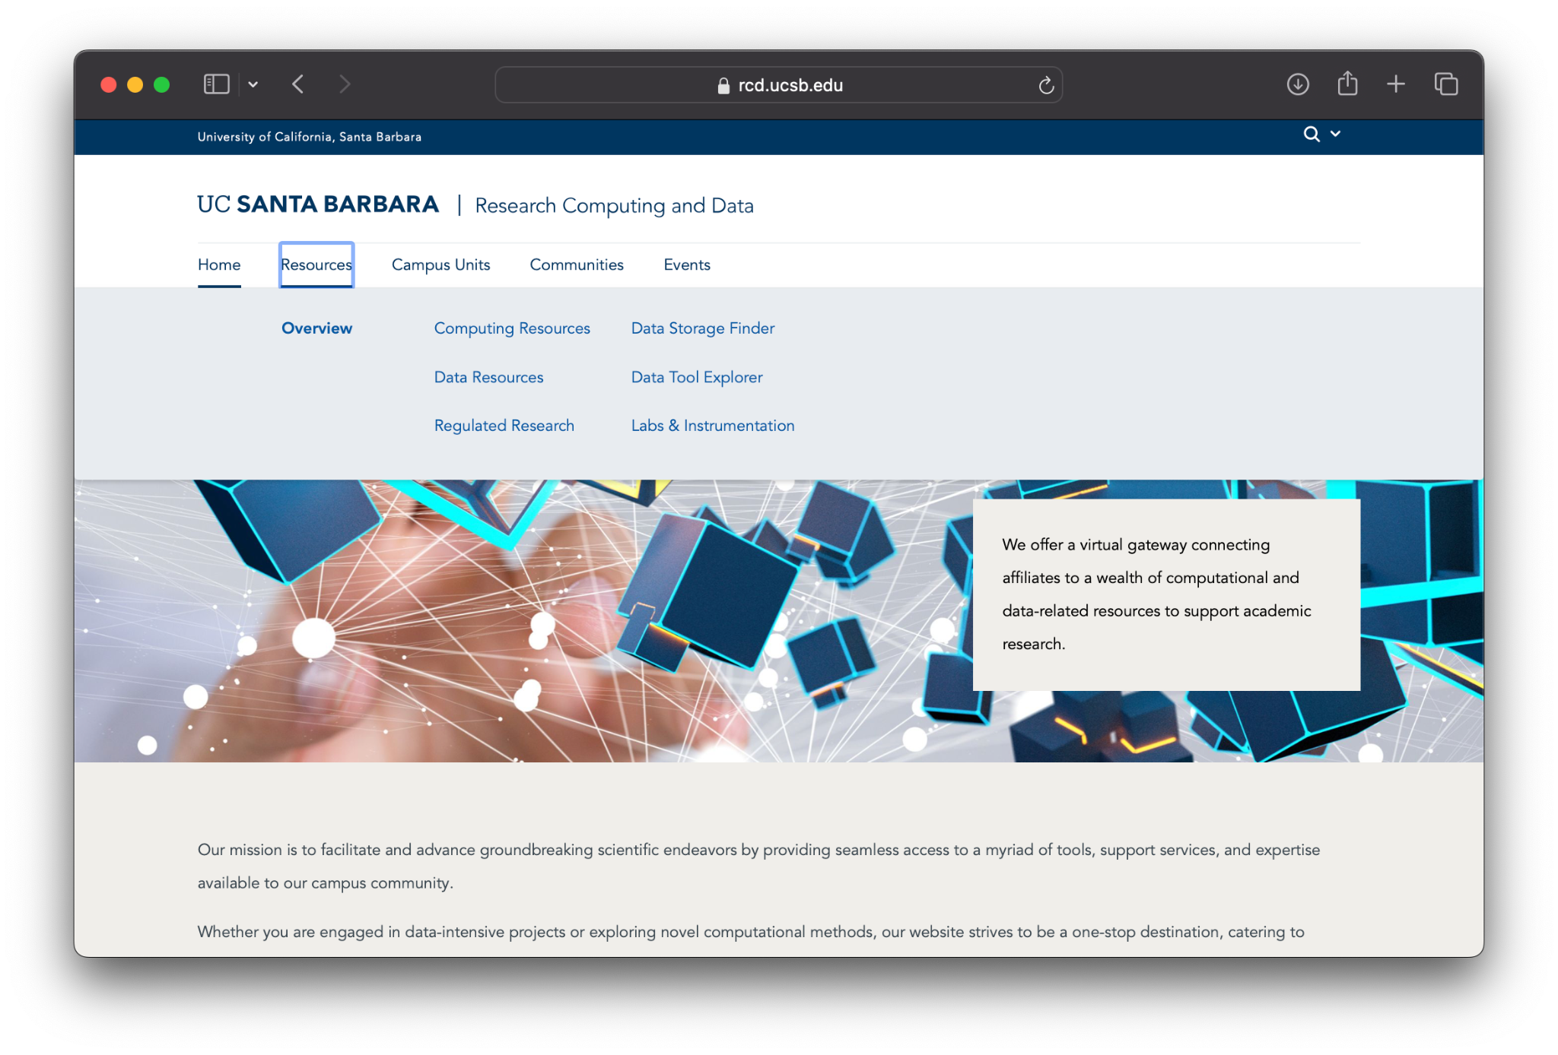
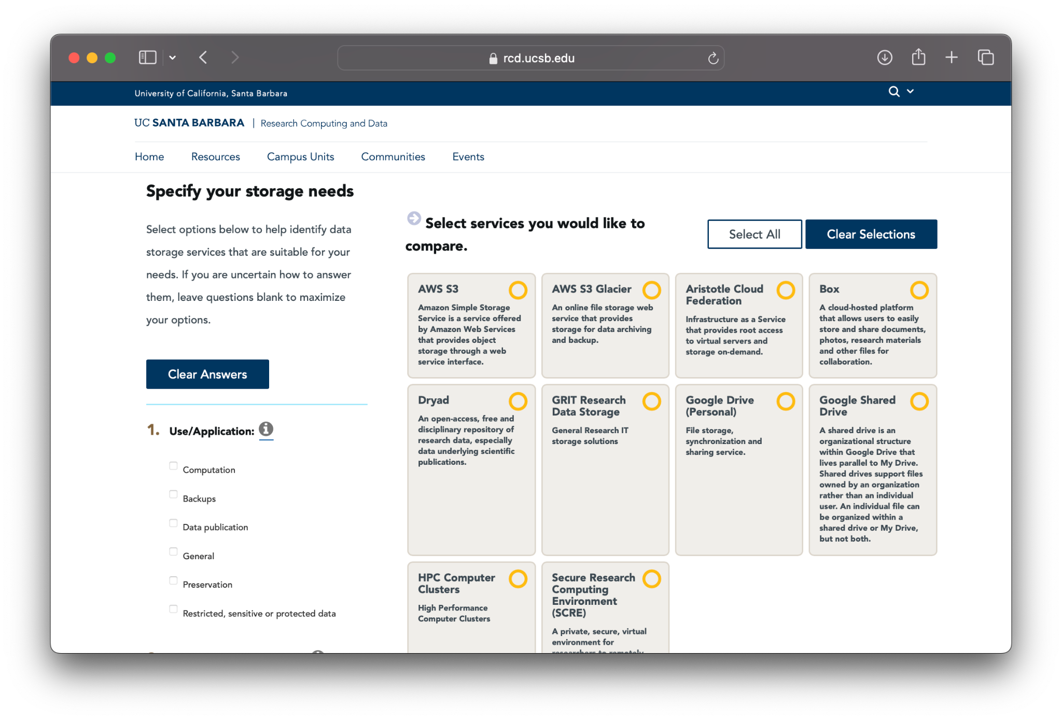
rcd.ucsb.edu
Notes:
Greg

Slide 4
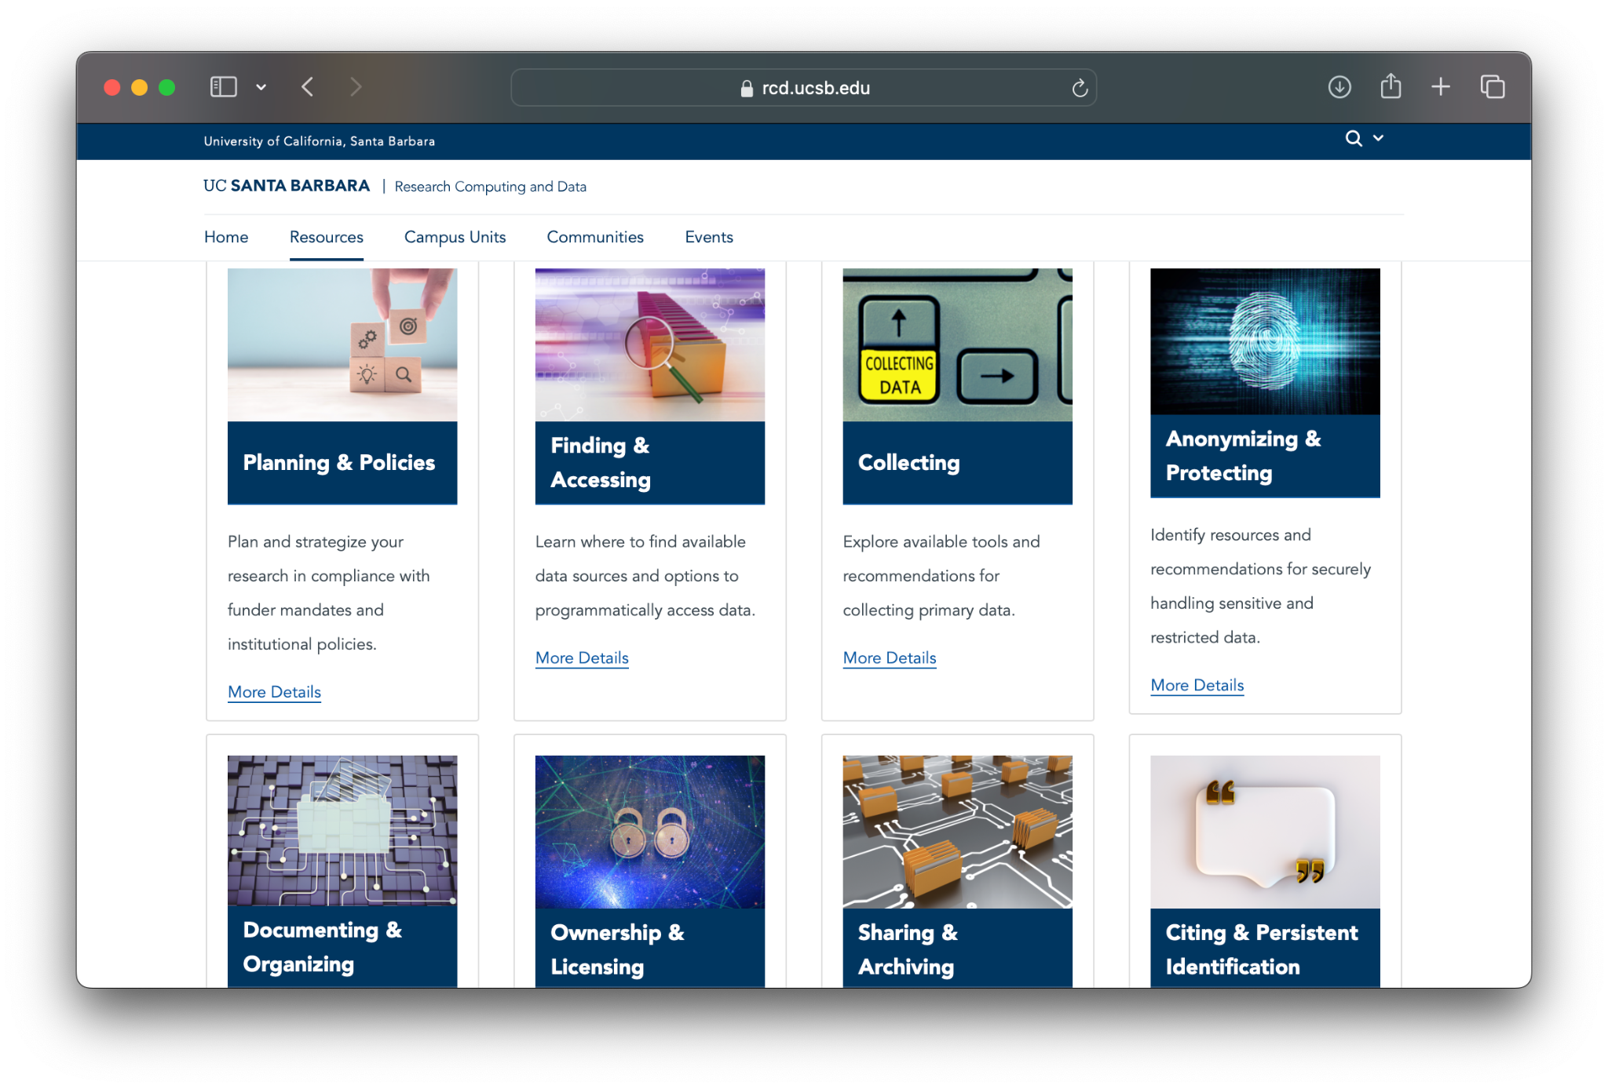
Notes:
Greg

Slide 5
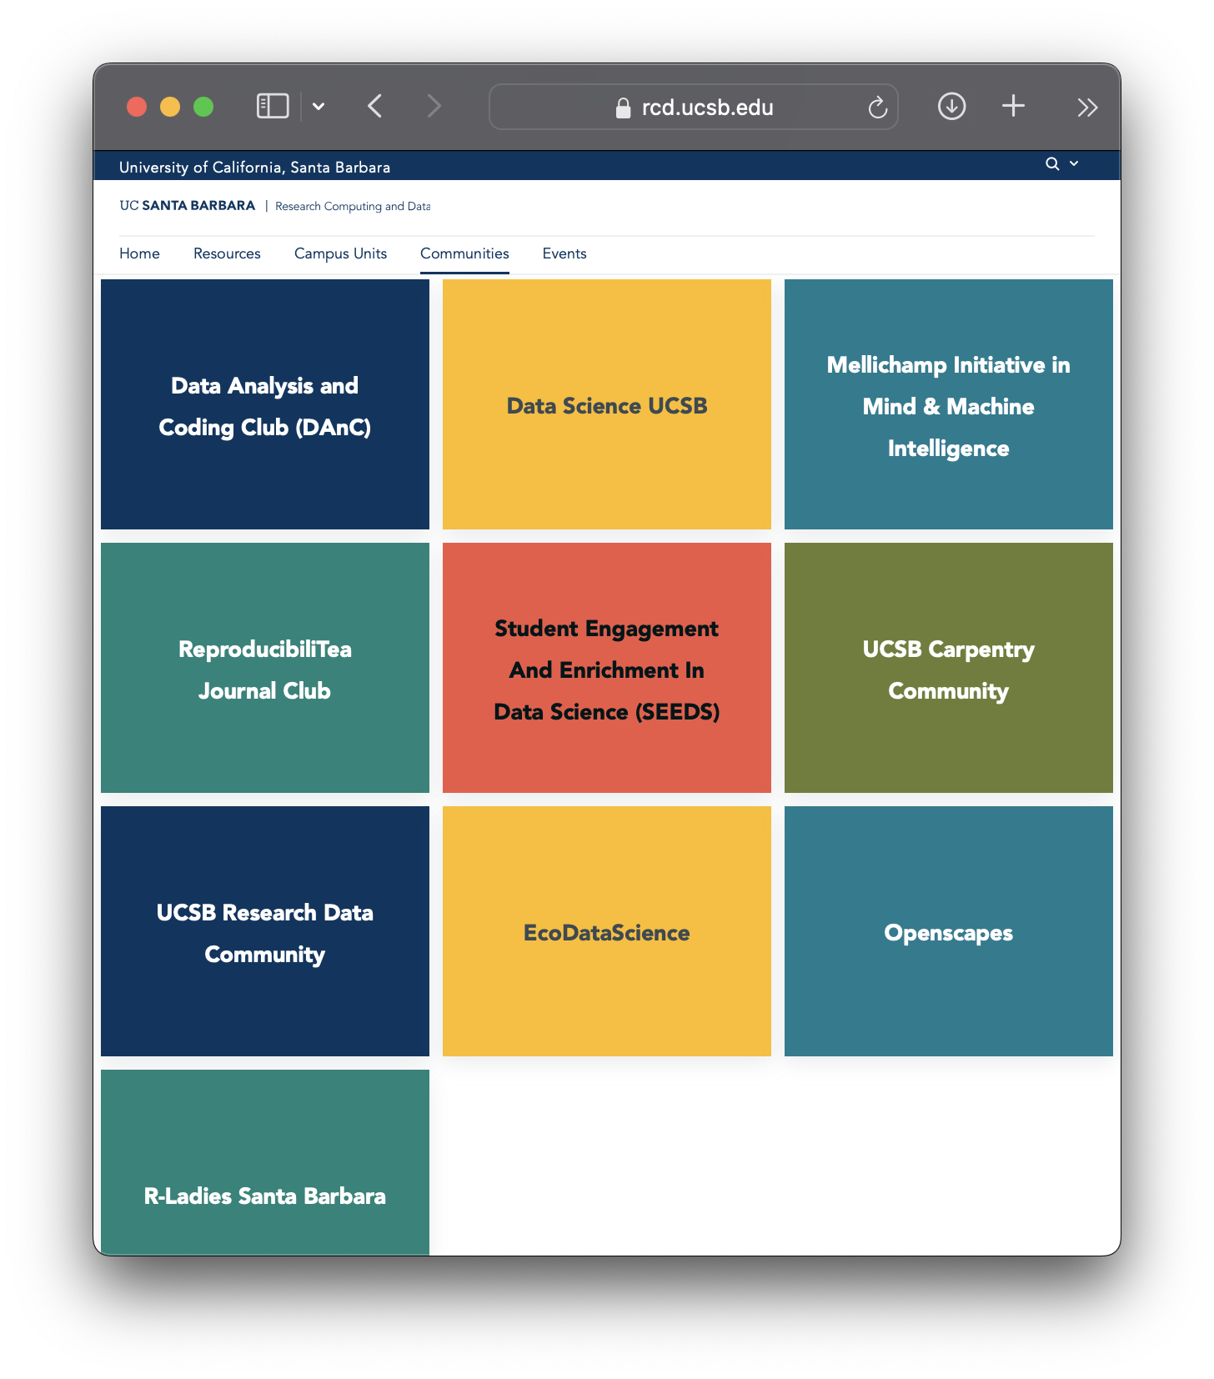
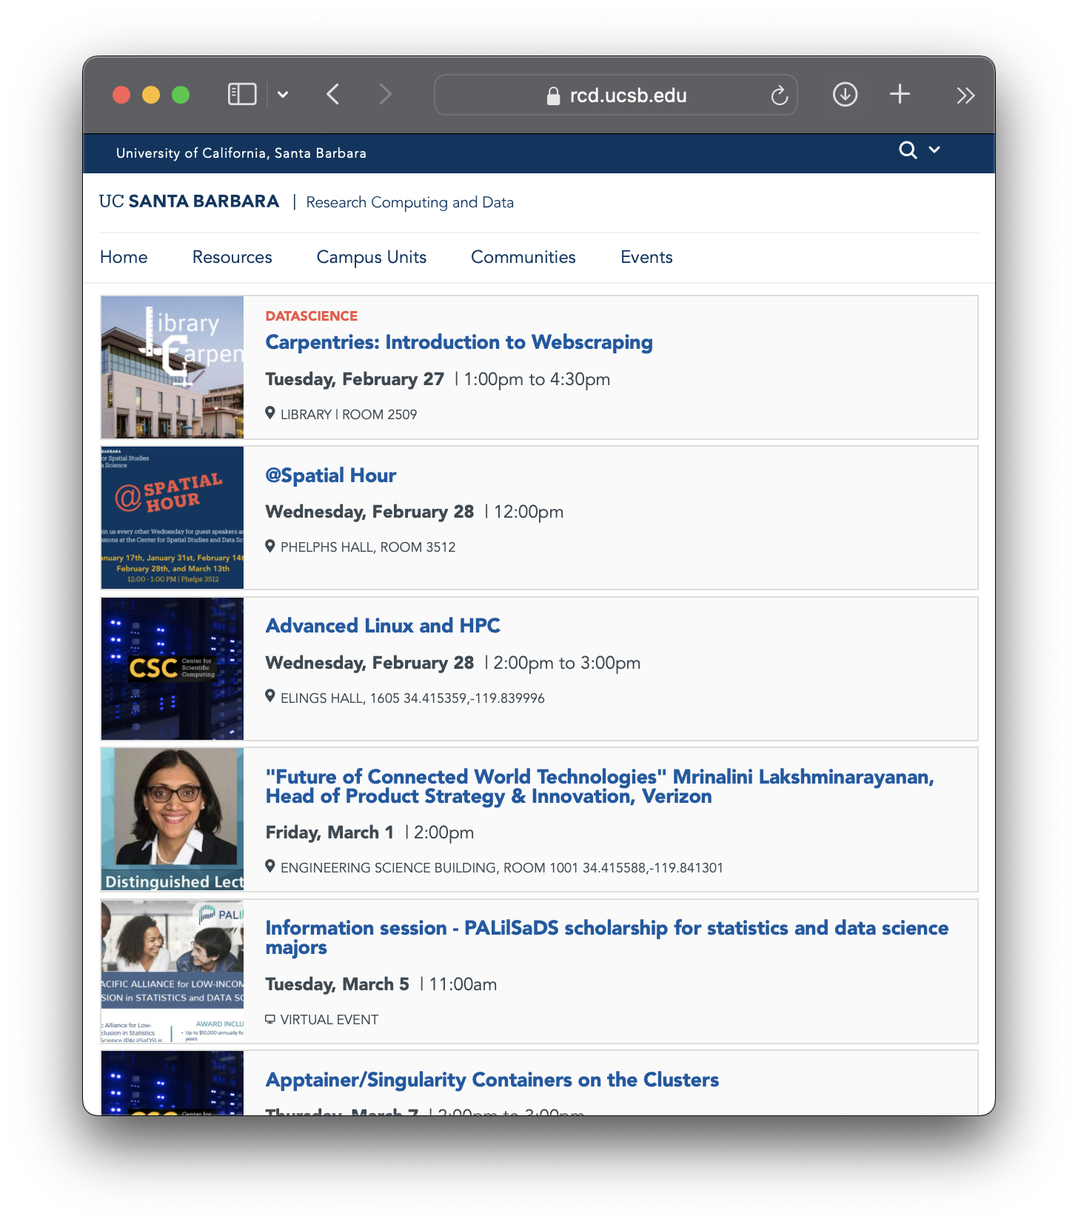
Notes:
Greg

