Slide 1
Data rescue
Potential, pitfalls, and the role of libraries
Greg Janée, Julien Brun
UCSB Library Research Data Services

Slide 2
The problem
Loss of published data
  Not exclusive to this presidential administration…
  …or to administration turnovers
  …or to federal data
    “191 (6.2%) of repositories in re3data have been shut down…” (https://doi.org/10.1162/qss_a_00277)
Notes:
Dorothea Strecker, Heinz Pampel, Rouven Schabinger, Nina Leonie Weisweiler; Disappearing repositories: Taking an infrastructure perspective on the long-term availability of research data. Quantitative Science Studies 2023; 4 (4): 839–856. doi: https://doi.org/10.1162/qss_a_0027

Slide 3
Data rescue project
https://www.datarescueproject.org/
Clearinghouse of mix of mature and homegrown efforts
Provide education, reduce duplication, host events
Notes:
Any data rescue effort should operate under the umbrella of the Data Rescue Project.

Slide 4
What does data rescue mean?
It must mean data reuse, by researchers
  Researchers must be able to find it…
  …understand it
  …recognize it as being authentic, trust it
  …be able cite it
Saving data is a first and necessary step, but insufficient
Notes:
Topic of this talk
Another way of saying this is: researchers use a certain process now to use data: they know what the authoritative sources are, where to find the data/how to search for it, how to gauge the authenticity of the data, etc. “Rescuing” data means replicating this process to some degree.

Slide 5
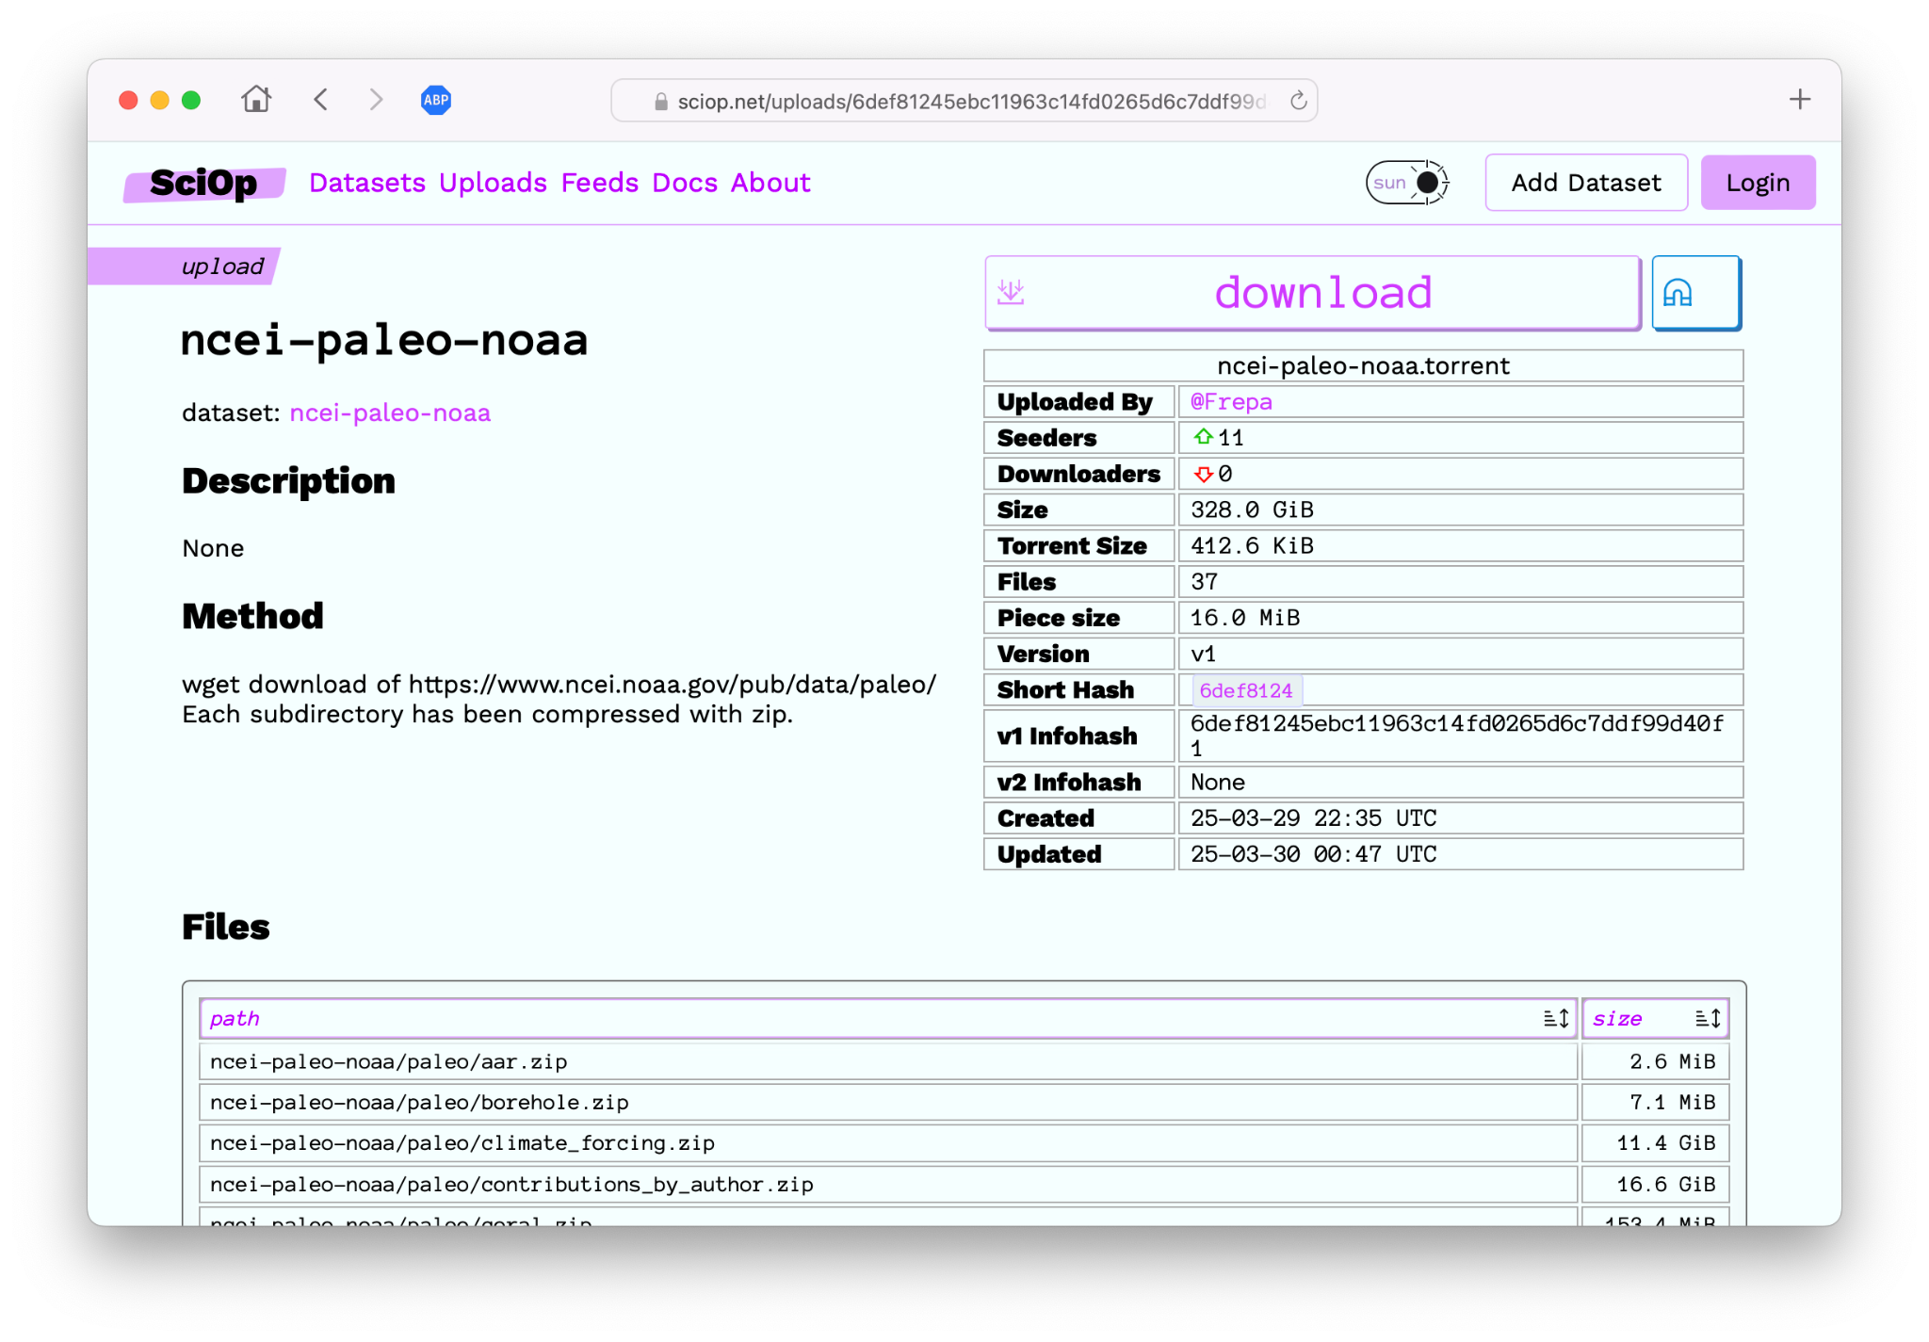
Notes:
Example of a mature, international, cooperative data rescue effort that has built substantial (and admirable) infrastructure. But:
How will researchers know about this? Find the dataset they want?
This is a very file-oriented view.
Metadata is entirely missing.

Slide 6
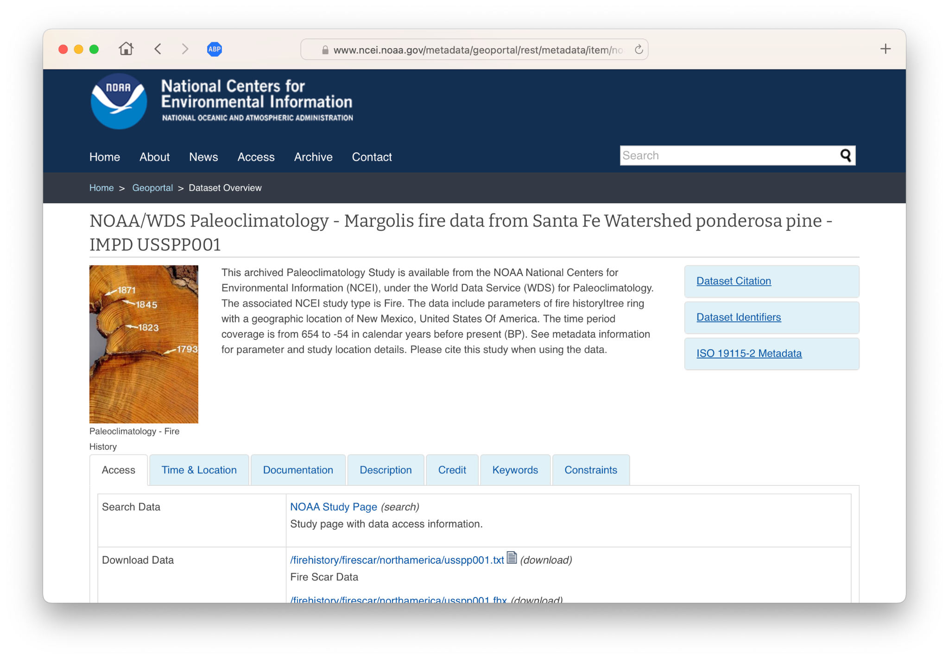
Notes:
Contrast previous with this view of the data… showing citation, metadata, and coming from the authoritative source.

Slide 7
Our approach
On-demand service (pilot phase)
Collaboration between
  Library (service provider, cataloging)
  UCSB General Research IT (data storage, access)
  NCEAS/DataONE (discovery)
Cataloging approach:
  Indicate that dataset is an archived copy (i.e., a snapshot that will never be updated)
Notes:
Collaboration: each organization is providing something the other two can’t.
Cataloging: metaphor for data is closer to one unique copy (as deposited by the original creator in the publishing repository) than books (where it’s understood that everybody has a copy). The archived copy won’t receive fixes, updates, new versions, etc., nor does it reflect any additional processing beyond what was originally captured. It’s a fixed snapshot.

Slide 8
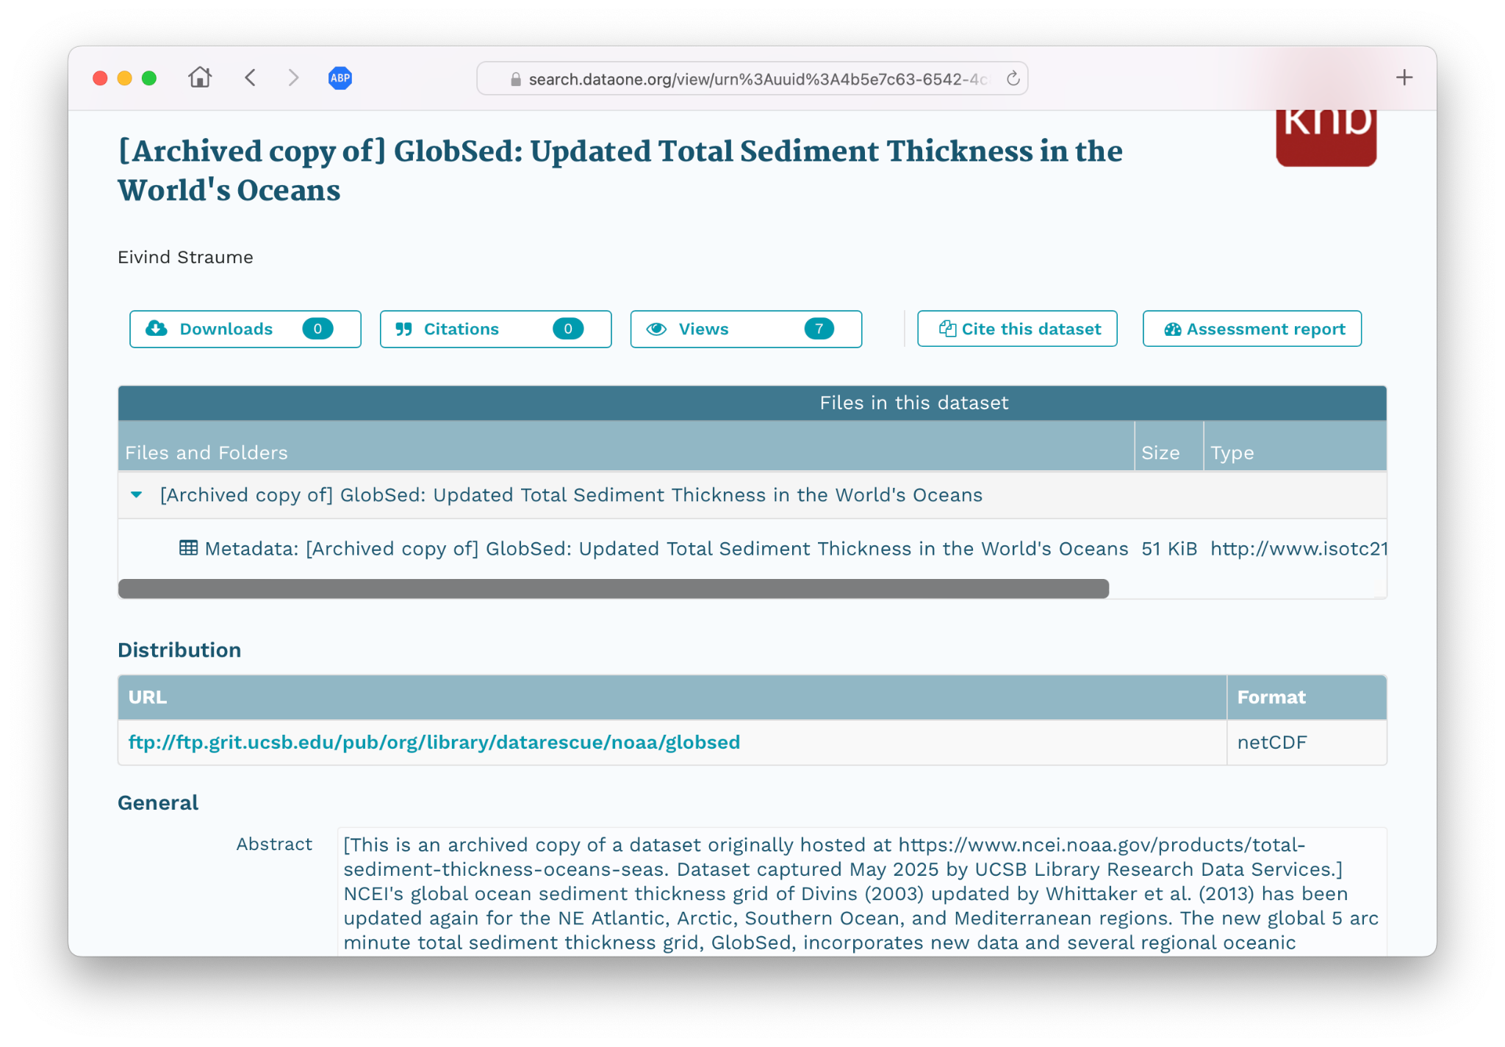
Notes:
Adding annotations to indicate archived copy. Data not in the repository; this is a metadata-only record that points to data held elsewhere.

Slide 9
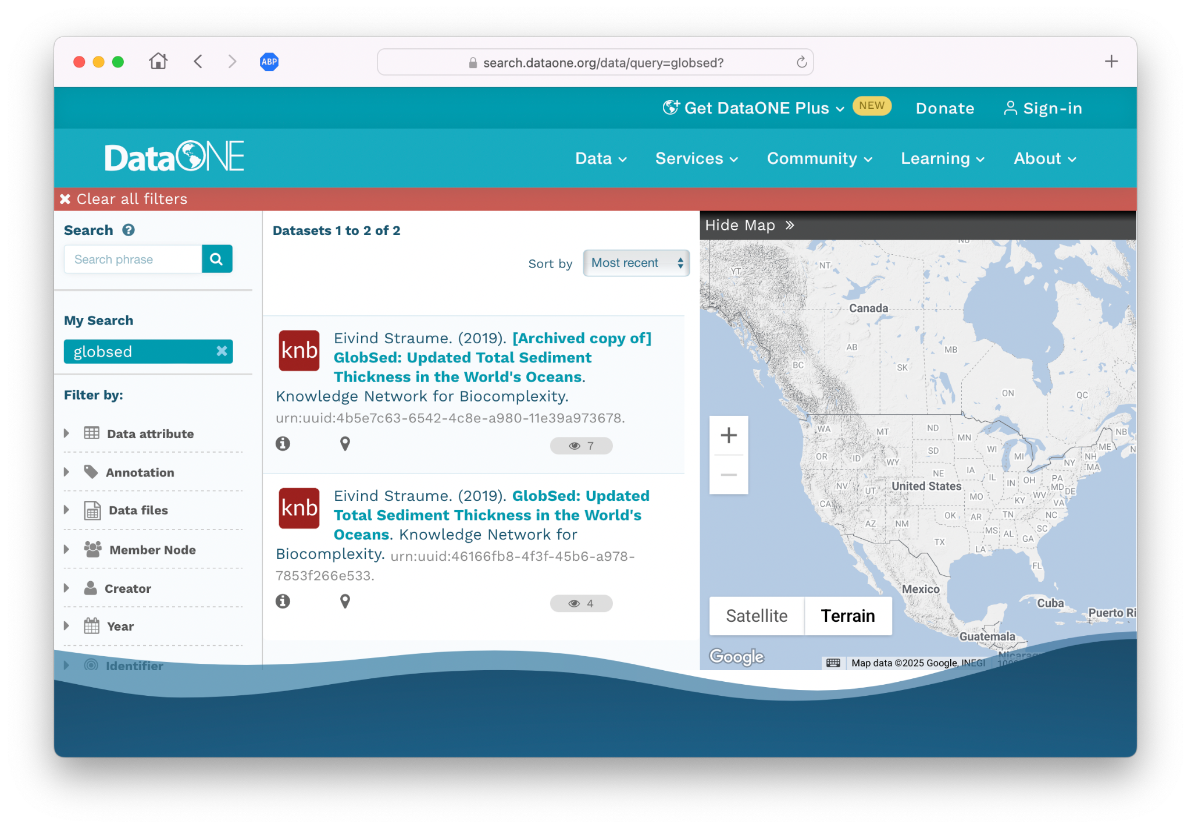
Notes:
By happenstance, demonstration of the value of indicating an archived copy. Another copy of the same dataset has shown up. While the source is unknown, if it is/were from NOAA, the distinction to the researcher is/would be useful.

Slide 10
Closing thoughts
Data is not rescued unless/until it’s reusable/reused
Reusability requires findability, citability, authenticity, trust
Libraries can provide expertise, trust
Our approach is greatly facilitated by a discovery framework that accepts metadata-only deposits
  Looking for similar systems for other disciplines
Notes:
Not all data rescue efforts are lacking w.r.t. reuse: ICSPR and EOT Archive. But there many that are more focused on saving files.
Last bullet: allowing metadata-only deposits means that the burden of storing the data can be dissociated from the publication of the data.

